Slide 1
Properties of Matter
VOCAB!!
Pages 4, 5, & 6 of your packet

Slide 2
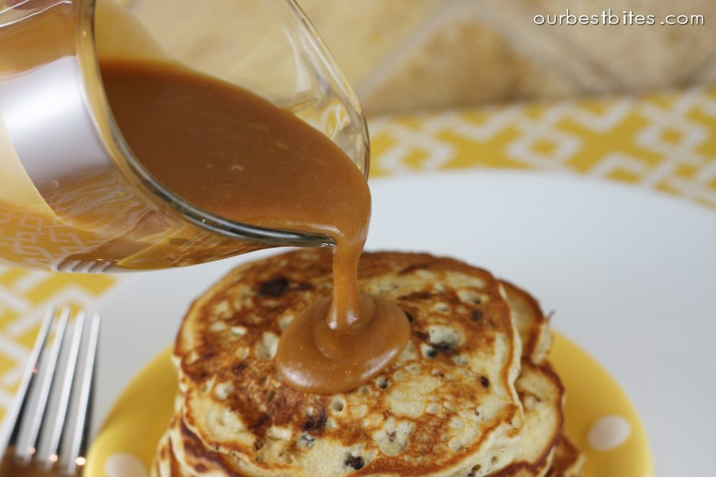
1. Viscosity: the ability to resist flowing
(P) Ex: syrup flows more slowly than water and has a high viscosity

Slide 3
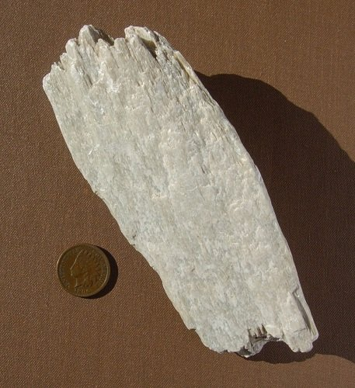
2. Hardness: the ability to scratch or be scratched by other materials
Ex: diamonds are the hardest minerals and can easily scratch other substances
Ex: If something is scratched by a penny it is considered quite soft.

Slide 4
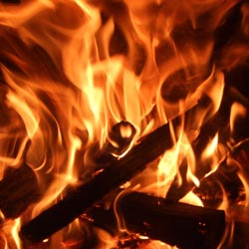
3. Flammability: the ability to burn in the presence of Oxygen
*Chemical Property Ex: some materials can more easily burn in oxygen than others

Slide 5
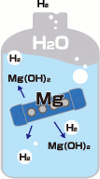
4. Reactivity: the ability to combine with another substance in a chemical bond
*Chemical Property
Ex: Magnesium will easily react with water to form Magnesium HydrOxide (MgOH) and hydrogen Gas (H₂)

Slide 6
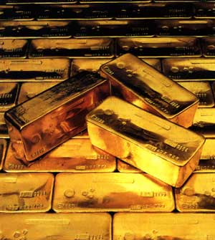
5. Density: how heavy a substance is (g/mL)
Ex: gold is extremely heavy, 19.32 g/cm³

Slide 7
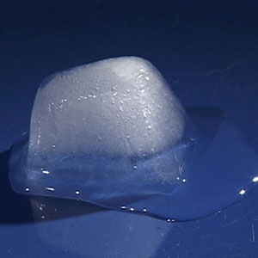
6. Melting point: the point at which a solid becomes a liquid
Ex: Ice (water) becomes a liquid above 0 C

Slide 8
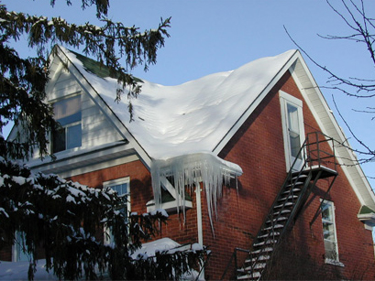
7. Freezing Point: the point at which a liquid becomes a solid.
Ex: water freezes into Ice below 0 C.

Slide 9
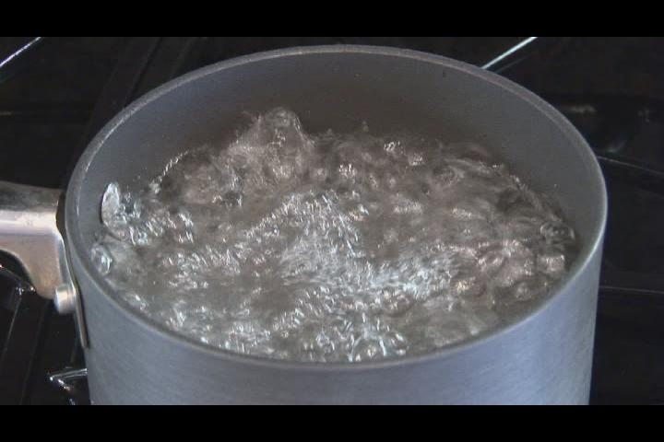
8. Boiling point: the point at which a liquid becomes a gas
Ex: water becomes a gas above 100 C

Slide 10
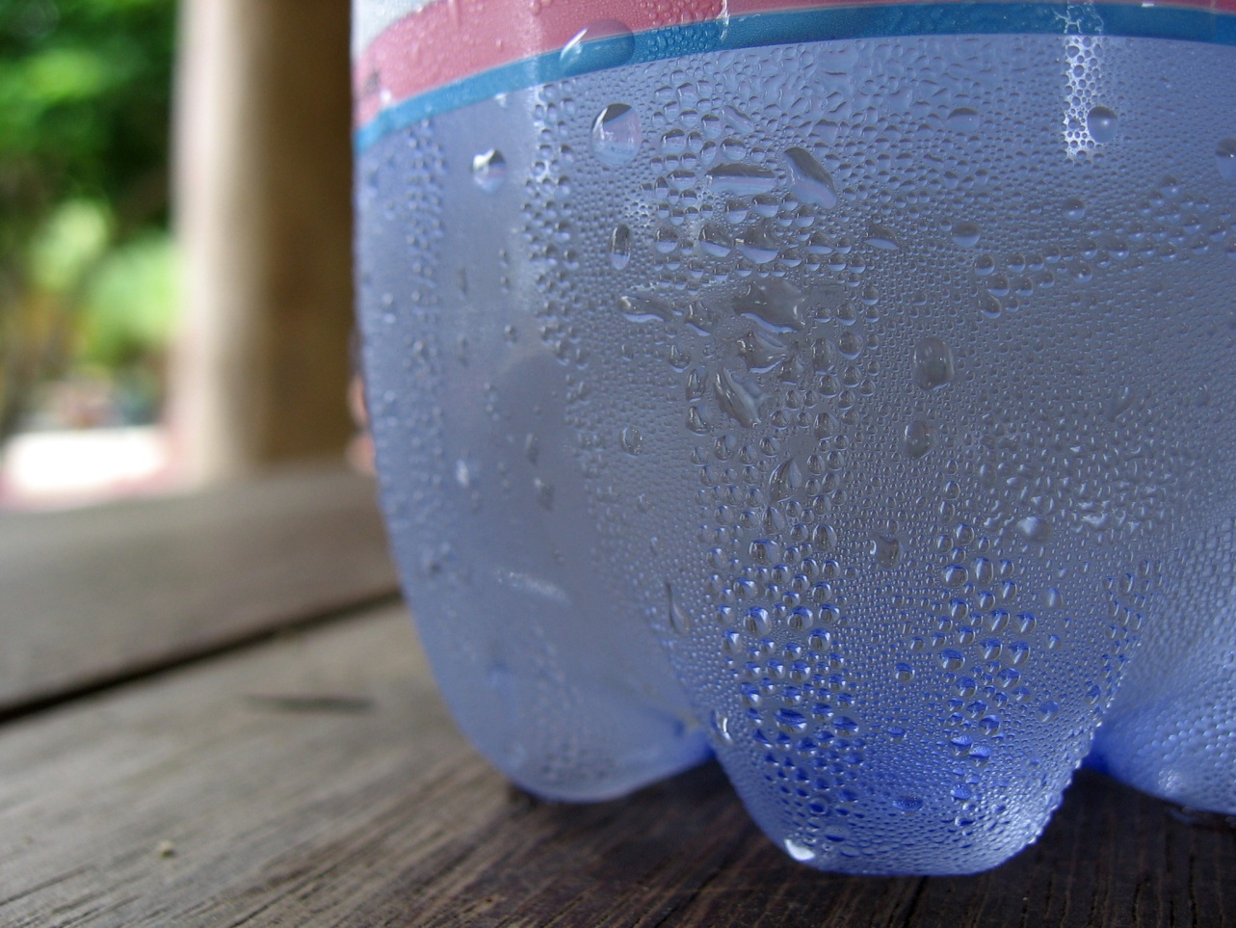
9. Condensation Pt. : the point at which a gas becomes a liquid.
Ex: water vapor in the air will condense into a liquid below 100 C.

Slide 11
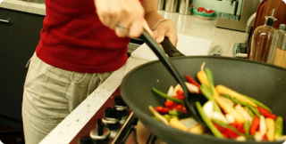
10. Conductivity: the ability to allow heat/electrons to flow through it
Ex: a metal pan can move heat up to the handle

Slide 12
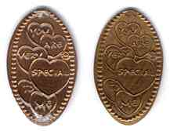
11. Maleability: the ability to be flatten the solid without it shattering
Ex: metals can be hammered into thin sheets under when heated or pressure.

Slide 13
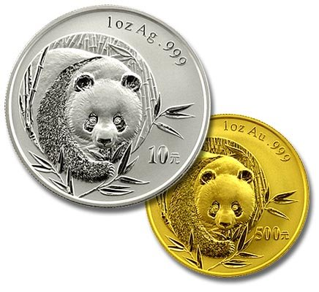
12. Luster: the ability to reflect light/shine
Ex: many metals such as gold, copper, aluminum will shine because its surface reflects light.

Slide 14
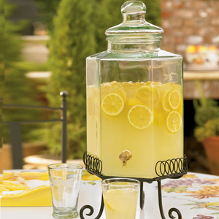
13. Solubility: the ability to be dissolved in a liquid
Ex: sugar will easily dissolve in water, however oil will not dissolve in water.

Slide 15
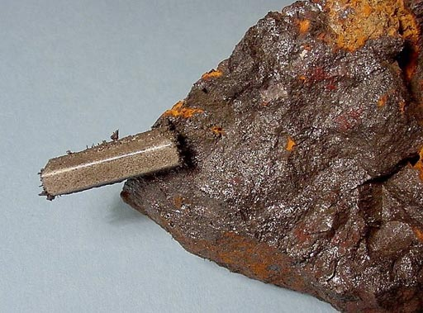
14. Magnetic: the ability for a substance to be attracted to magnets.
Ex: Iron filing will be attracted to a magnet.

Slide 16
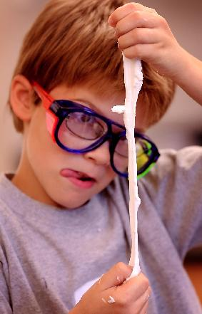
15. Flexible: The ability to change shapes and then go back to the original shape easily.
Ex: putty is quite flexible.

Slide 17

16. Evaporation: The ability to release gases under conditions before the boiling point
Ex: water can evaporate even at room temperature. If water is in warmer temperature (ex: 100 F) then it will evaporate more quickly.

Slide 18
17. Physical Property: the material’s ability to change what it looks like but not change what it is.
Ex: malleability, solubility, M.P., B.P., viscosity.

Slide 19
18. Physical Change: When the materials actually change in someway but do not change what it is.
Ex: change in: textures, shape, size, color,

Slide 20
19. Chemical Property: the ability of being able to change what it is under some process
Ex: flammability, reactivity

Slide 21
20. Chemical Change: When the materials actually change into a new substance. Atoms are rearranged into new molecules.
Ex: wood is burned and becomes ash (carbon) and carbon dioxide gas. Any Reaction is a chemical change.

Slide 22
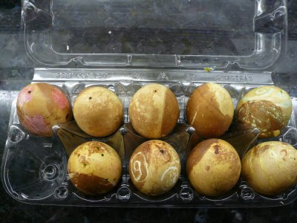
5 Signs there is a Chemical Change
(** can occur in Physical Change)
1. Produce an Odor: A smell is given off.
Ex: something rotting.

Slide 23
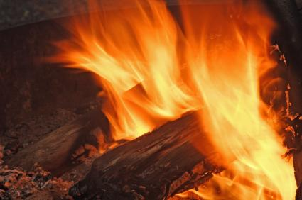
5 Signs there is a Chemical Change
(** can occur in Physical Change)
2. Change in Temperature: A chemical reaction gets cold or warm.
Ex: heat from a fire.

Slide 24
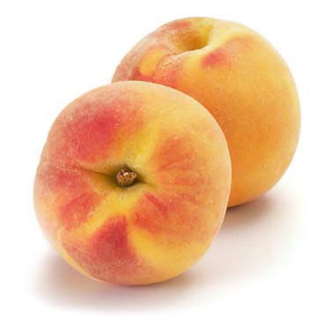
5 Signs there is a Chemical Change
(** can occur in Physical Change)
3. Change in Color**: Ex: fruit changes color when ripens
(but color dye or
kool aid dissolving
is a physical change)

Slide 25
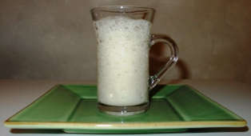
5 Signs there is a Chemical Change
(** can occur in Physical Change)
4. Formation of Gas: When bubble are given off or smoke.
Ex: smoke from a fire is CO₂ gas, or baking
Soda &
Vinegar
Make bubbles

Slide 26
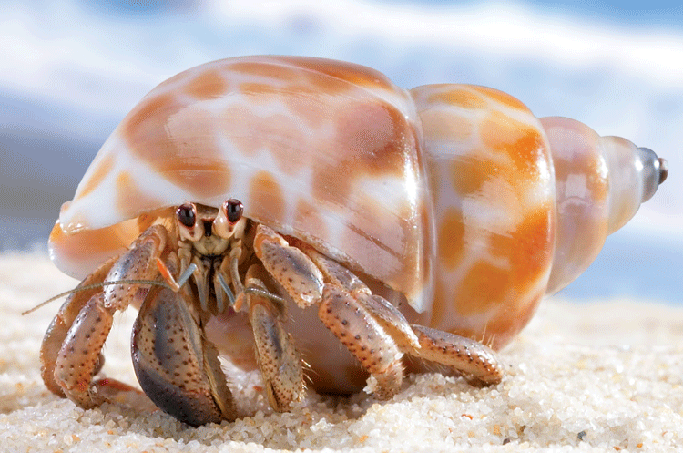
5 Signs there is a Chemical Change
(** can occur in Physical Change)
5. Formation of a Solid **: The solid is called a precipitate. Example: crabs and mussels use
chemicals in their
body to react with
water creating a
solid shell. Their
shell is the
precipitate!

