Slide 1
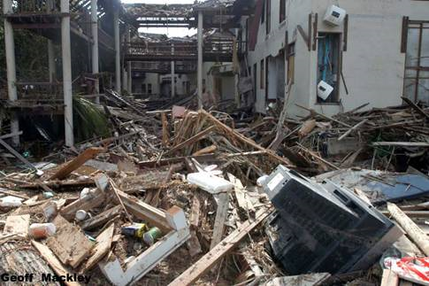
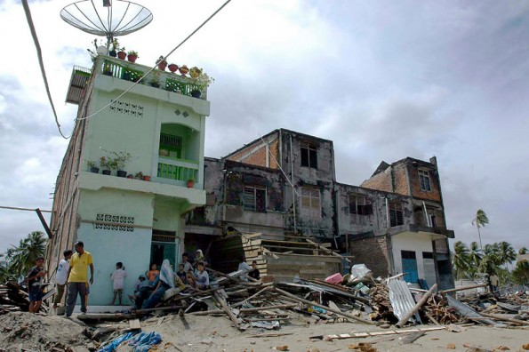
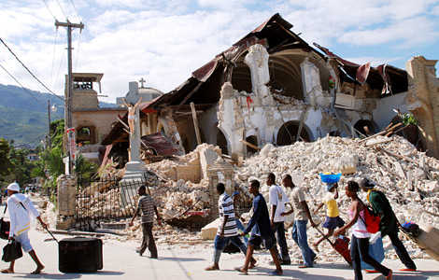
Earthquakes

Slide 2
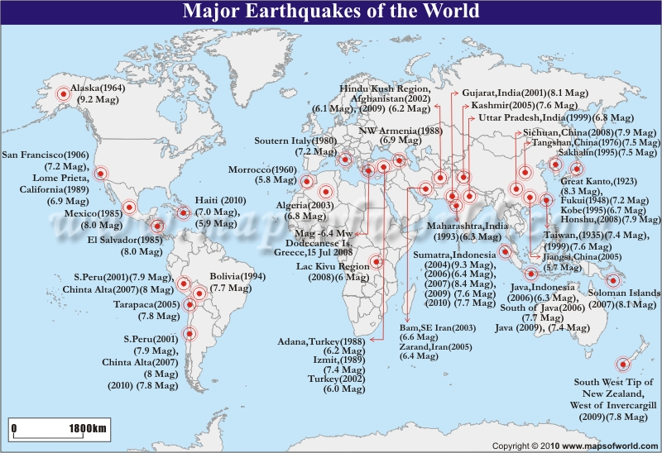

Slide 3
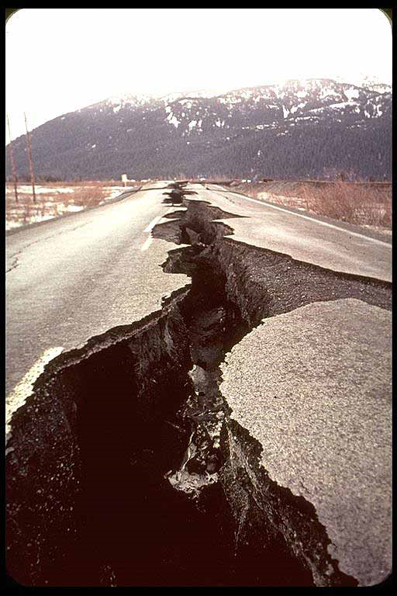
Earthquake
The sudden release of energy in the Earth’s crust

Slide 4
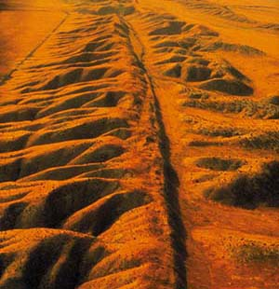
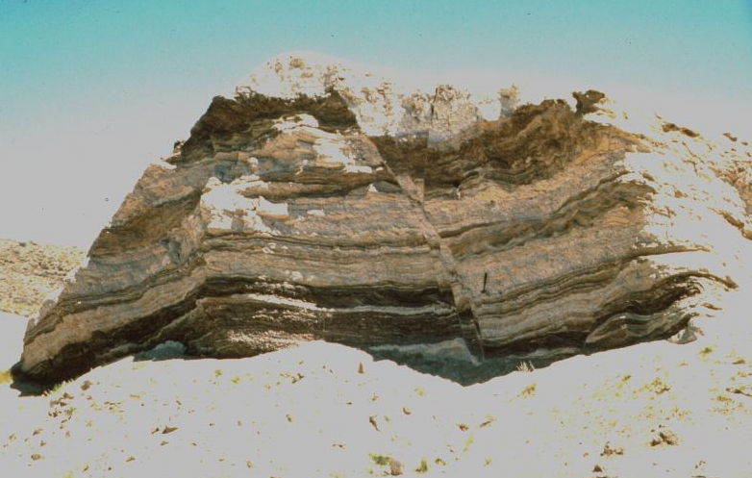
Fault
A break in the Earth’s crust where movement takes place because of tectonic plate movement

Slide 5
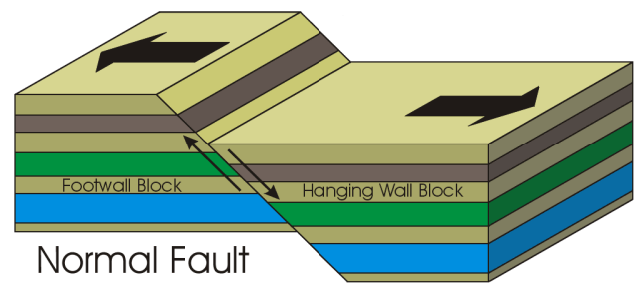
NORMAL FAULT
The hanging wall has moved down relative to the footwall. (land moves away)

Slide 6
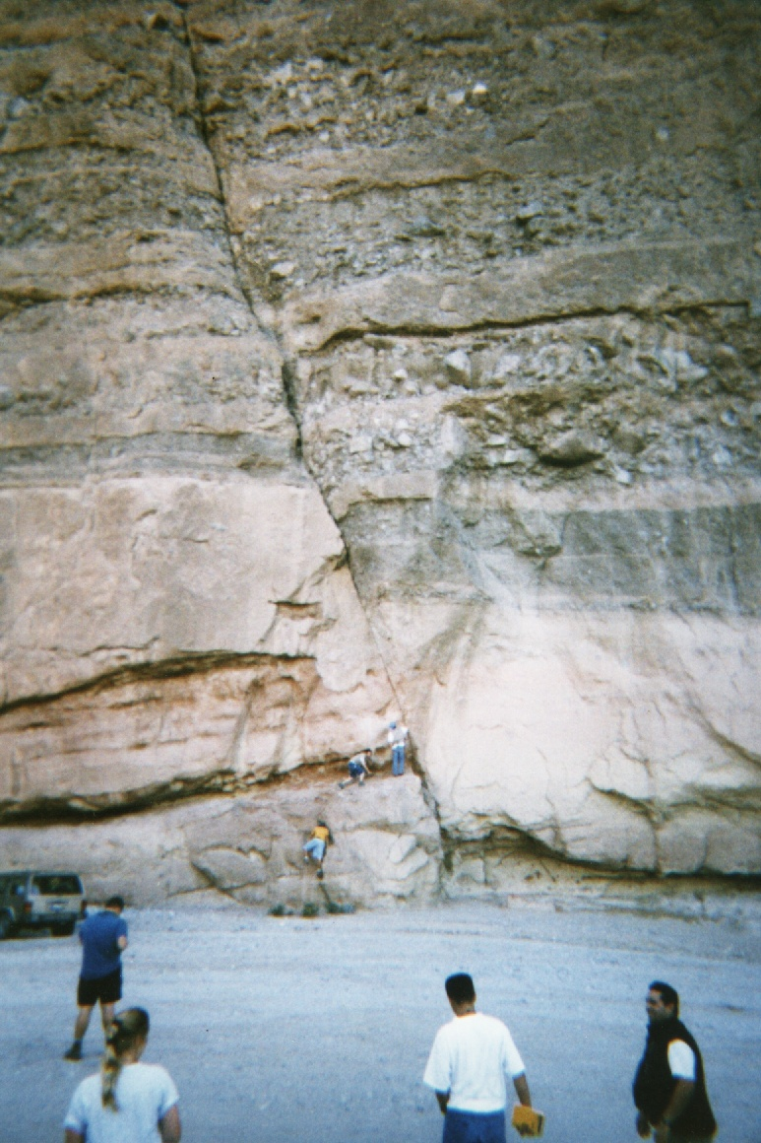
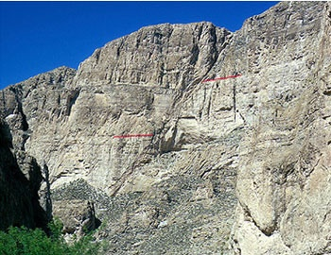
Split Mtn. Gorge

Slide 7
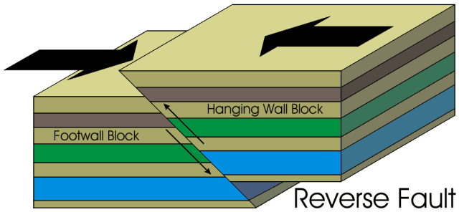
REVERSE FAULT
The hanging wall has moved up relative to the footwall

Slide 8
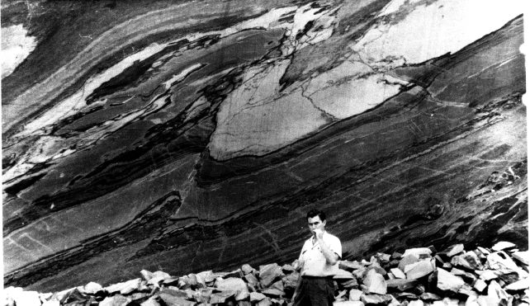
Jazida do Urubu, Brazil

Slide 9
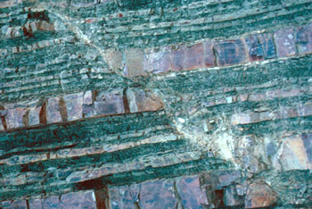

Slide 10
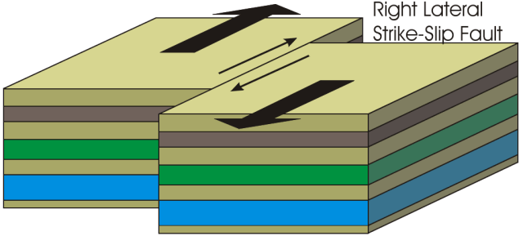
STRIKE-SLIP
Movement is horizontal and parallel
http://www.wwnorton.com/college/geo/egeo/flash/8_1.swf

Slide 11
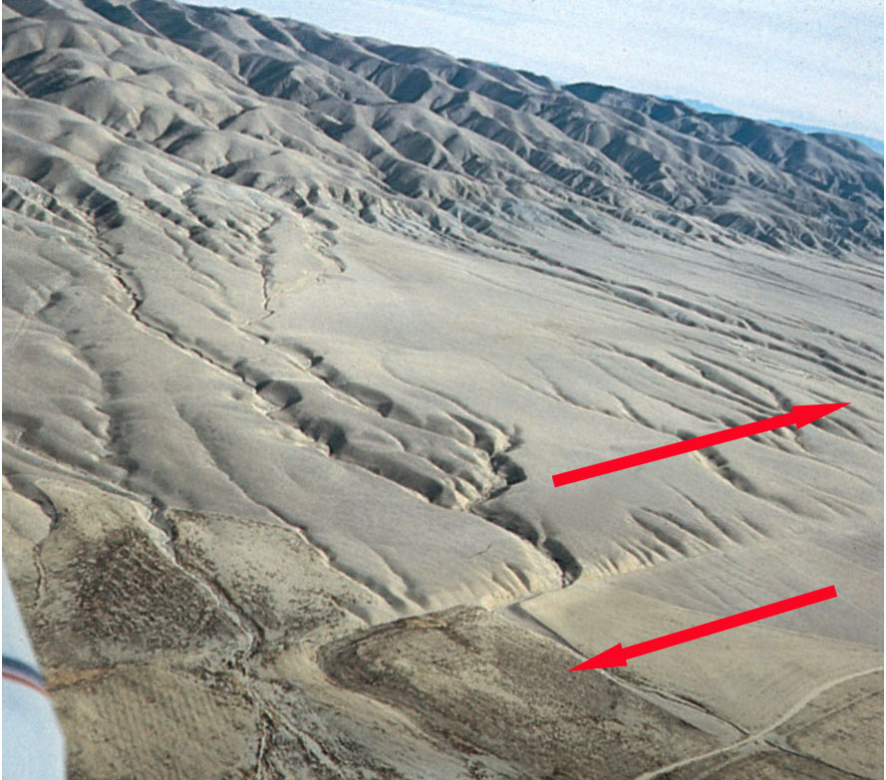

Slide 12
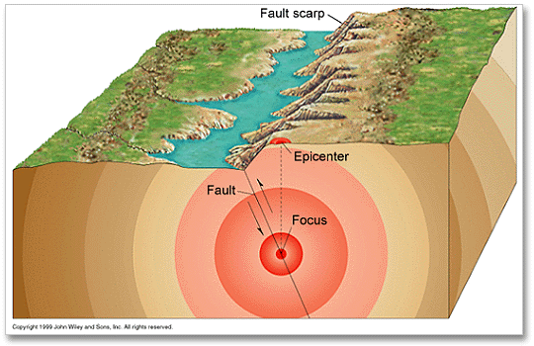
Focus
The place inside Earth where the earthquake wave began

Slide 13
Epicenter
The place on the surface of earth directly above the focus

Slide 14
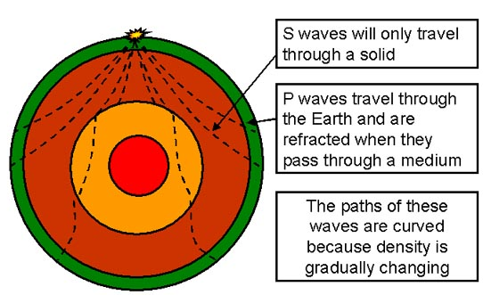
Seismic Waves
Body waves: earthquake waves that travel through the layers of the Earth

Slide 15
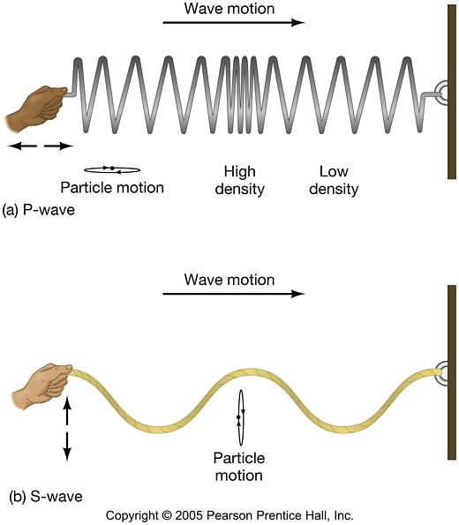
Primary Waves (P-waves)
Fastest
Travel through solids, liquids and gases
http://en.wikipedia.org/wiki/File:Onde_compression_impulsion_1d_30_petit.gif http://en.wikipedia.org/wiki/File:Ondes_compression_2d_20_petit.gif

Slide 16
Secondary Waves (S-waves)
Slower and travel only through solids
http://en.wikipedia.org/wiki/File:Onde_cisaillement_impulsion_1d_30_petit.gif
http://en.wikipedia.org/wiki/File:Ondes_cisaillement_2d_20_petit.gif

Slide 17
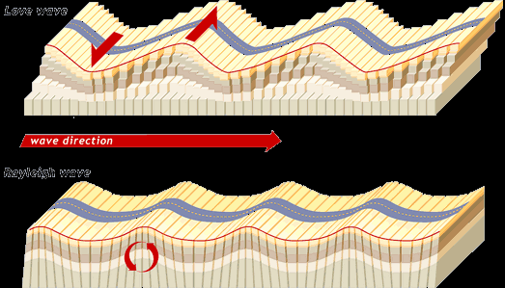
Surface Waves
Earthquake waves that travel only through the crust
Slowest but cause more damage

Slide 18
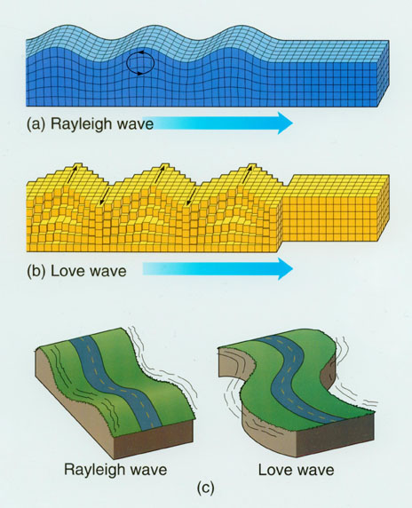
Love and Rayleigh Waves
Love: move rock side-to-side
Rayleigh: move rock in circles
Animations

Slide 19
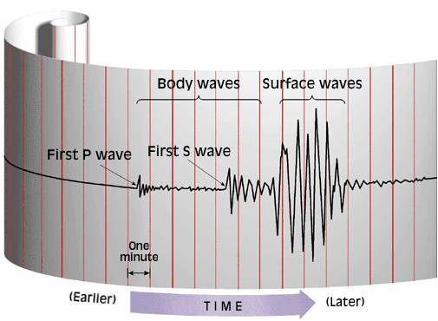
Richter scale
Measures the size of Earthquakes by recording the arrival times of seismic waves

Slide 20
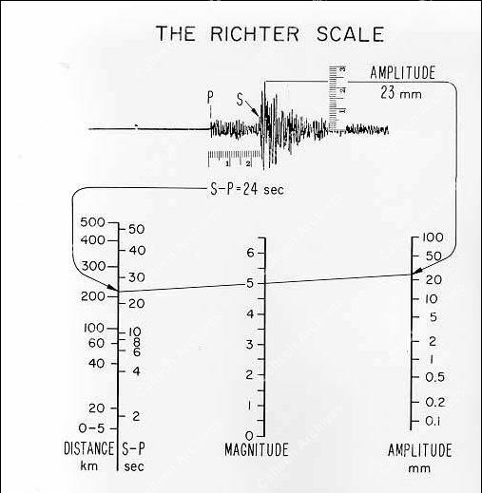

Slide 21
Japan March 2011
9.0 undersea earthquake
Tsunami with 38 m waves that moved 10 km inland
18,000 dead
4711 injured
14,921 missing
125,000 damaged or destroyed buildings
Energy: 600 million times Hiroshima bomb
Moved Japan 2.4 m closer to the Americas
Dropped 400 km vertically by over 2 feet
900 aftershock earthquakes

Slide 22
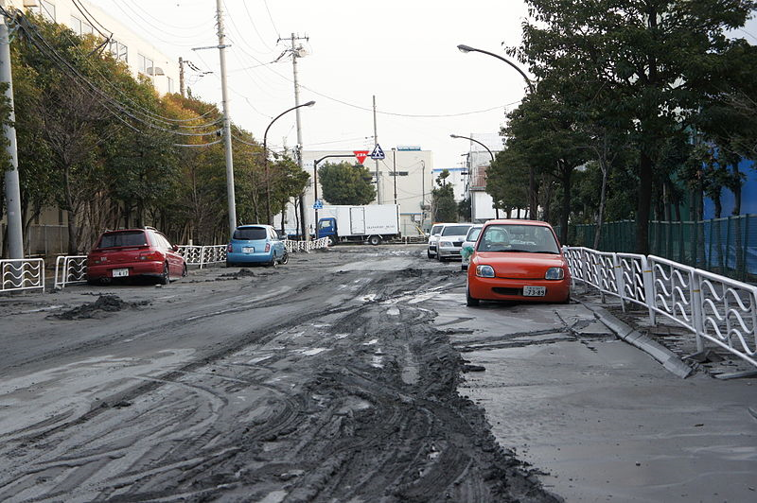
Soil Liquification

Slide 23
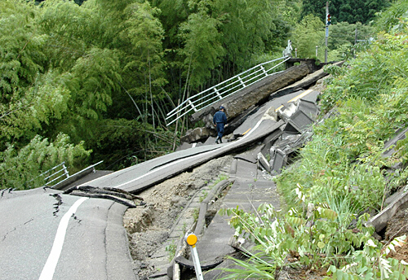
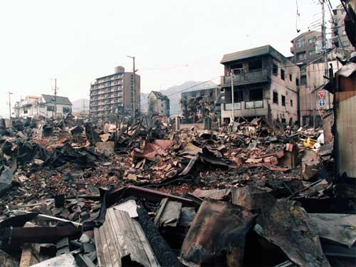
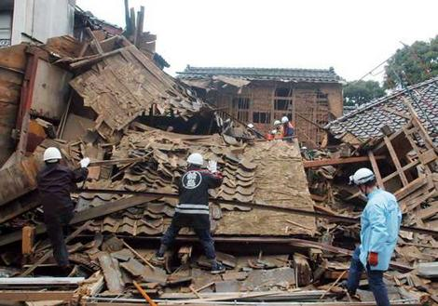
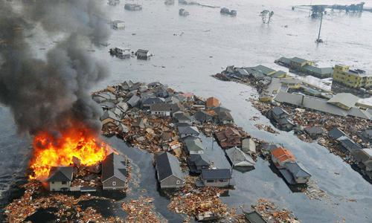
Japan 2011

Slide 24
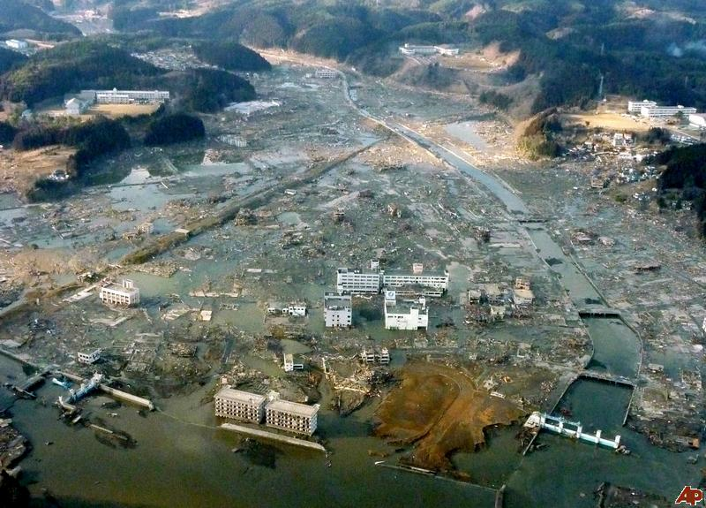

Slide 25
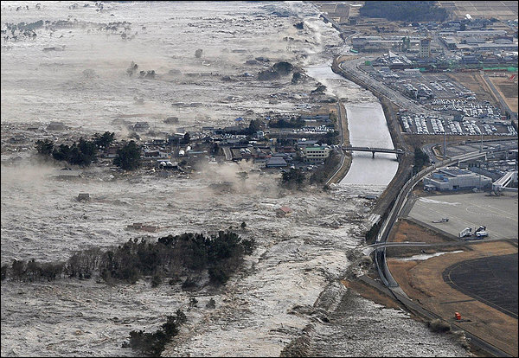
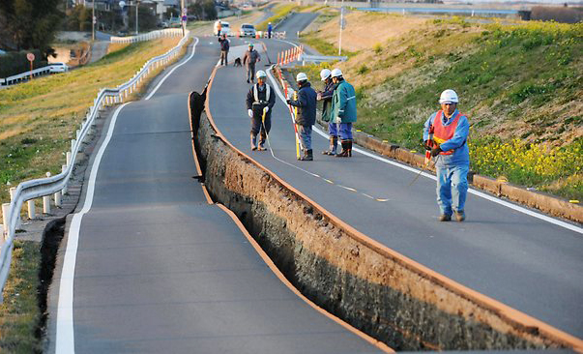

Slide 26
Japan
March 2011
The earthquake shifted the Earth's axis by 25 cm (9.8 in).
This deviation led to a number of small planetary changes, including the length of a day and the tilt of the Earth.
The speed of the Earth's rotation increased, shortening the day by 1.8 microseconds due to the redistribution of Earth's mass.
The axial shift was caused by the redistribution of mass on the Earth's surface, which changed the planet's moment of inertia. Because of conservation of angular momentum, such changes of inertia result in small changes to the Earth's rate of rotation. These are expected changes for an earthquake of this magnitude.

Slide 27
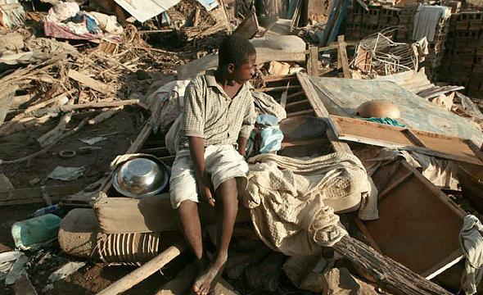
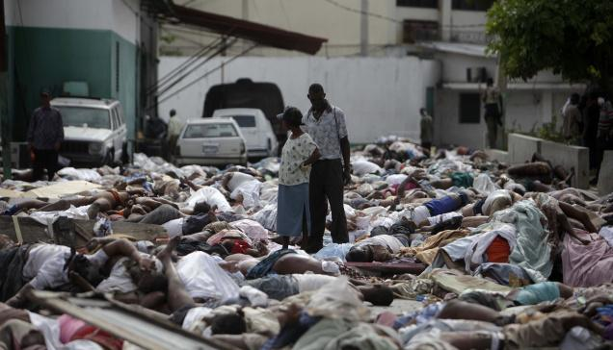
Haiti 2010
7.0 magnitude
52 aftershocks larger than 4.5 magnitude
316,000 died
300,000 injured
1 million homeless

Slide 28
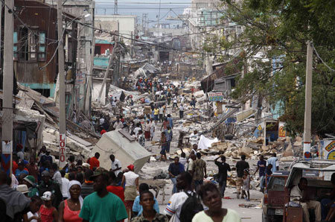
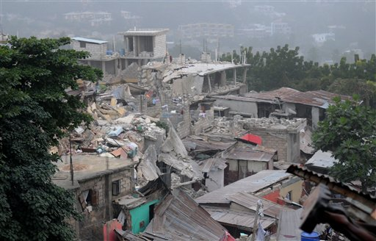
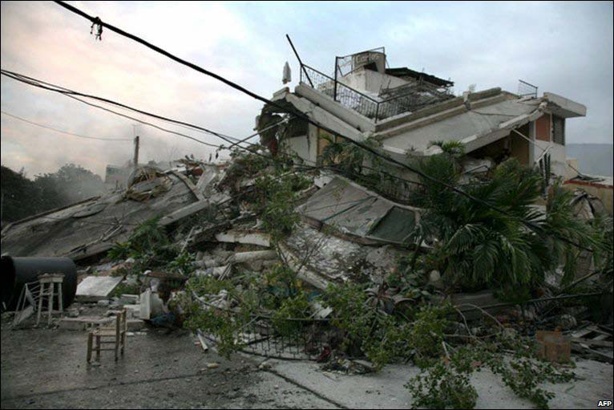

Slide 29
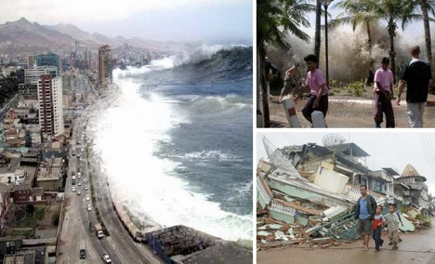
Sumatra
2010
7.8 magnitude
Caused tsunami
  3 m high
  600 m inland
20,000 lost their homes
435 killed
100’s missing

Slide 30
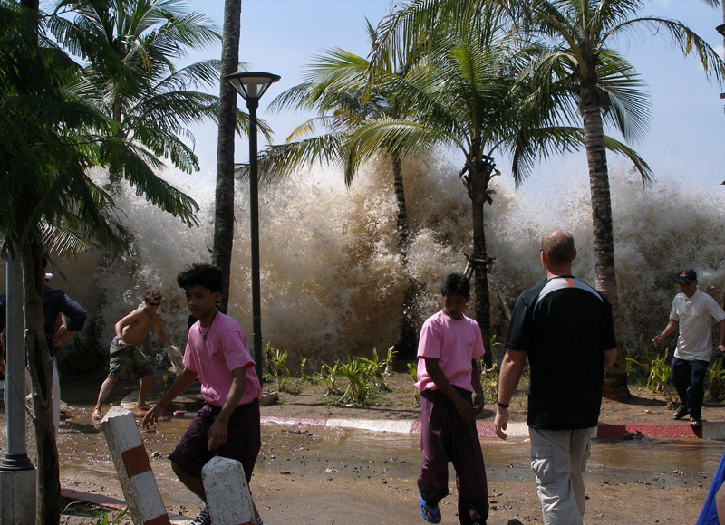
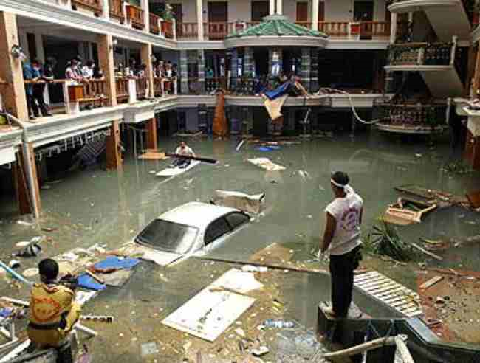

Slide 31
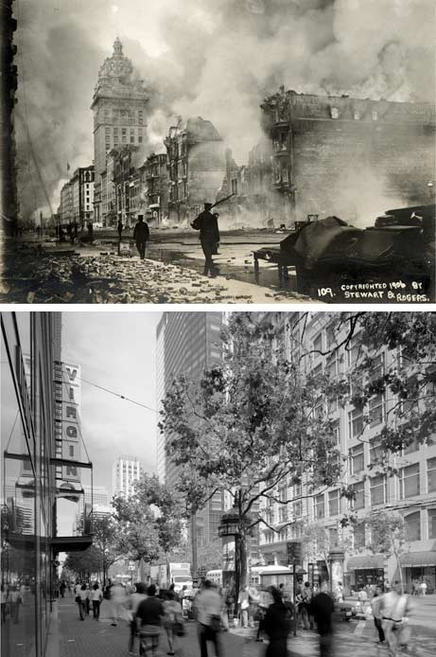
San Francisco
1906
Caused a great fire
$5 Billion worth of damage
Magnitude 7.9
3,000 deaths
San Andreas fault shifted 296 miles

Slide 32
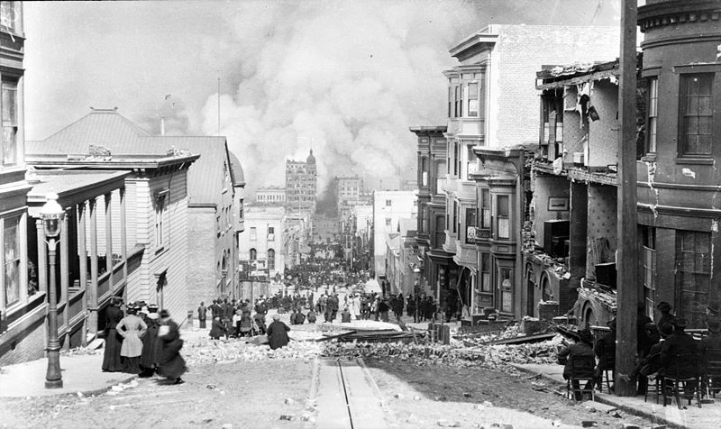

Slide 33
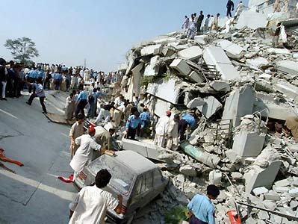
Pakistan
2005
7.6 Magnitude
79,000 deaths
$5.4 billion damages

Slide 34
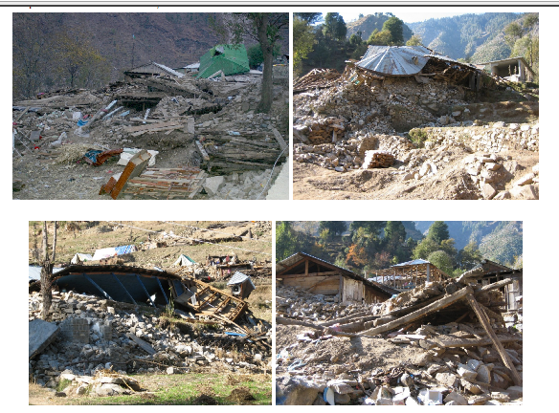

Slide 35
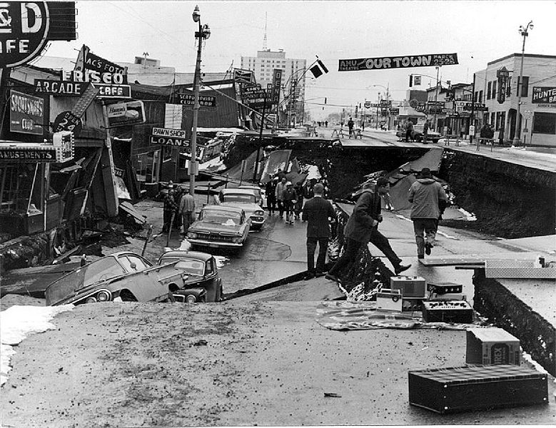
Alaska
1964
Magnitude 9.2
10,000 aftershocks
Triggered a Tsunami
Reverse fault

Slide 36
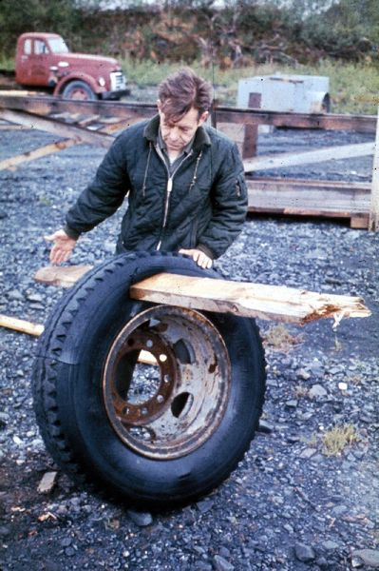
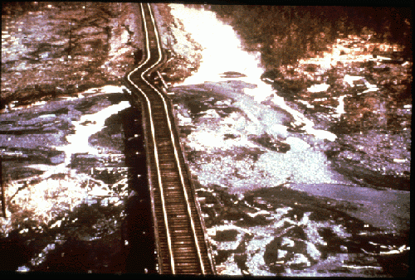
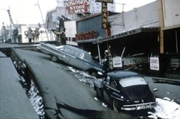

Slide 37
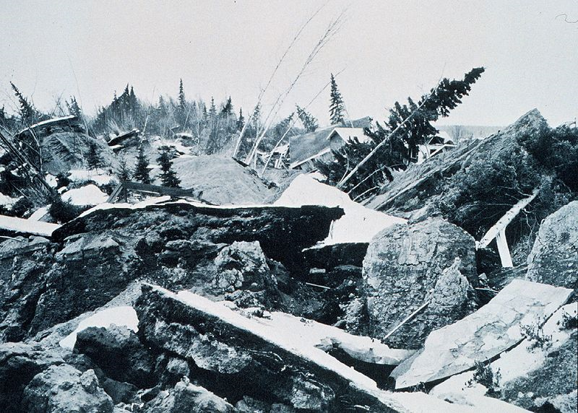
Alaska 1964

Slide 38


Slide 39
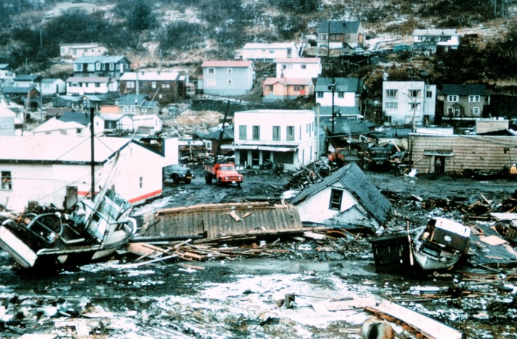

Slide 40
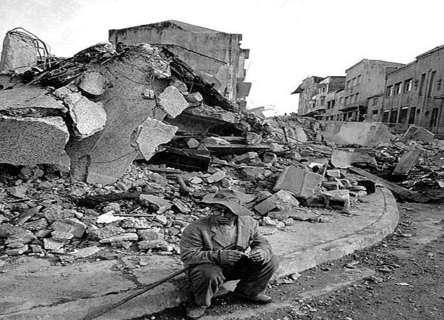
Chile
1960
Magnitude 9.5
Largest ever
$500 Billion
6000 dead
Tsunami hit
  Chile, Hawaii, Japan, Australia, New Zealand, Philippines

Slide 41
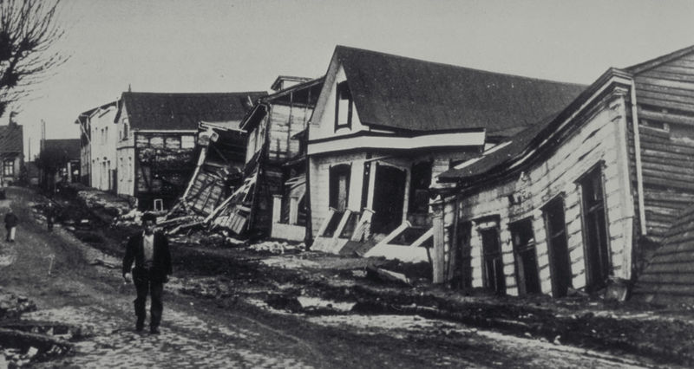

Slide 42

http://earthquake.usgs.gov/earthquakes/world/10_largest_world.php

