Slide 1
Comets, Asteroids and Meteors

Slide 2
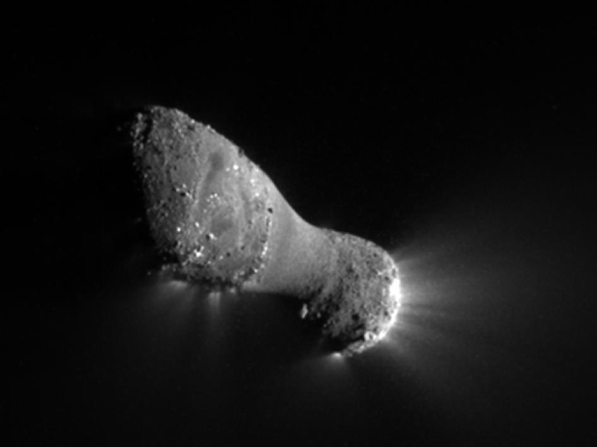
Comets
A small icy ball that orbits the Sun
Found in the Kuiper Belt: beyond Pluto

Slide 3
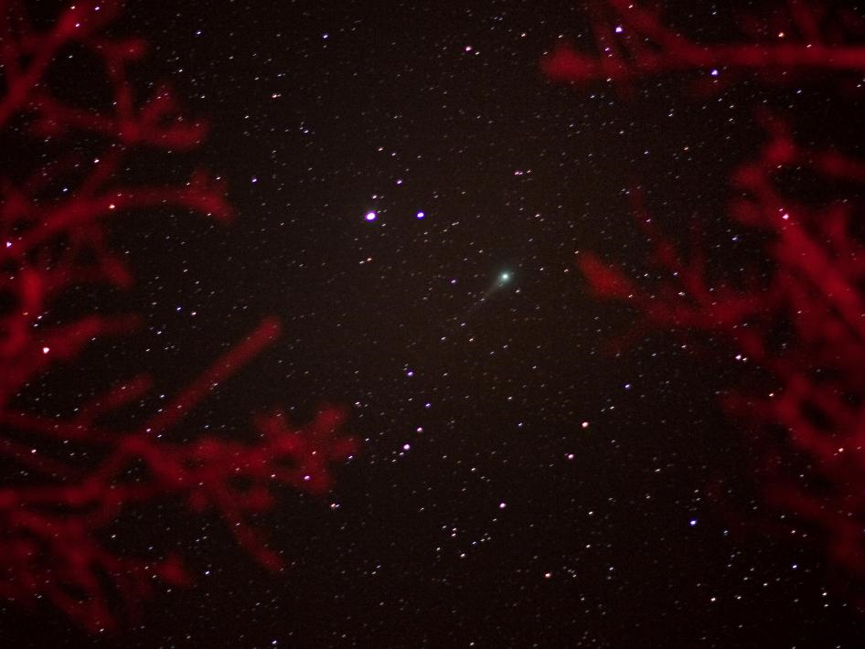
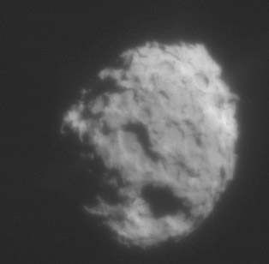
Nucleus
A loosely packed clump of dirt and ice
100’s of meters to several km in size

Slide 4
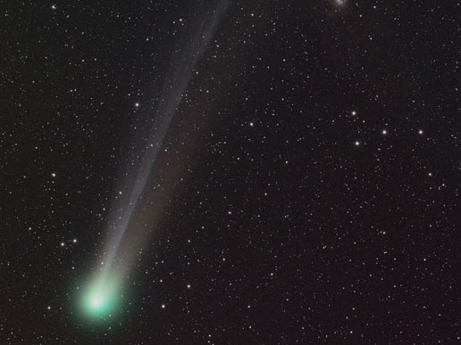
Tail
Only produced when the comet is near the Sun

Slide 5
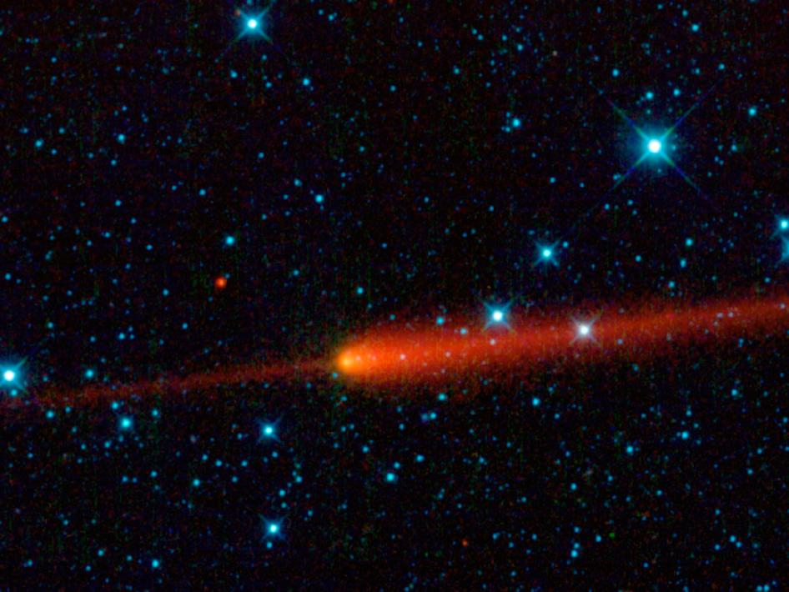
Comet 65 – P Gunn

Slide 6
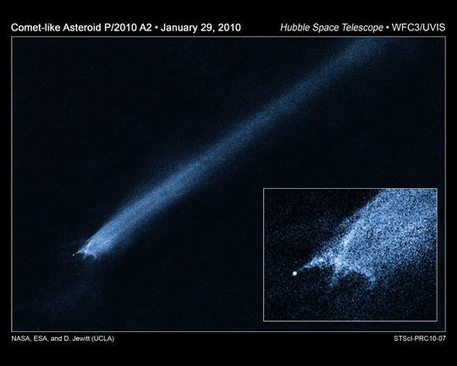
Asteroids
Rocky objects that orbit the Sun
1 km to 1000’s of km in size

Slide 7
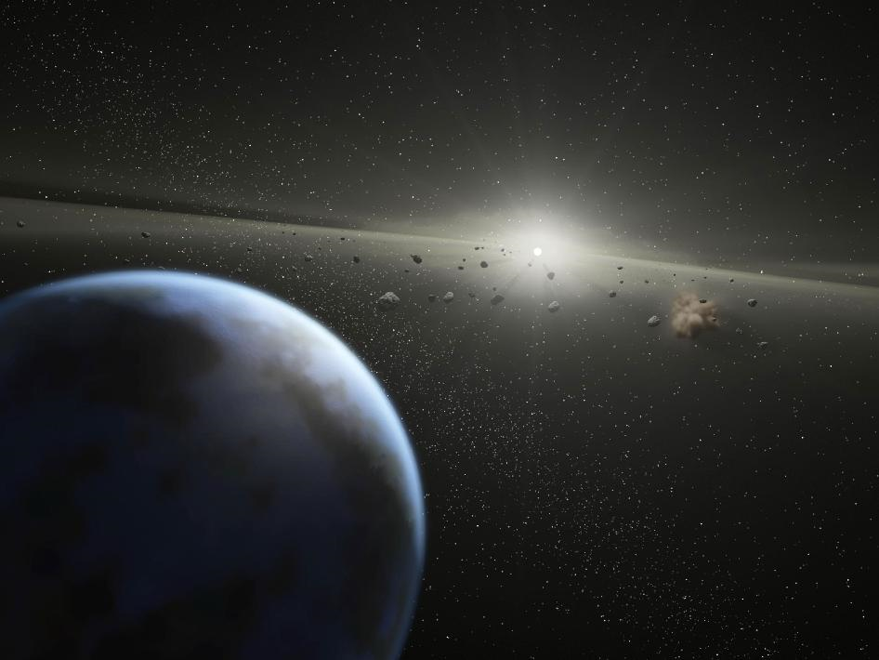
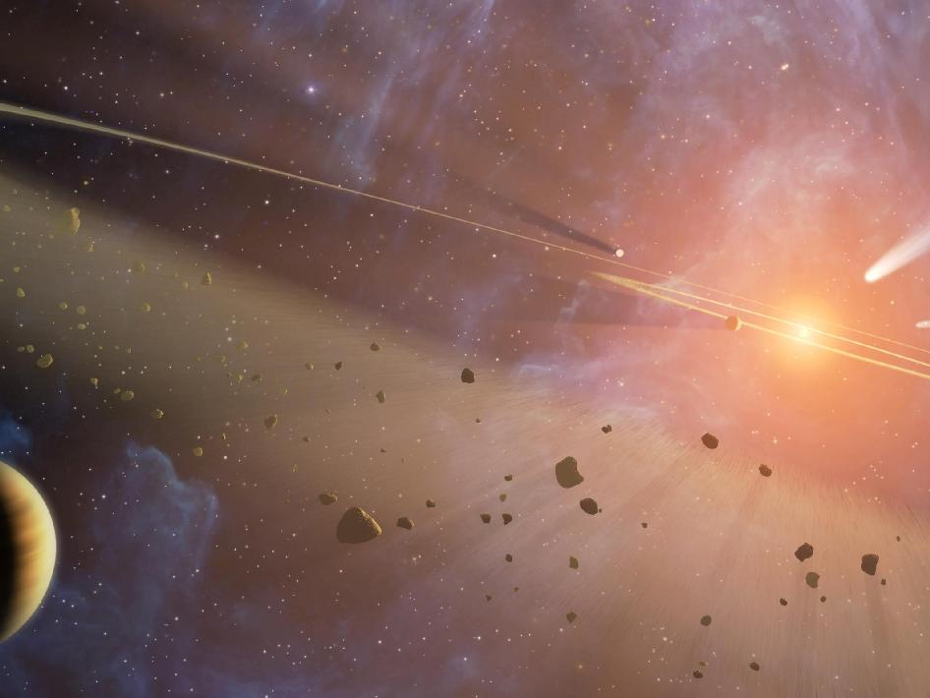
Asteroid Belt
Between Mars and Jupiter
2-3 AU from the Sun

Slide 8
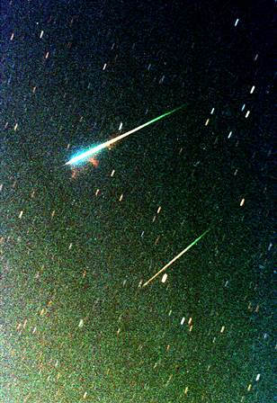
Meteor
Space debris: metals, rock, ice
Burn up in the mesosphere
16,000 mph
Millions enter the atmosphere everyday

Slide 9
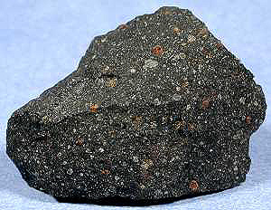
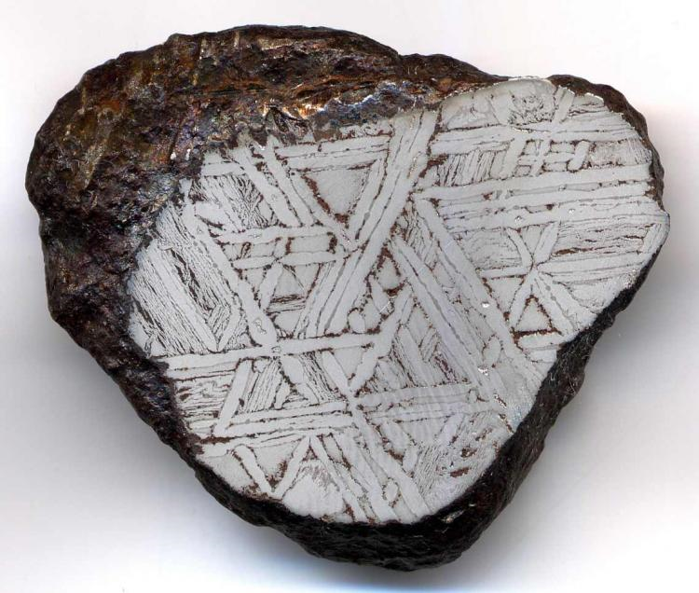
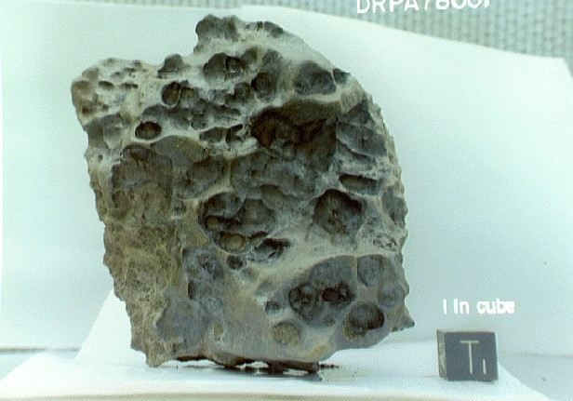
Meteorite
The portion of the meteor reaches Earth’s surface
Only a few dozen per year are collected
Ancient people saw them as omens or signs

