Slide 1
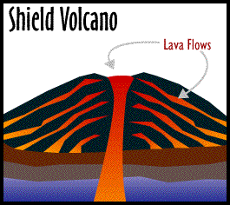
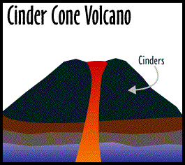
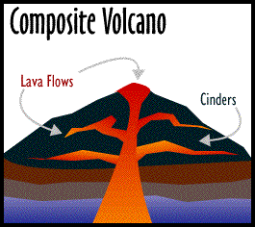

Slide 2
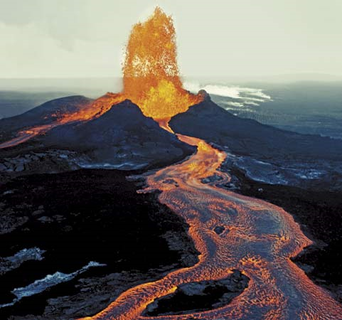
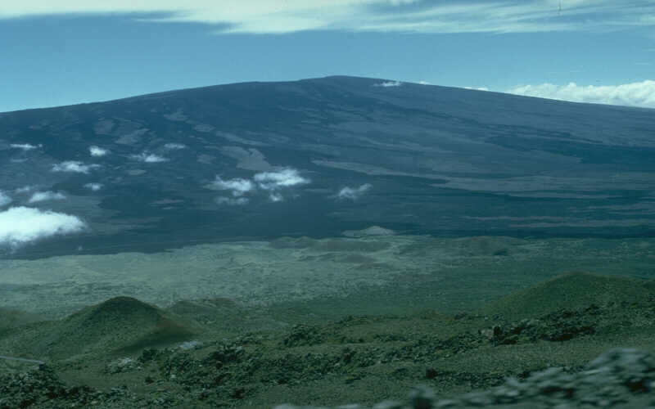
Shield volcanoes
Broad at the base and have gently sloping sides
Quiet eruptions
Ex: Hawaiian Islands

Slide 3
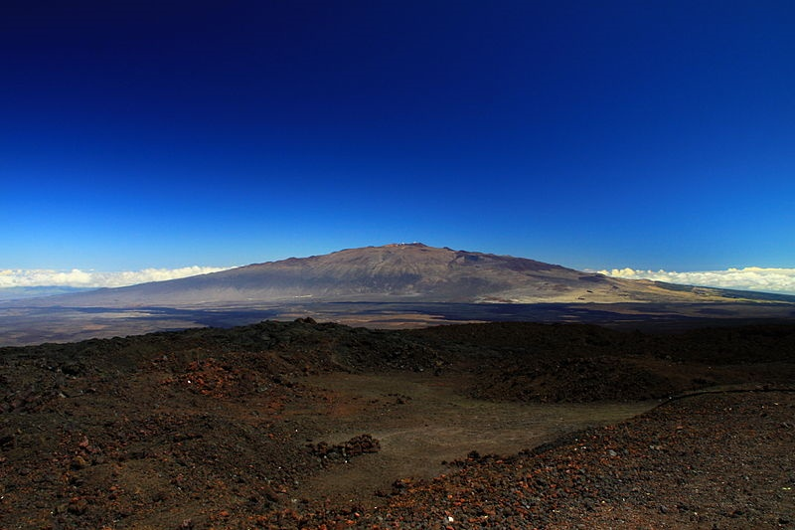
Mauna kea, hawaii

Slide 4
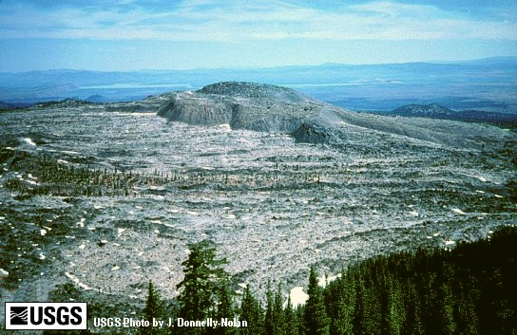
Medicine lake, california

Slide 5
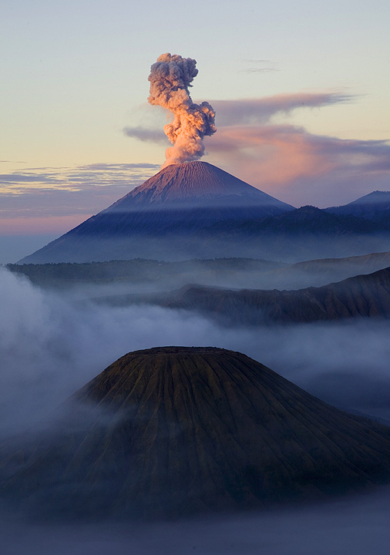
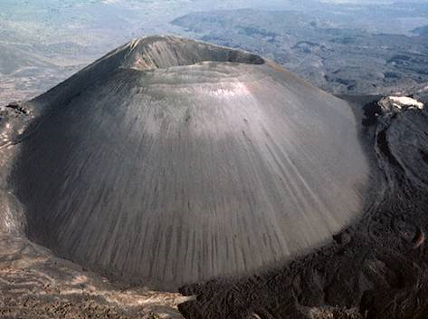
Cinder cone volcanoes
Very steep slopes
Explosive eruptions

Slide 6
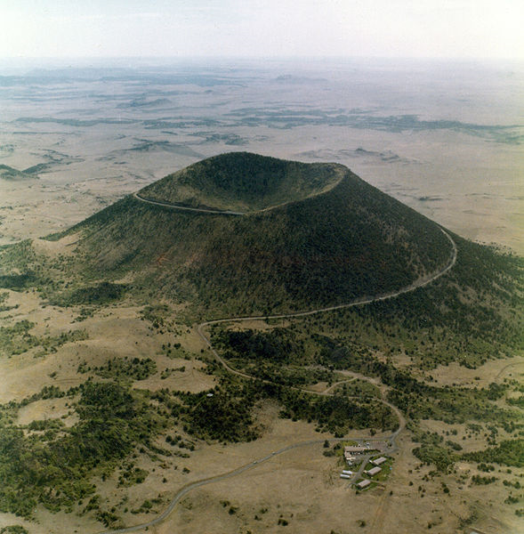
Capulin mountain, new mexico

Slide 7
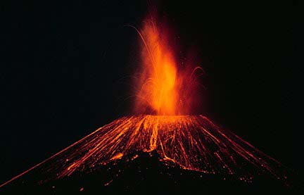
Paricutin, Mexico
Birth, growth and death 1943-1952
Cone grew 1400 ft in 9 years

Slide 8
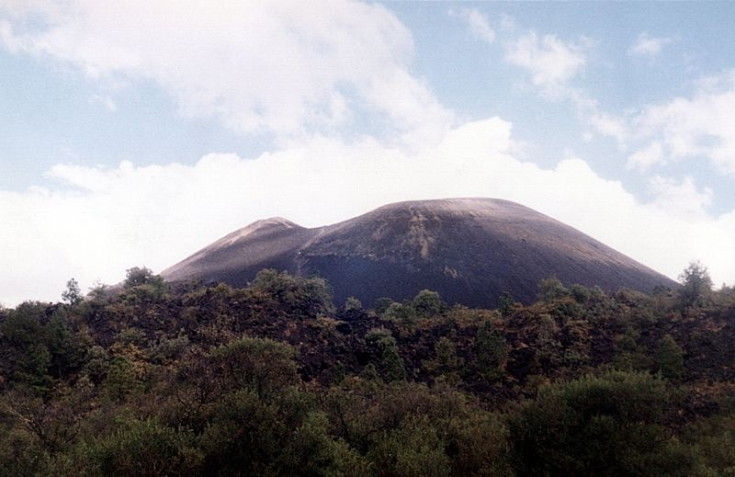

Slide 9
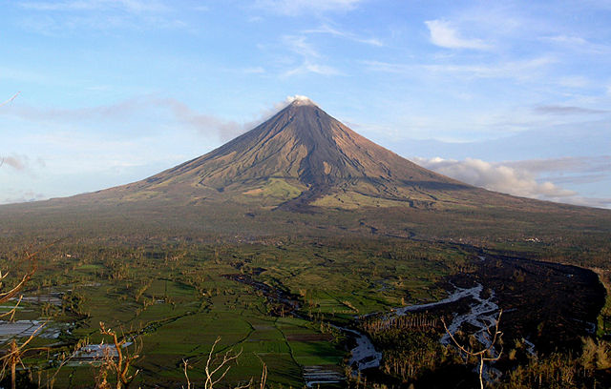
caja del rio, nm

Slide 10
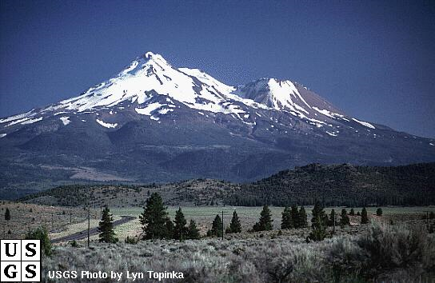
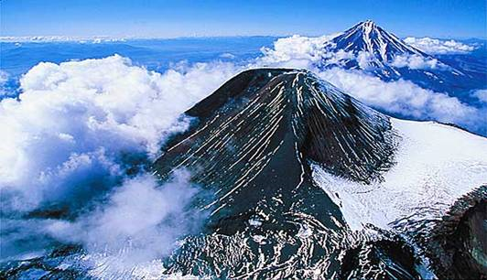
Composite volcanoes
Mountains made of alternating layers of lava and sediment
Both explosive and quiet eruptions
Ex: Mt. St. Helens

Slide 11
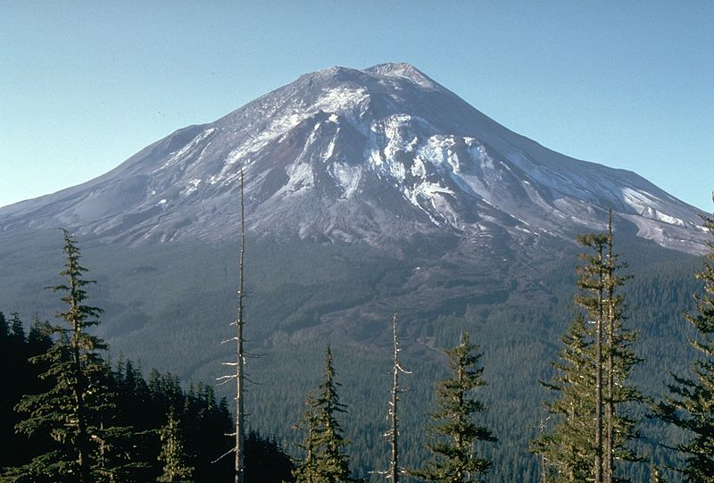
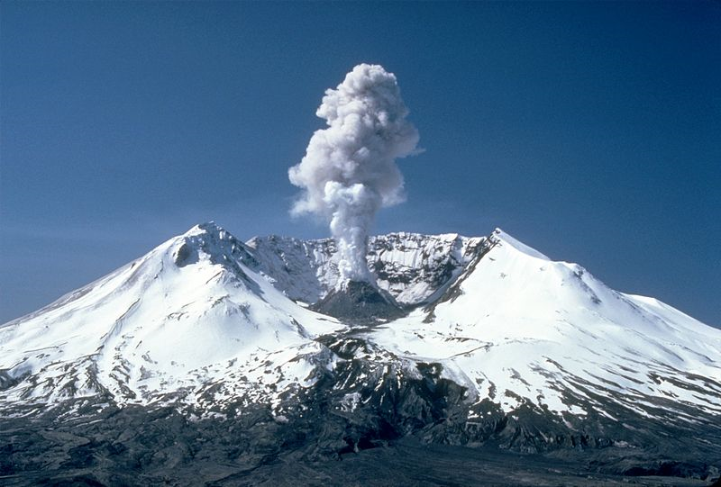
Mt. saint helens

Slide 12
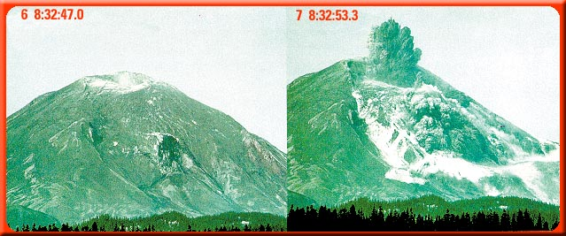
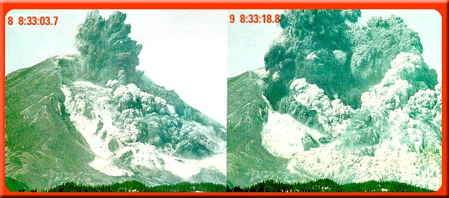

Slide 13
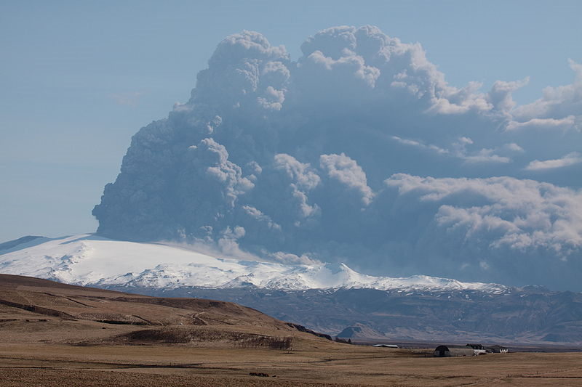
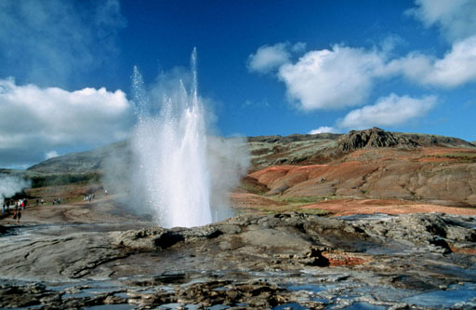
Iceland

Slide 14
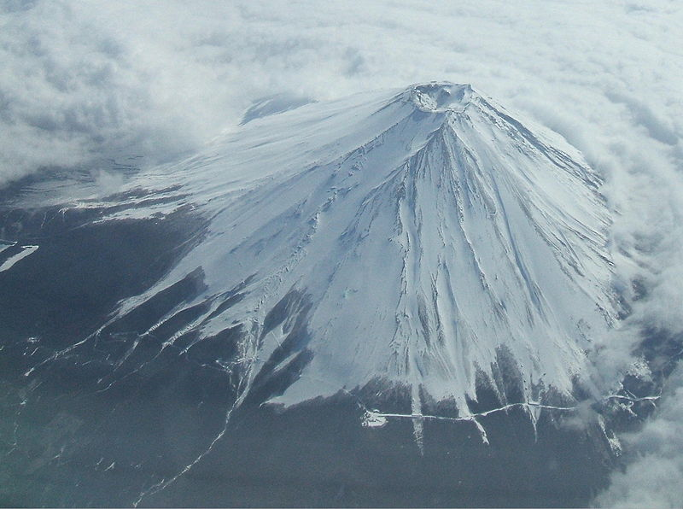
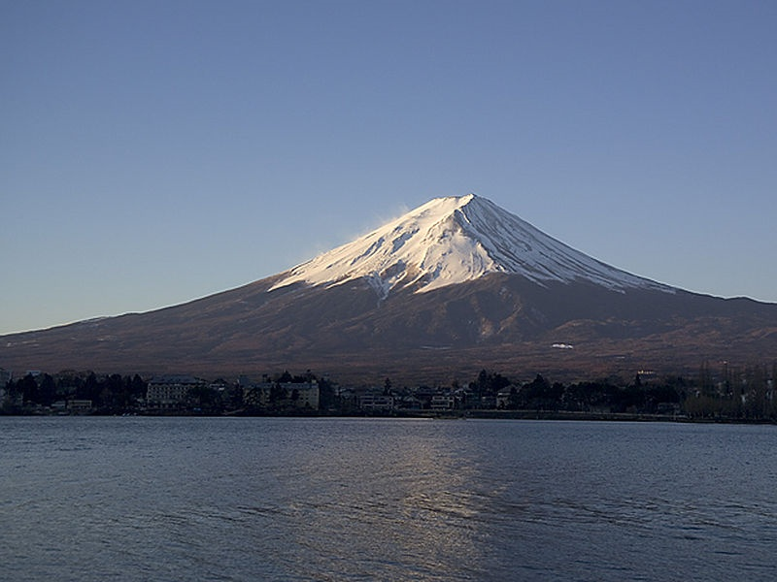
Mt. fuji, japan

Slide 15
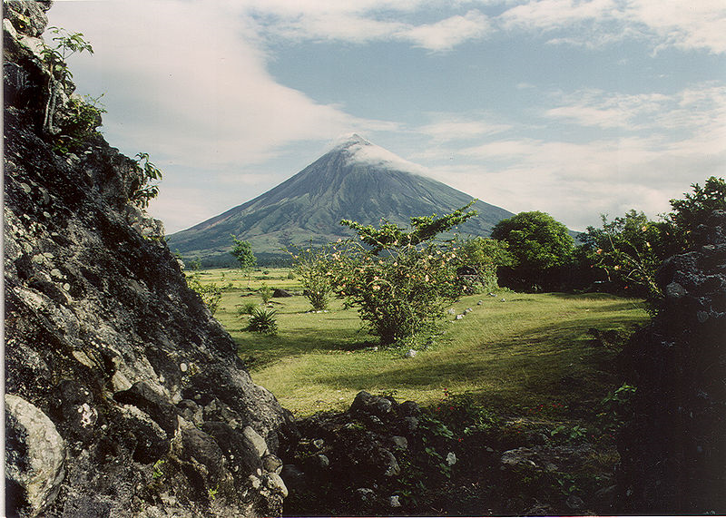
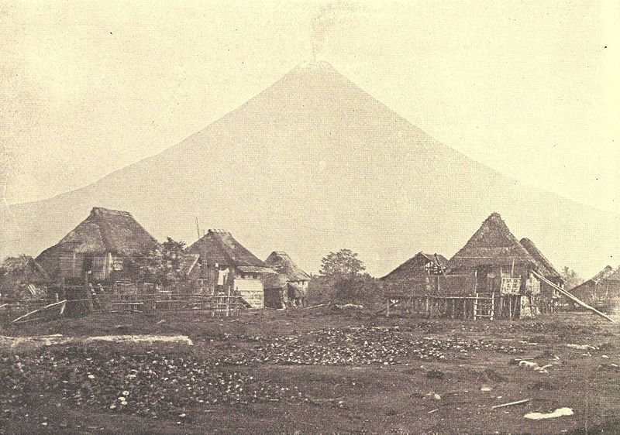
Mayon, phillipines

Slide 16
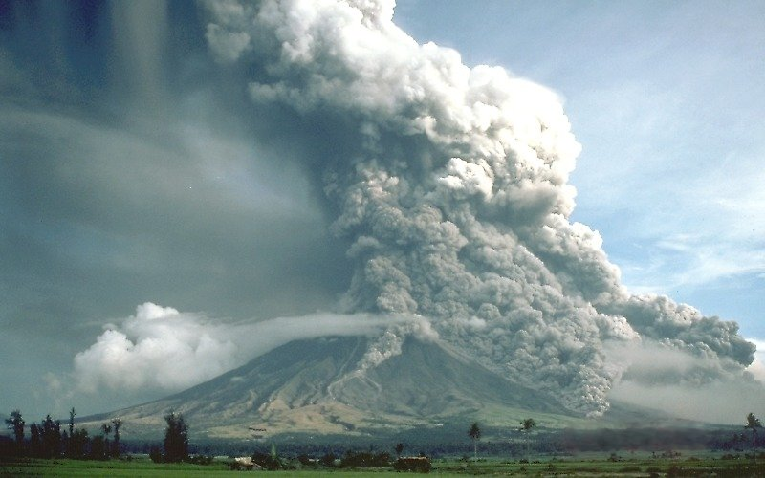
Mayon, phillipines

Slide 17
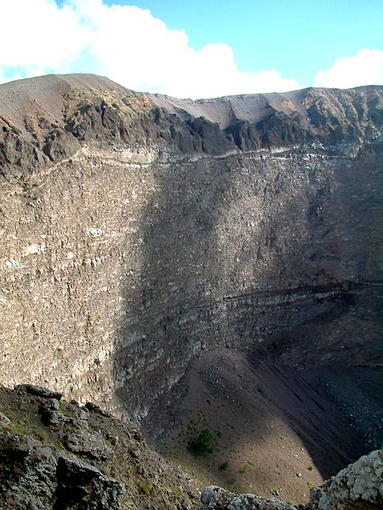
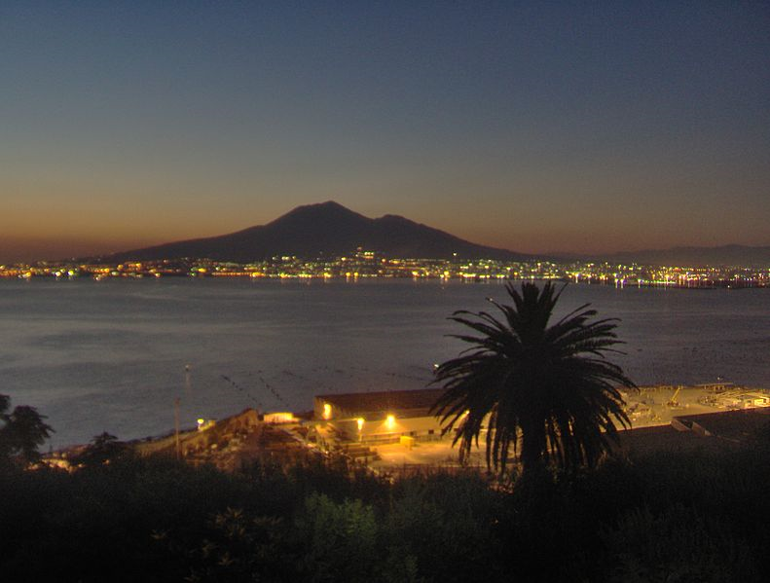
Mt. vesuvius, italy

Slide 18
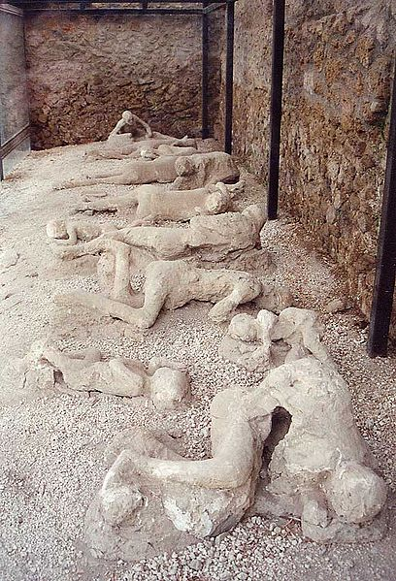
Mt. vesuvius
Casts of pumice ash

Slide 19
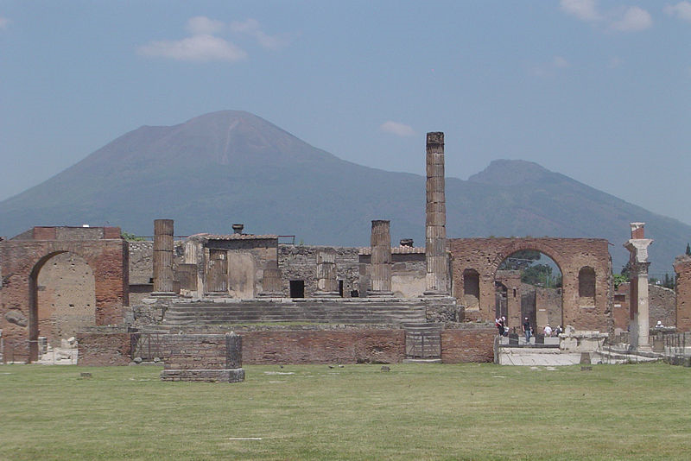
Mt. vesuvius, italy

Slide 20
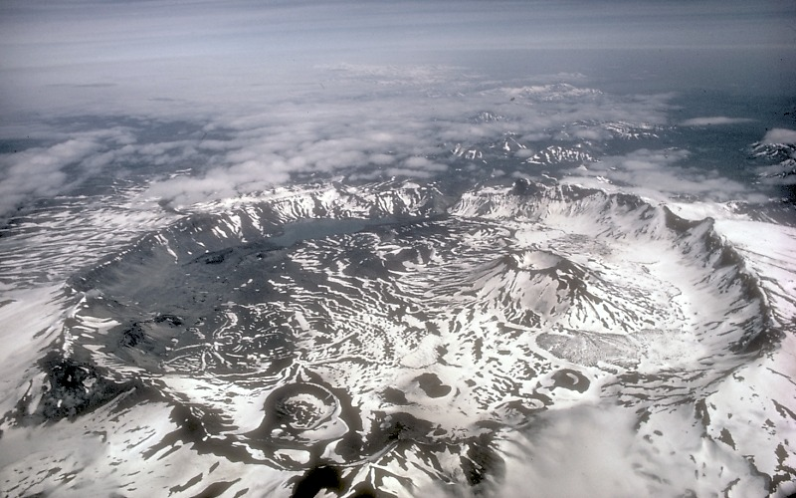
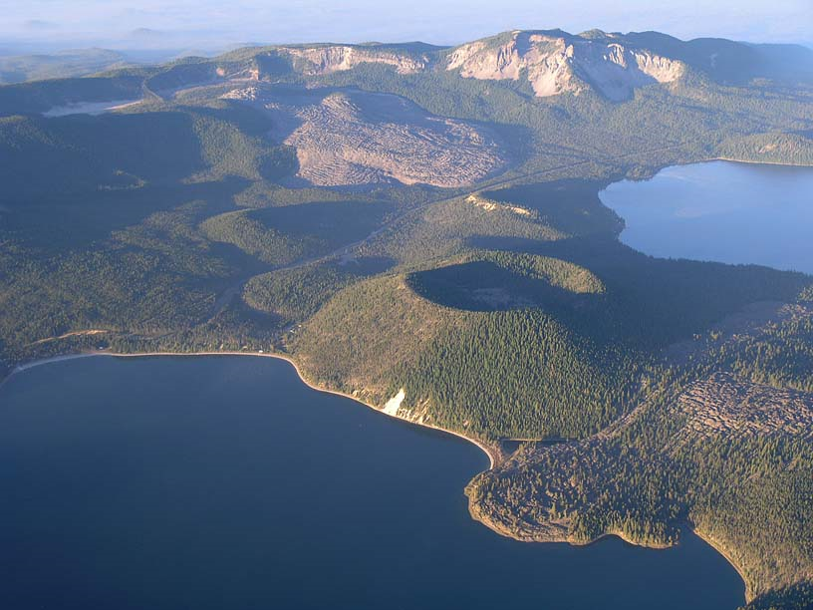
caldera
An empty magma chamber left over from an explosive eruption
Ex: Yellowstone

Slide 21
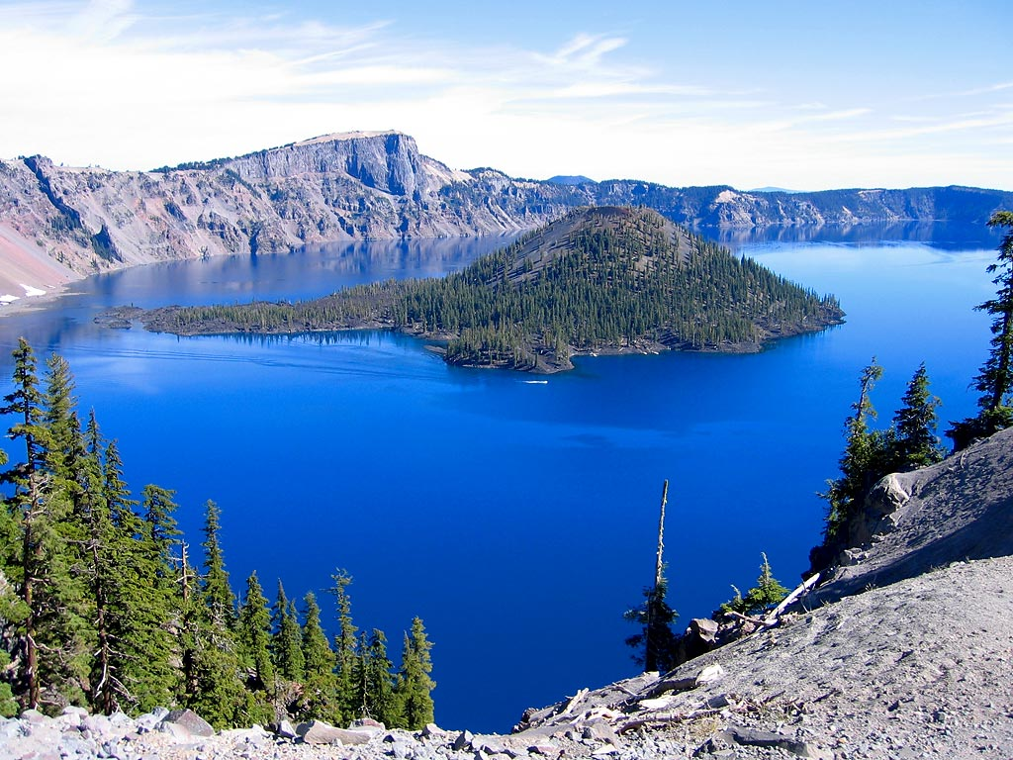
Crater Lake, oregon

Slide 22
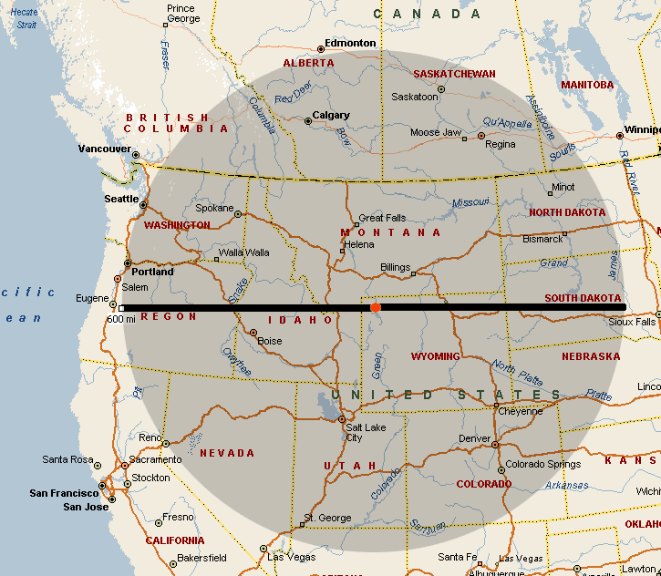
Yellowstone – Over a hot spot in Earth’s mantle and could have a massive eruption

Slide 23
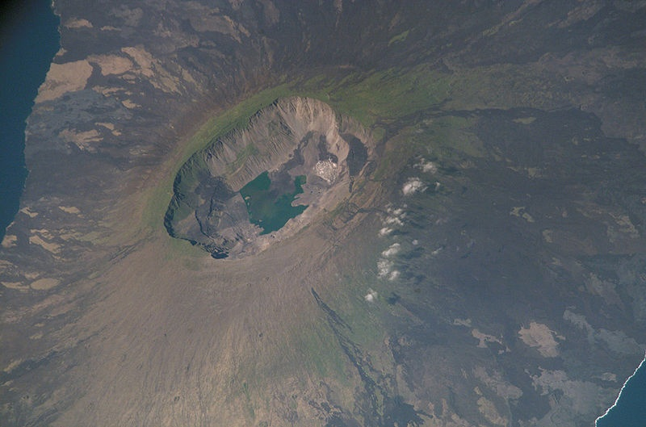
Ferdinand island, galapagos

Slide 24
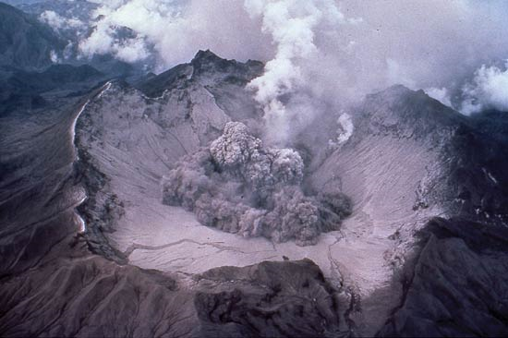
Mt. Pinatubo. Philippines

Slide 25
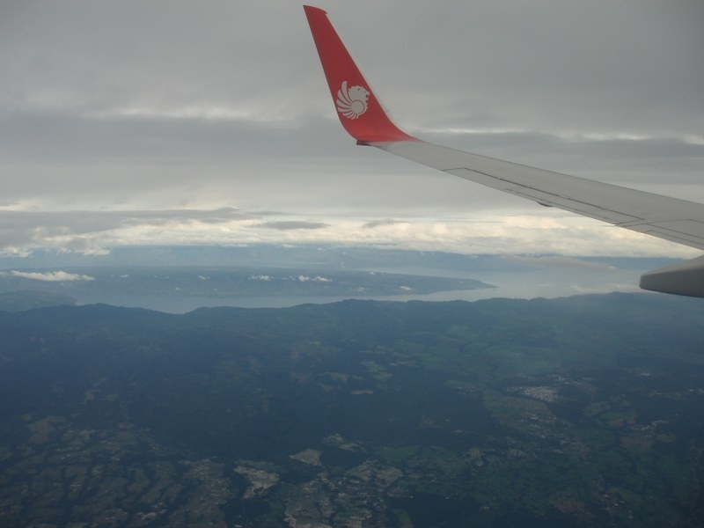
Lake toba, phillipines

