Slide 1
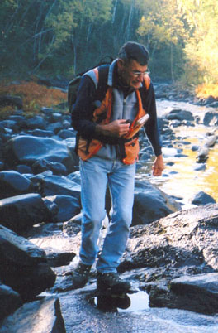
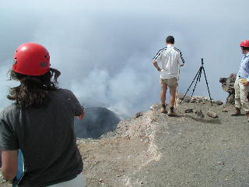
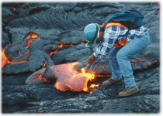
Volcanology
Volcanology – The study of Volcanoes, magma and lava
Vulcan: The Roman God of Fire

Slide 2
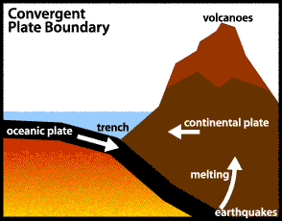
Convergent volcanism
Volcanoes that happen at Subduction zones
80% of all volcanoes

Slide 3
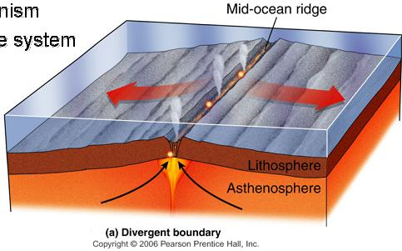
Divergent volcanism
Volcanoes that happen at Mid-ocean ridges
15% of all volcanoes

Slide 4
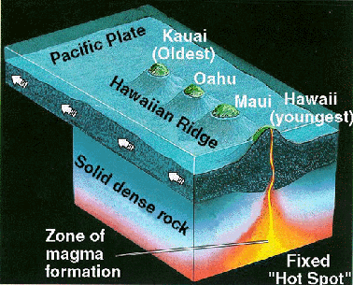
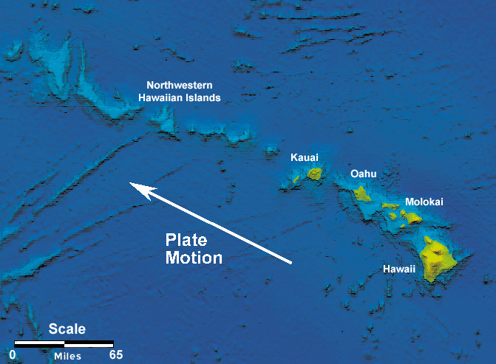
Hot Spots
An unusually hot place where magma melts through the crust
Not on a plate boundary
5% of volcanoes
Ex: Hawaiian islands and Yellowstone

Slide 5
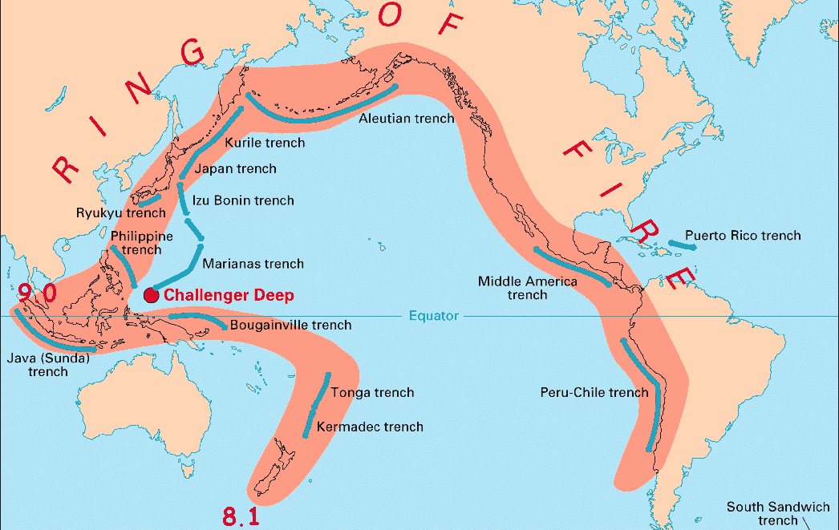
Ring of Fire
Subduction zones around the Pacific Plate with lots of volcanic activity

Slide 6
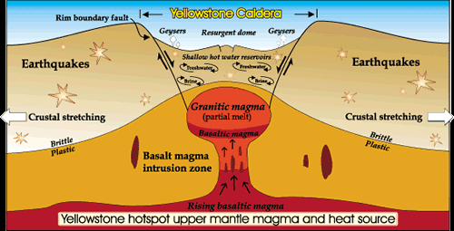
Yellowstone
A supervolcano that is caused by a hot spot and has the potential to produce large scale devastation

Slide 7
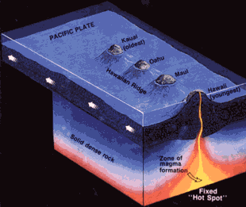
Hot Spots
The PLATES MOVE over the hot spot, the hot spot DOES NOT move!

Slide 8
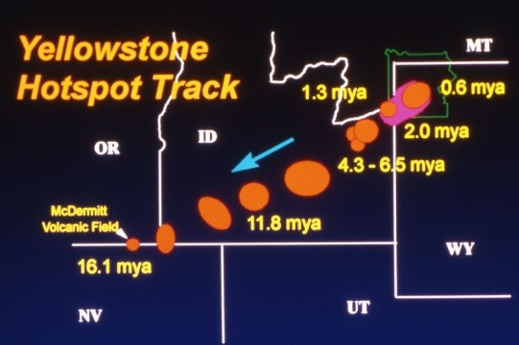

Slide 9
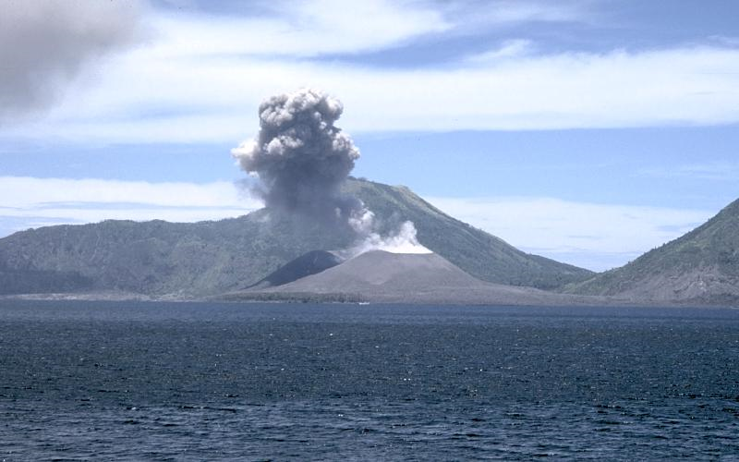
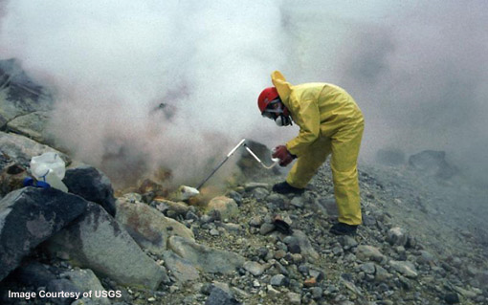
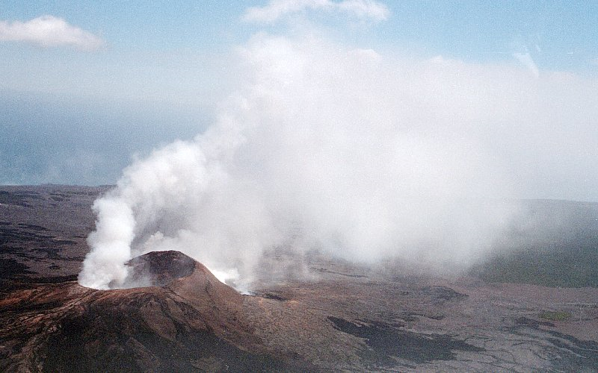
Warning signs of volcanoes
Release of gases
Small earthquakes
Vibrations
Acidic water

Slide 10
