Slide 1
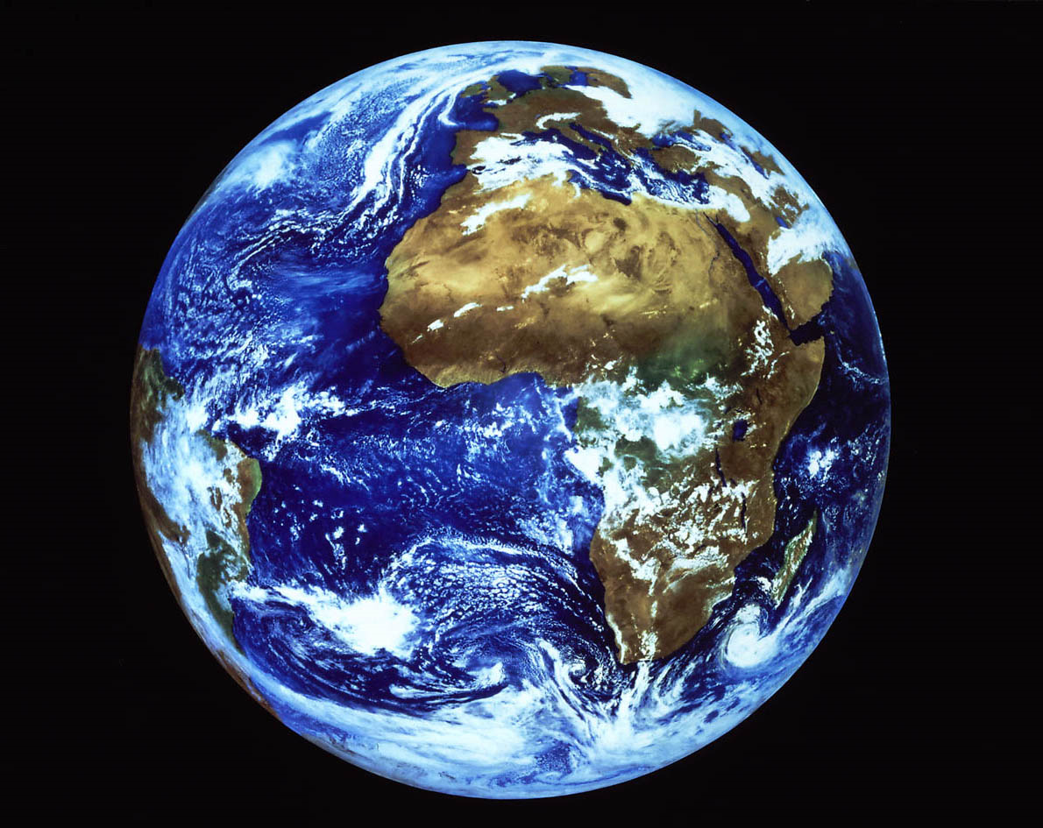
Age of the Earth, Solar System and Universe
Solar System: 4.6 billion years old
Earth: 4.5 billion years old
Universe: 13.8 billion years

Slide 2
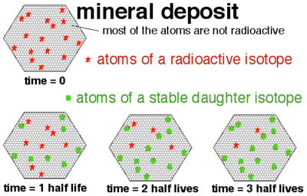
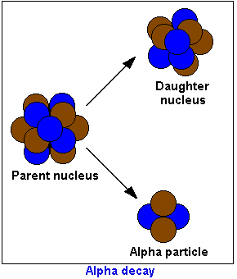
Radioactive Decay
The decay of radioactive elements into other elements
Mass gets released as energy

Slide 3
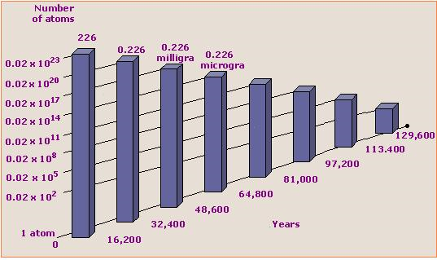
Radiometric Dating
Uses the rate of decay of certain elements to date rock and other objects

Slide 4
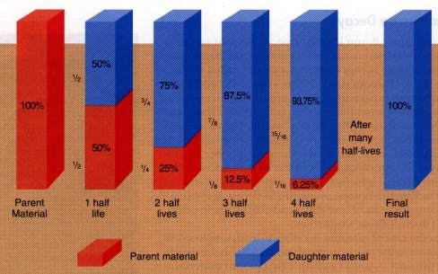
Half-Life
The time it takes for an element to decay by half

Slide 5
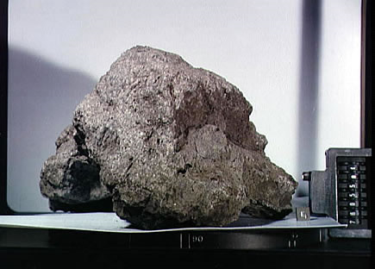
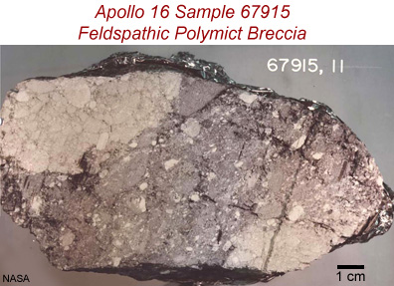

Evidence for the age of the Earth
Dating rocks
Dating meteorites
Dating lunar rocks

Slide 6
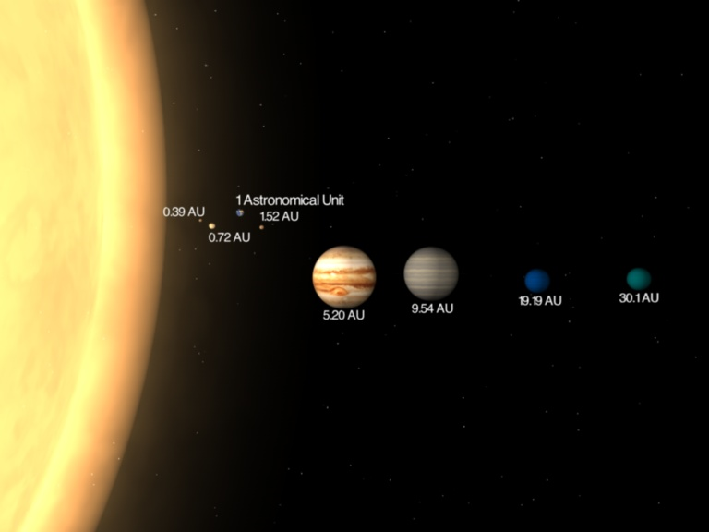
Measuring the Solar System
Astronomical Unit (AU)
  The distance from the Earth to the Sun
    149,600,000 km (92,957,130 miles)

Slide 7
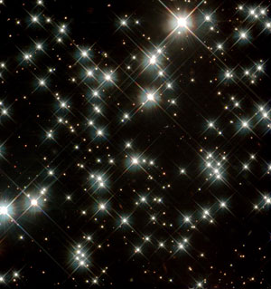
Measuring the Universe
Parsec: 8 trillion miles
  Used to measure the distance to stars
  206,265 AU

Slide 8

Speed of Light
Speed of light
  186,282 miles/second
  670,615,200 mph
Light Year: the distance light can travel in one year
  5.9 trillion miles
  Proxima Centauri : 4.2 ly

Slide 9
History of the Universe in 10 minutes
https://www.youtube.com/watch?v=wXLfbfsidp4

