Slide 1
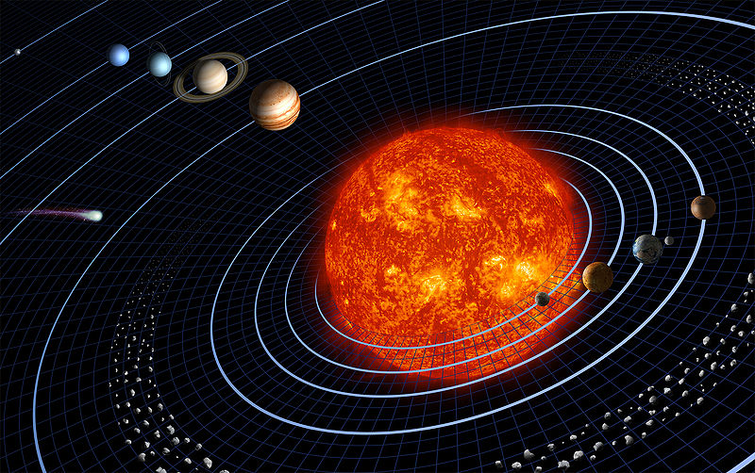
Formation of the Solar System

Slide 2
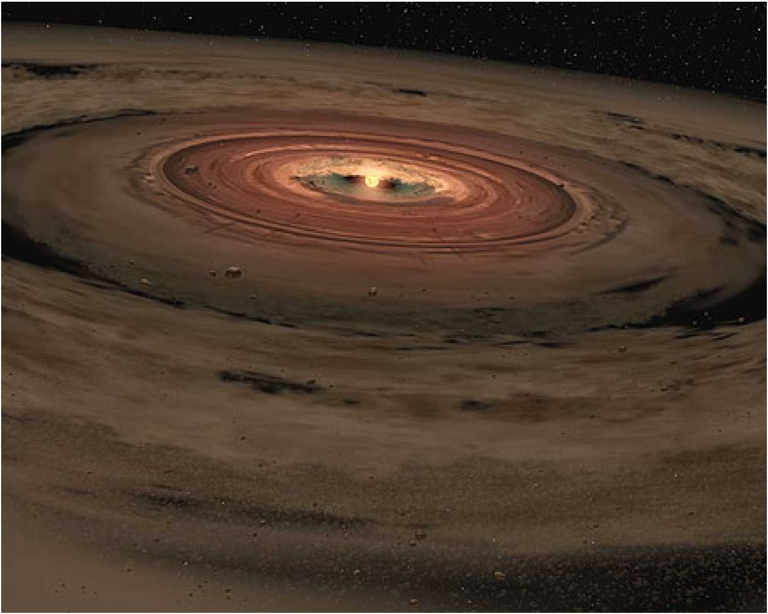
Solar Nebula
A disk of dust and gas orbiting a newly formed star

Slide 3
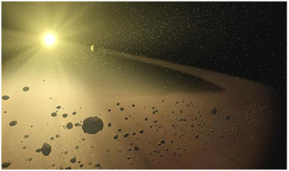
Formation of the Solar System
1. A solar nebula was disturbed
  Maybe by a supernova explosion?
2. The shockwaves made the gases and debris begin to condense due to gravity by things with more
mass and
Set a motion of
Planets spinning
And orbiting.

Slide 4
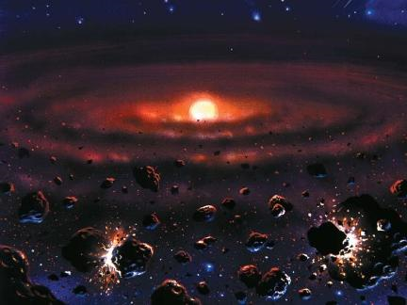
Formation of the Solar System
3. As the cloud condensed and the sun formed
4. Planets and moons formed through repeated collisions of the left over materials

Slide 5
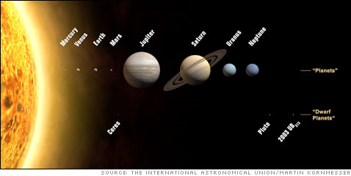
Formation of the Solar System
5. Rocky planets formed close to the sun
  They could withstand the heat
6. Gas planets formed further away where it was cooler

Slide 6
Our Solar System Includes:
The Sun, Planets, Moons (satellites), Meteors, Asteroids, Dwarf Planets and Comets

