Slide 1
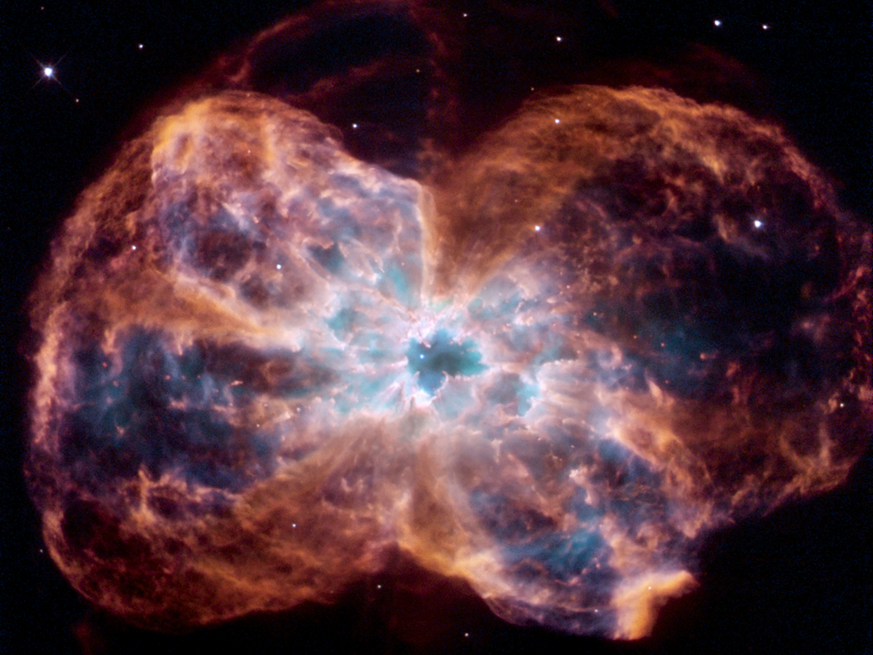
Bowtie Nebula

Slide 2
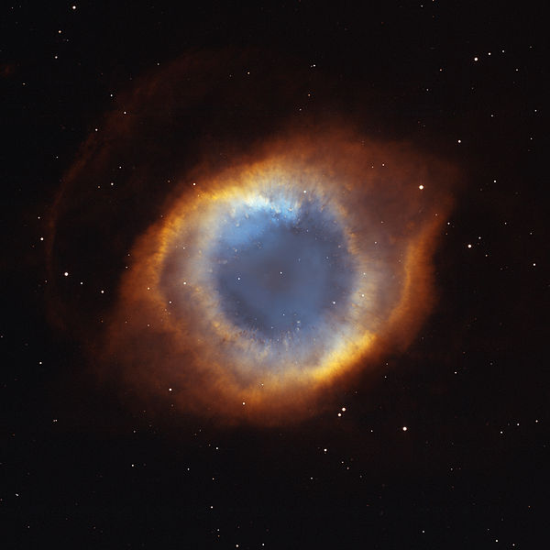
Helix Nebula

Slide 3
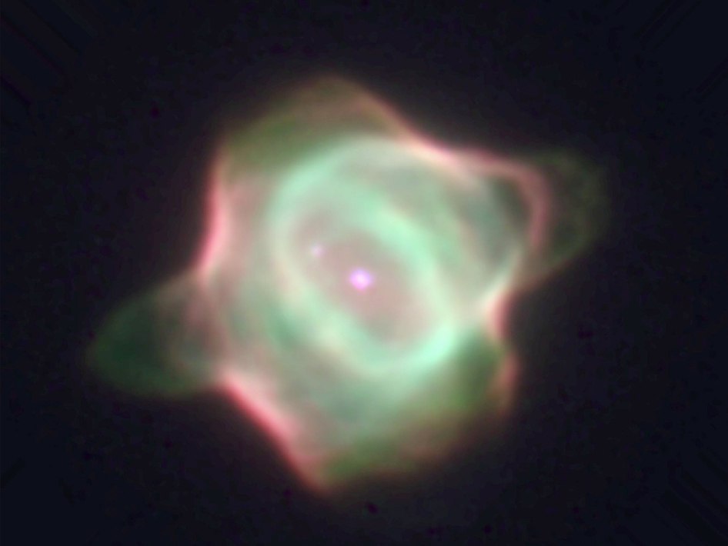
Stingray Nebula

Slide 4
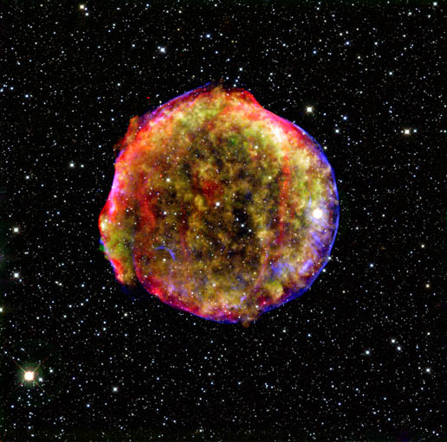
Tycho Supernova

Slide 5
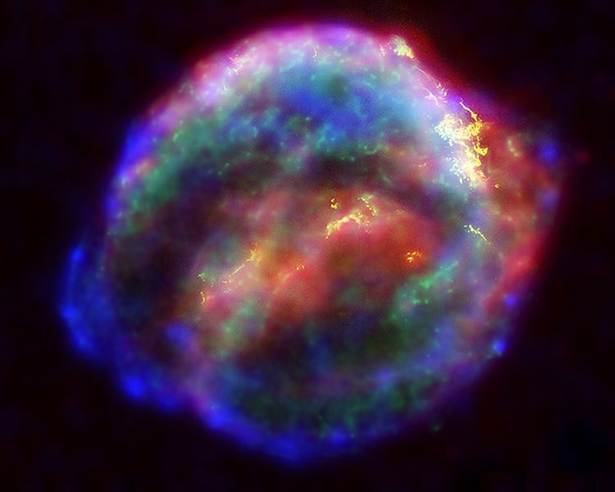
Kepler Supernova

Slide 6
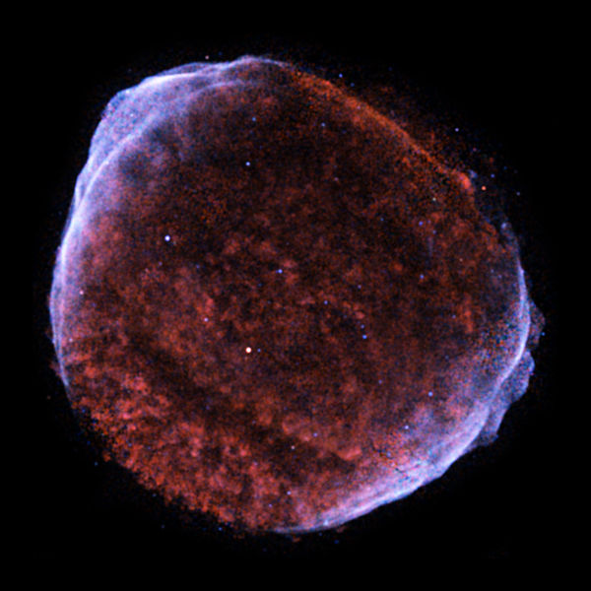
SN1006

Slide 7
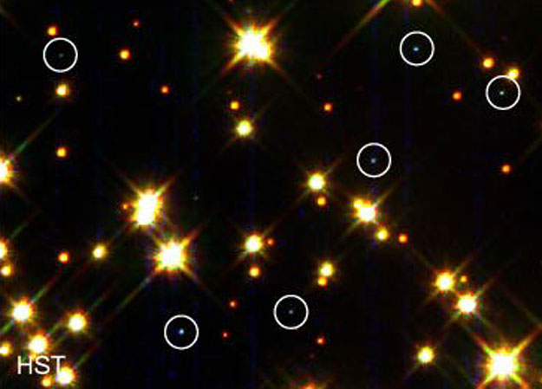
Step 6
White Dwarf: A collapsed star
Very hot, dense and dim
Has the mass of the Sun inside something the size of the Earth
Has a huge gravitational pull

Slide 8
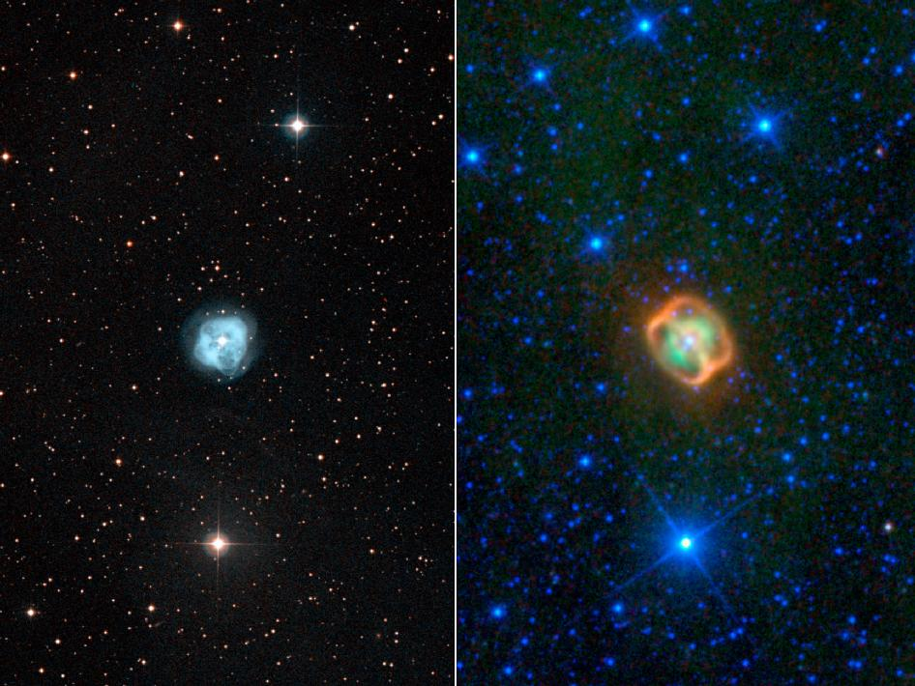
NGC 1514

Slide 9
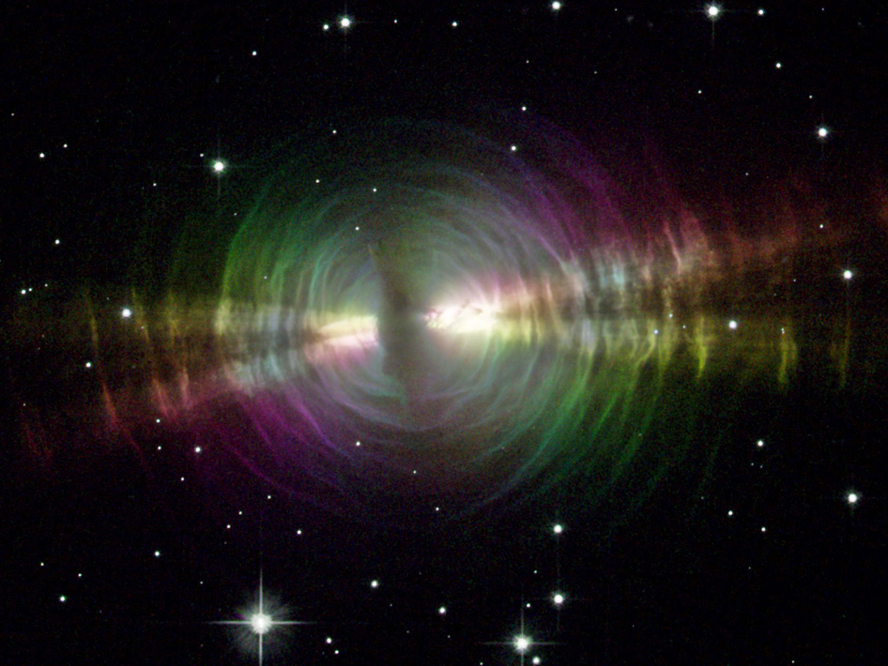
Egg Nebula

Slide 10
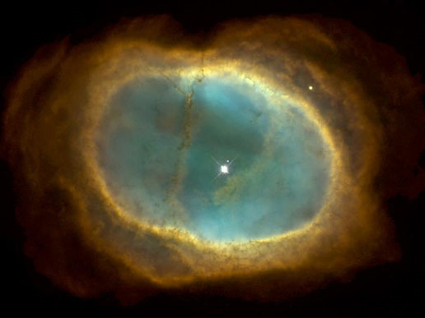
Southern Ring Nebula

Slide 11
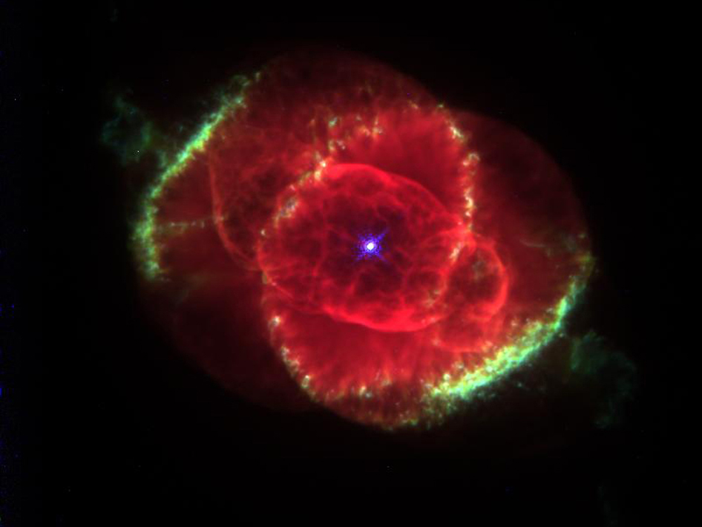
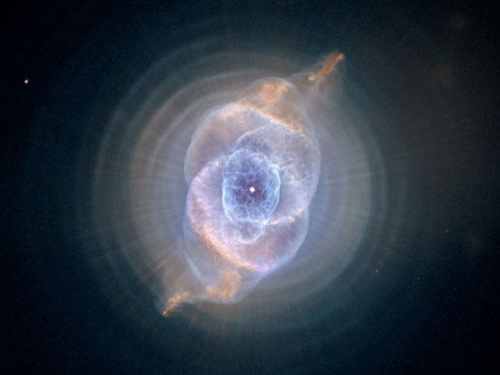
Cats Eye Nebula

Slide 12
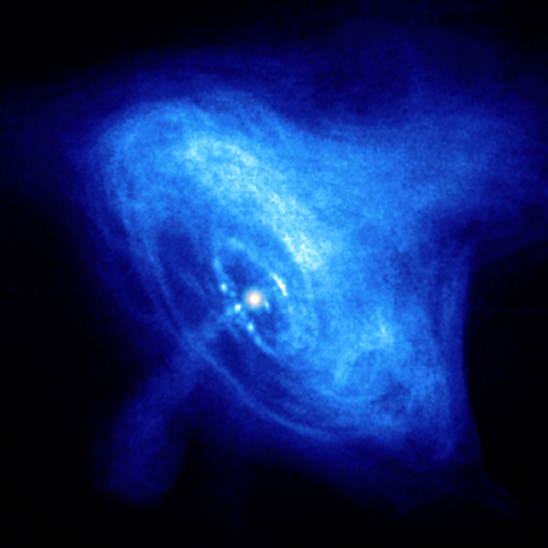
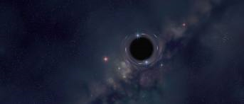
Step 6
Neutron Star
Black Hole
A collapsed super red giant
Mostly neutrons
Hottest temperature in the universe
A collapsed super red giant
Has so much gravity that not even light can escape

Slide 13
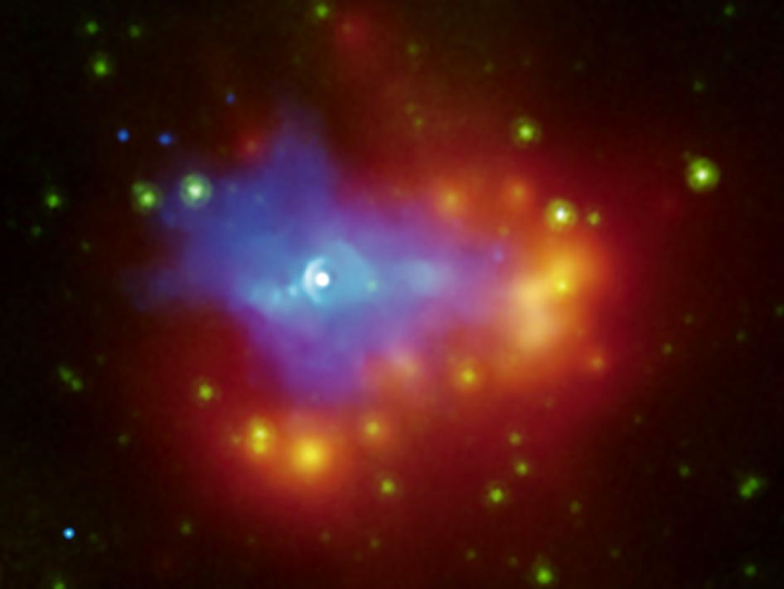
Neutron Star

Slide 14
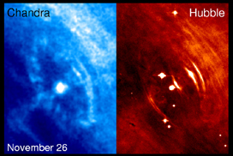
Neutron Star

Slide 15
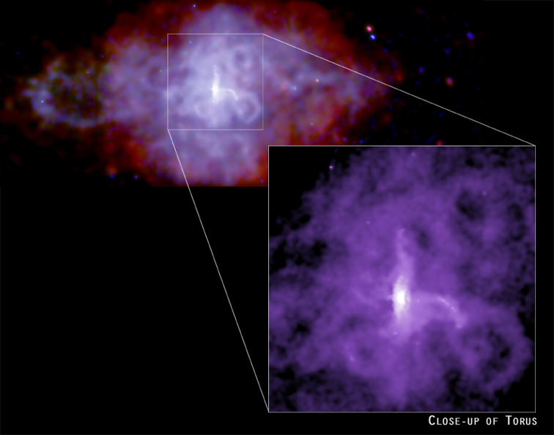

Slide 16
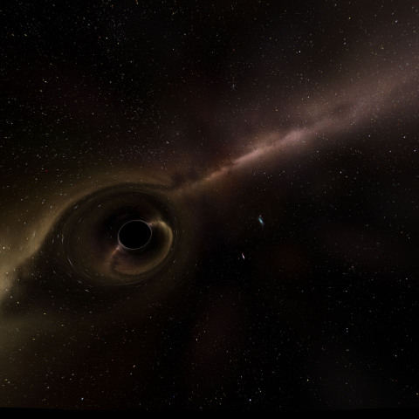
Black Hole
  http://en.wikipedia.org/wiki/File:Black_hole_lensing_web.gif

Slide 17
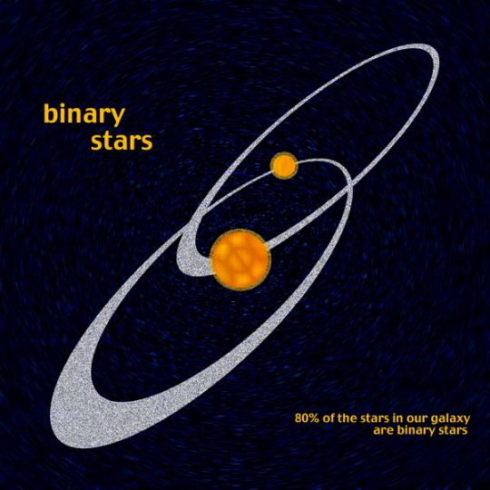
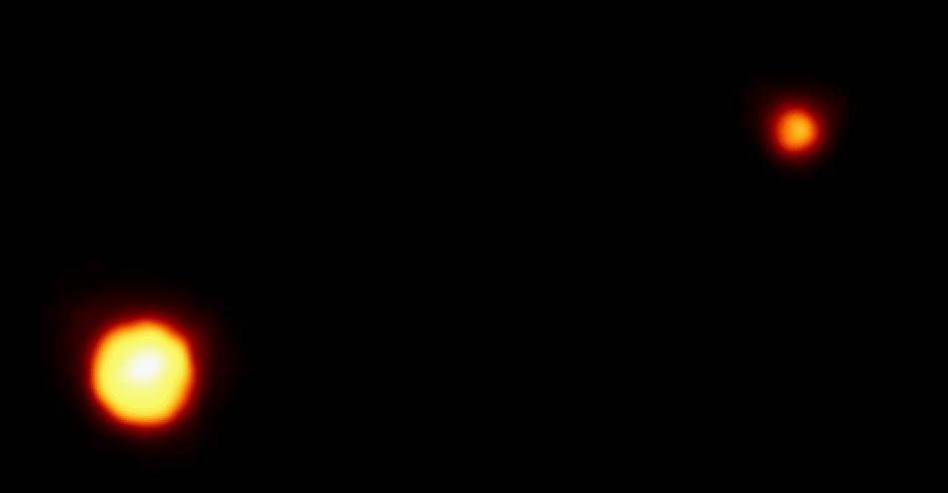
Binary System
Two stars that orbit each other

