Slide 1
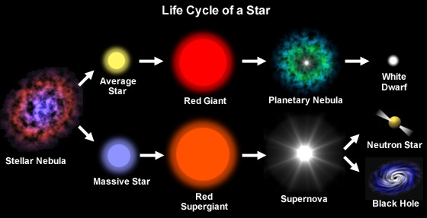
Life Cycle of a Star

Slide 2
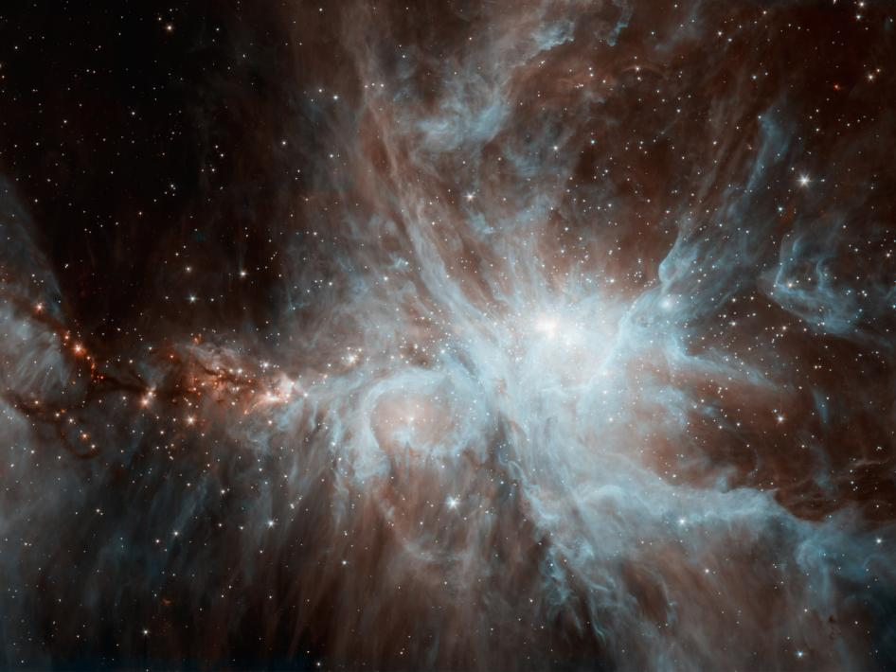
Step 1
Nebula: A large cloud of dust and gases
  Birthplace of stars
  High temps
  High pressure

Slide 3
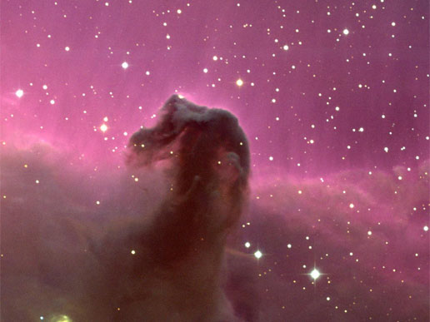
Horse head Nebula

Slide 4
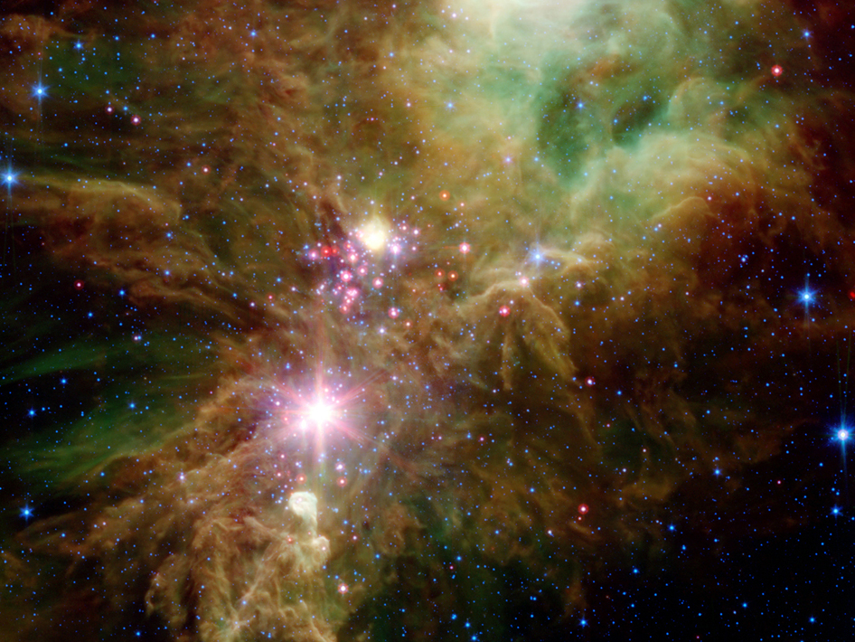
Cone Nebula

Slide 5
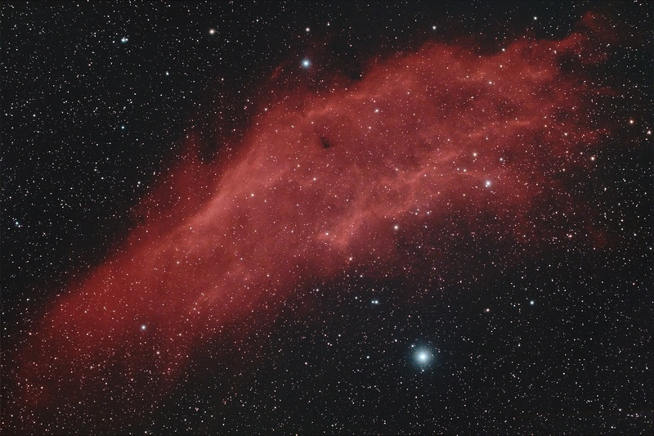
California Nebula

Slide 6
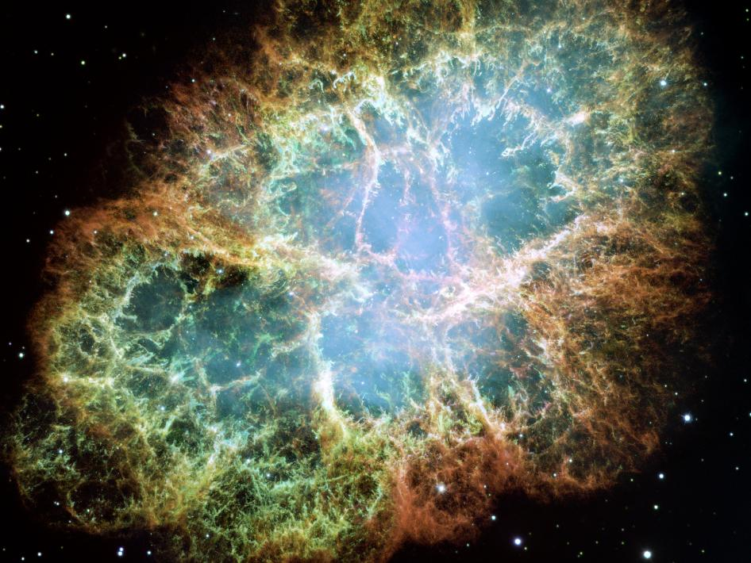
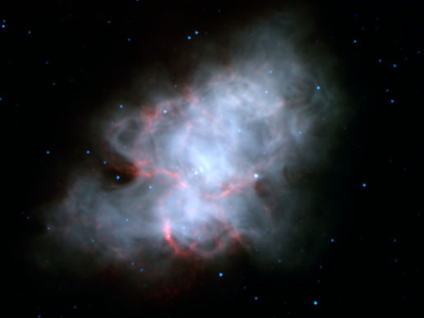
Crab Nebula

Slide 7
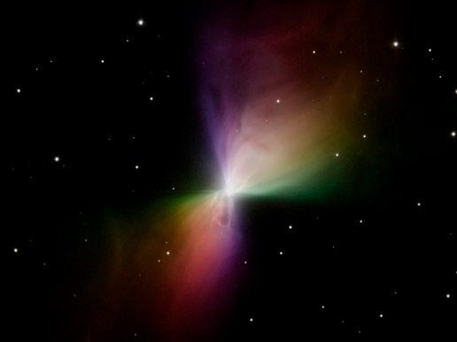
Boomerang Nebula

Slide 8
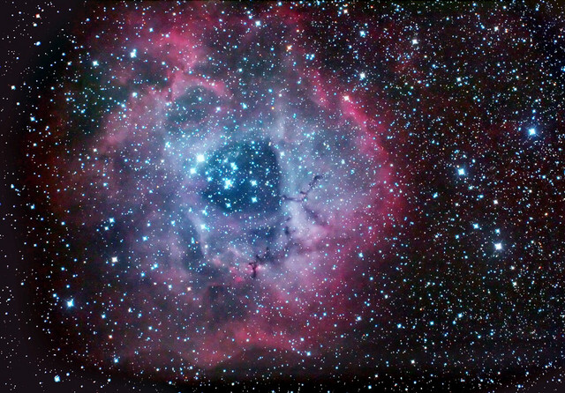
Rosette Nebula

Slide 9
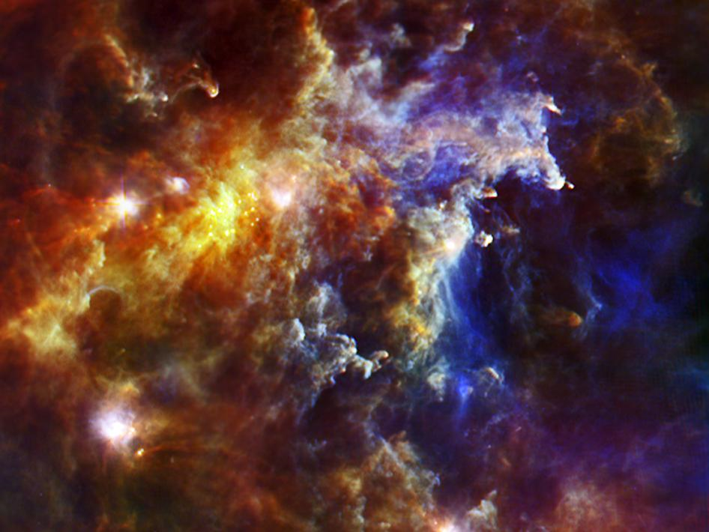
Rosette Nebula

Slide 10
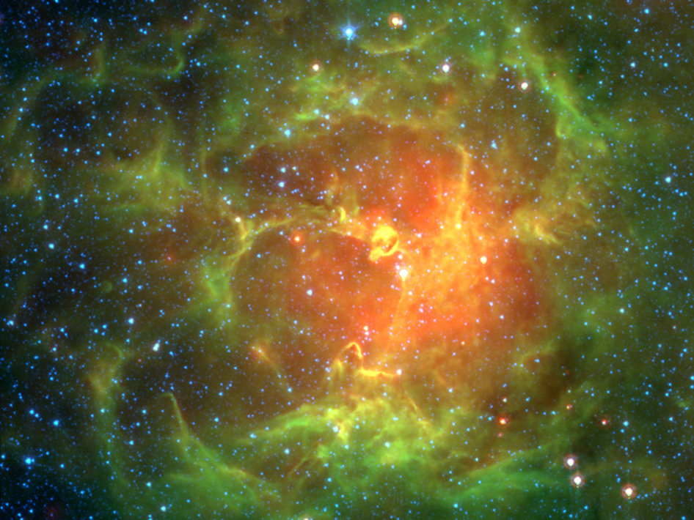
Trifid Nebula

Slide 11
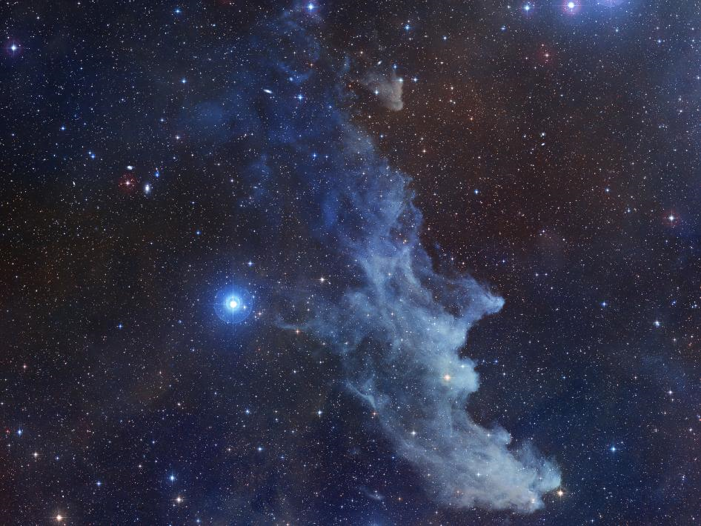
Witch head Nebula

Slide 12
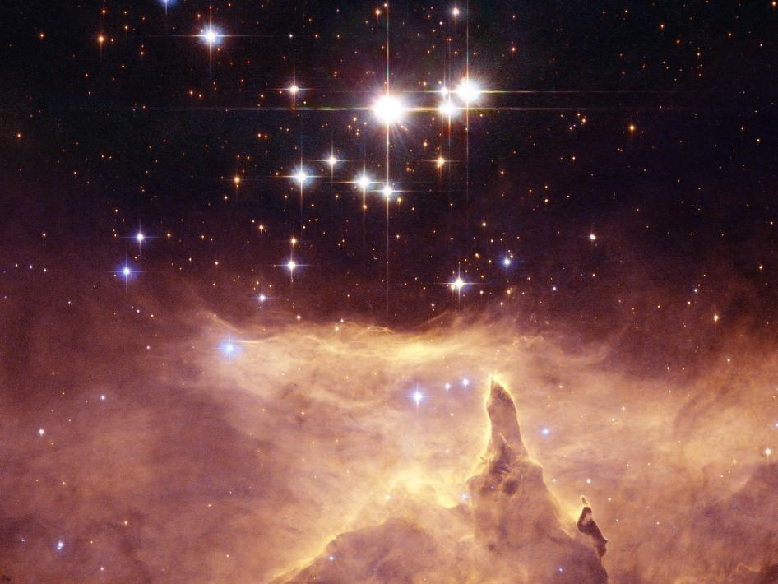
Step 2
Protostar: A new star that forms when the gases and dust in a nebula condense
  Usually more than one is produced per nebula

Slide 13
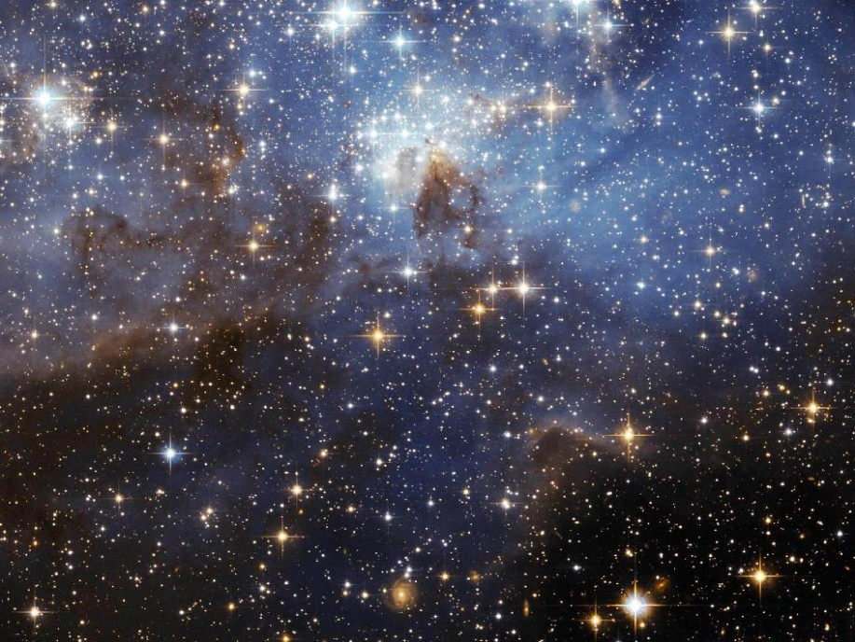
Step 3
Main Sequence Star
Massive Star
Has enough energy to fuse hydrogen into helium
Stable star like our sun
Has enough energy to fuse hydrogen into helium
10-20 times larger than our Sun
Has a shorter life span

Slide 14
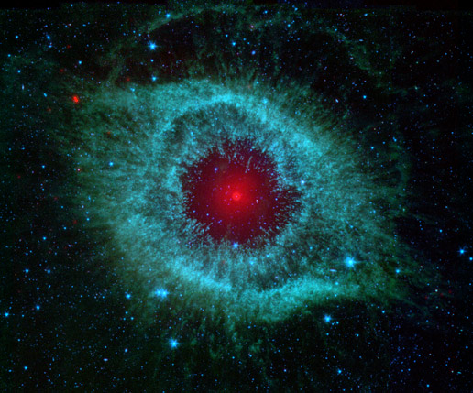
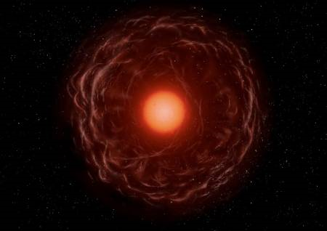
Step 4
Red Giant
Super Red Giant
All hydrogen has been converted into Helium
Helium shell expands
5-10 times larger than our Sun
hydrogen has been converted into Helium
Helium shell expands
20-40 times larger than our Sun

Slide 15
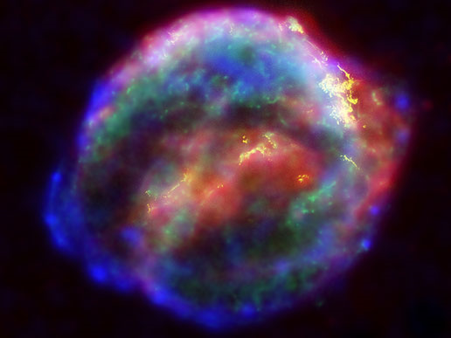
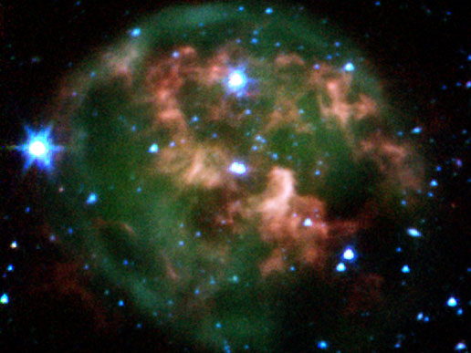
Step 5
Planetary Nebula
Supernova Explosion
The dying star runs out of fuel and ejects a cloud of dust and gas as it collapses
The massive star runs out of fuel and collapses causing a massive explosion

Slide 16
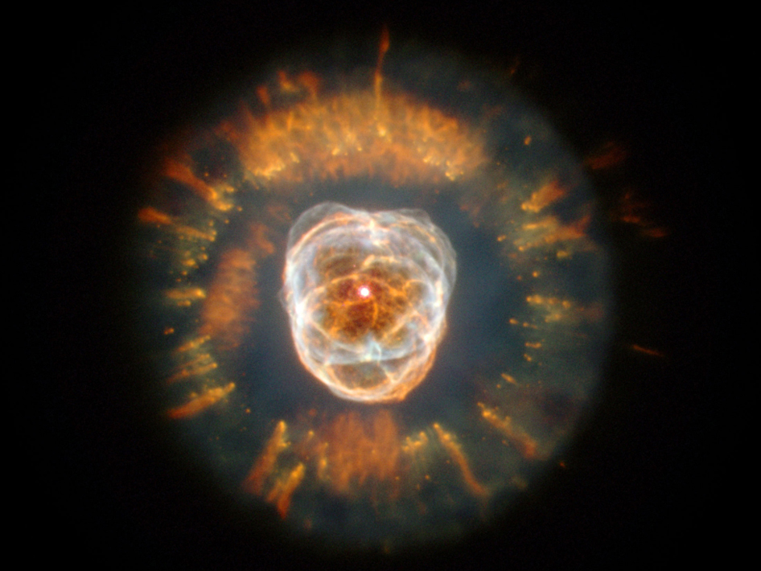
Eskimo Nebula

Slide 17
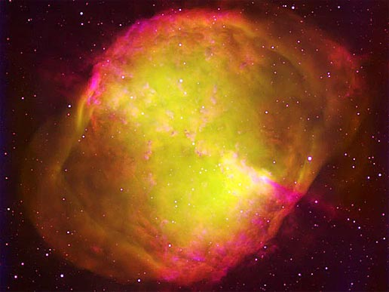
Dumbbell Nebula

