Slide 1
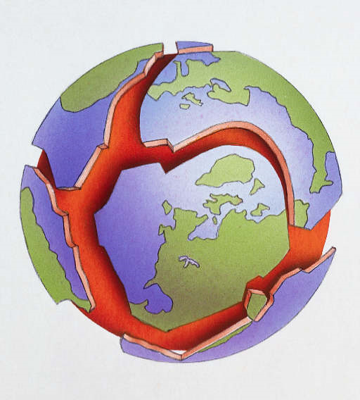
Continental Drift

Slide 2
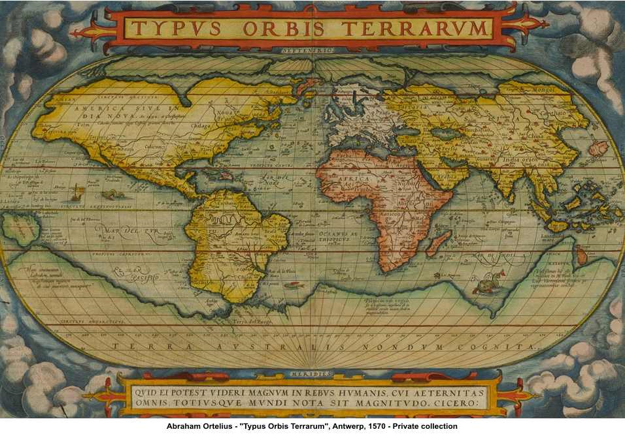
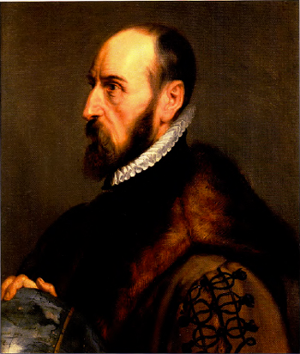
Abraham Ortelius
1596: geologist and cartographer who first theorized that the continents were once jointed together

Slide 3
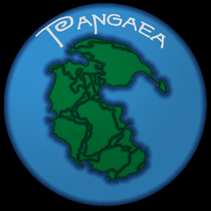
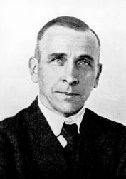
Alfred Wegener
1912: German geologist who proposed the idea of continental drift

Slide 4
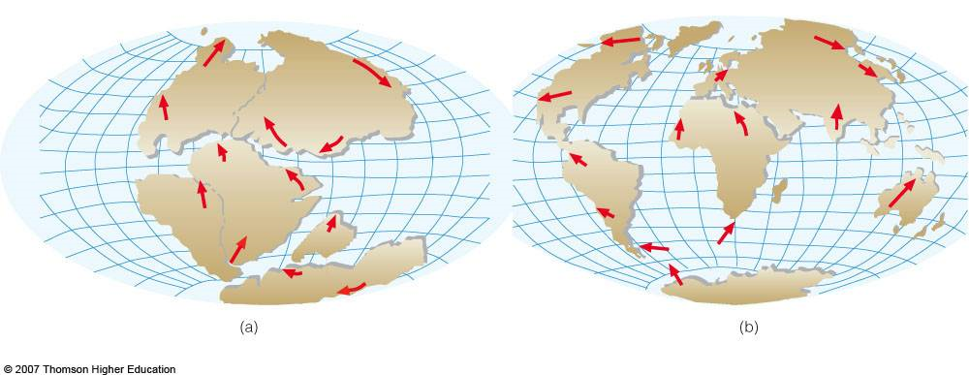
Continental Drift
The theory that the continents are slowly drifting around on top of the Earth’s mantle

Slide 5
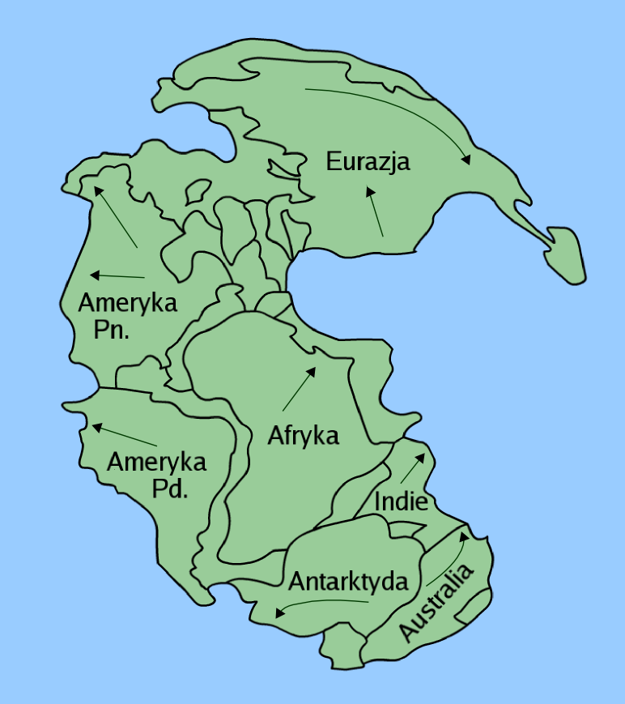
Pangaea
The supercontinent that existed 225 million years ago
Started breaking up after the Permian mass extinction

Slide 6
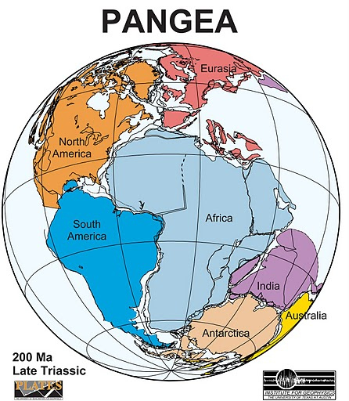
Evidence for Pangaea
1. Continents seem to form a puzzle

Slide 7
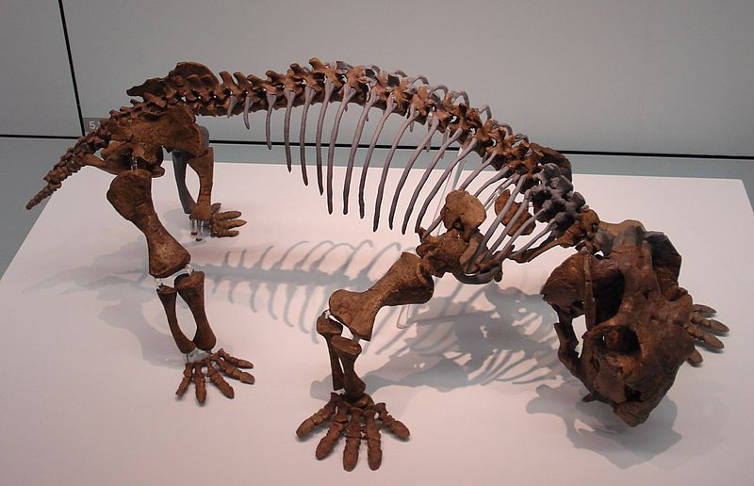
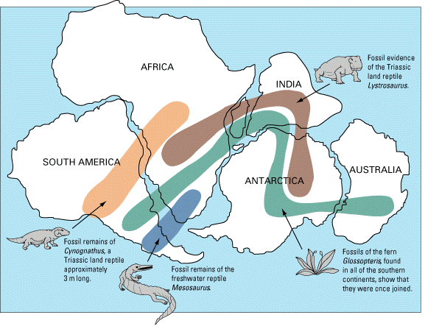
Evidence for Pangaea
2. The same fossils are found on different continents

Slide 8
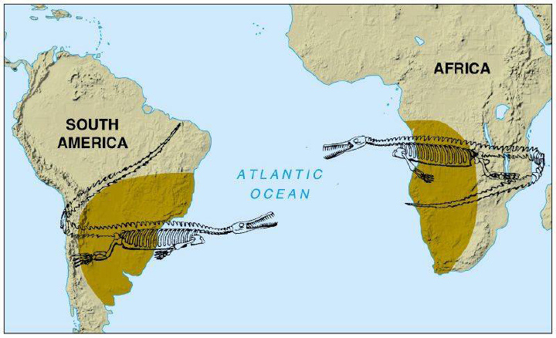

Slide 9
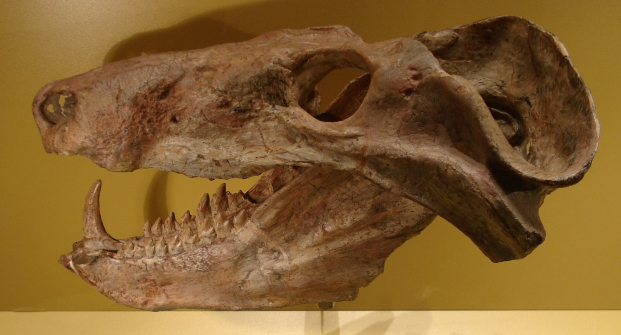
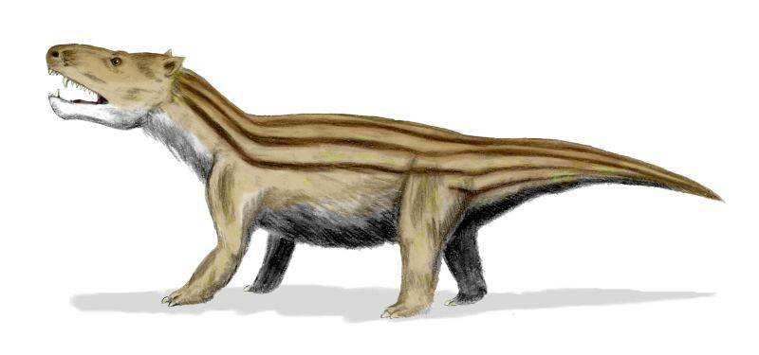
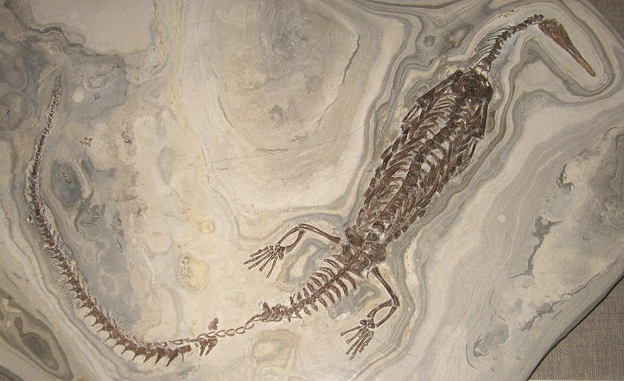

Slide 10
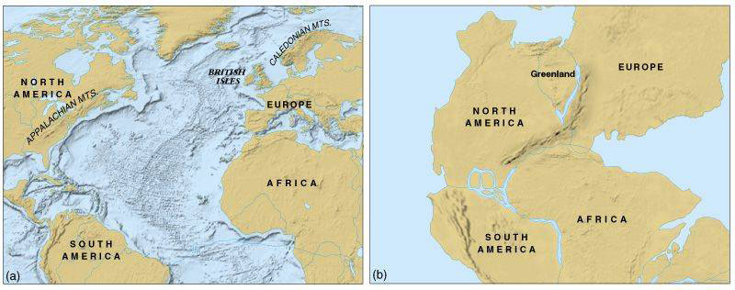
Evidence for Pangaea
3. Rock formations across continents match very closely
  Appalachian mountains in the eastern U.S. fit with the Caledonian mountains in Europe

Slide 11
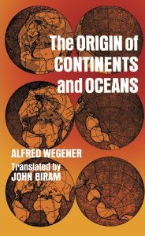
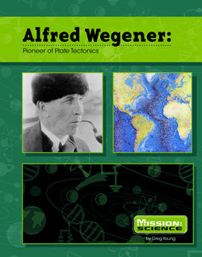
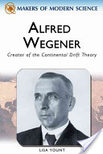
Why didn’t anyone believe Alfred?
He could not explain HOW the continents moved around
Most scientists couldn’t imagine a force strong enough to move an entire continent

Slide 12
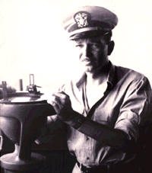
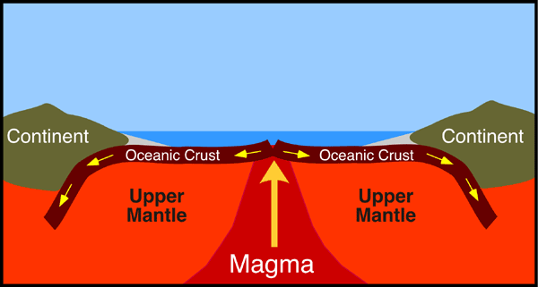
Harry Hess
1959: American geologist and Navy admiral who discovered that the seafloor is spreading at mid ocean ridges

Slide 13
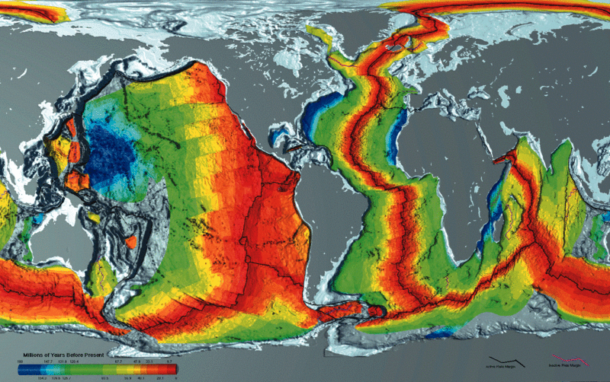

Slide 14
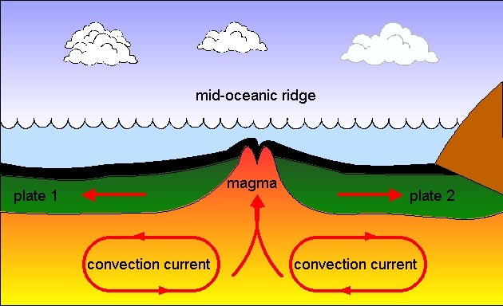
Seafloor Spreading
Plates move apart and new oceanic crust is formed and creates mid-ocean ridges
  Pacific Plate 3-8 cm/year
  Atlantic Plate 1-2 cm/year

Slide 15
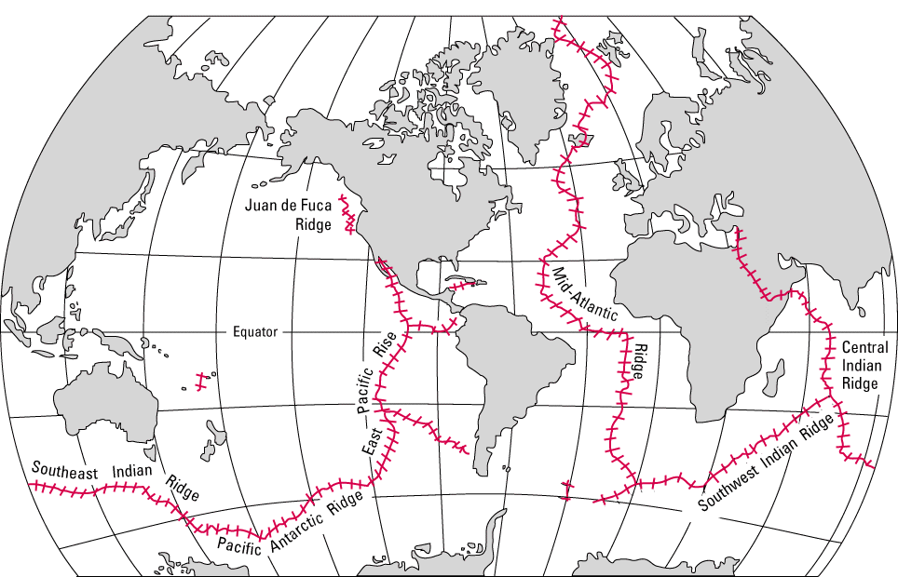
Seafloor Spreading

