Slide 1
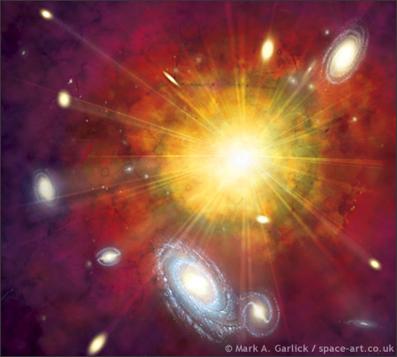
Light Elements
Produced during the Big Bang
Hydrogen, Helium and lithium

Slide 2
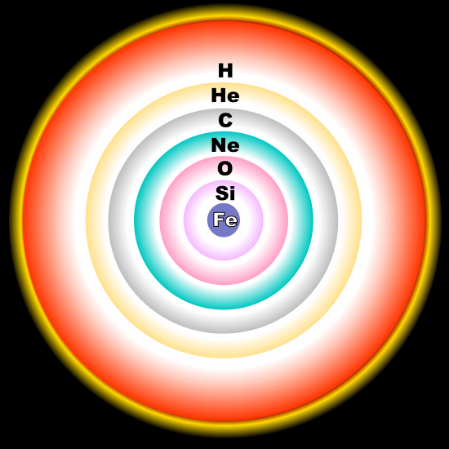
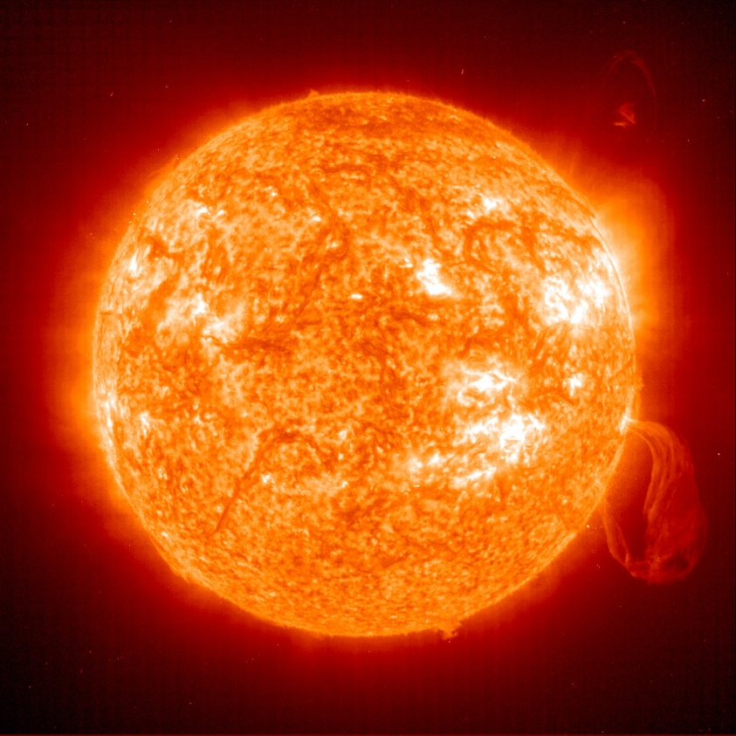
Heavier elements
  Formed during fusion inside a star

Slide 3
Heavier Elements
  Elements up to the atomic number 26 (iron) Iron
  Carbon
  Oxygen
  Nitrogen
  Magnesium
  Silicon
  Calcium
  Phosphorous
  Potassium
  Sodium
  Titanium
  Aluminum

Slide 4
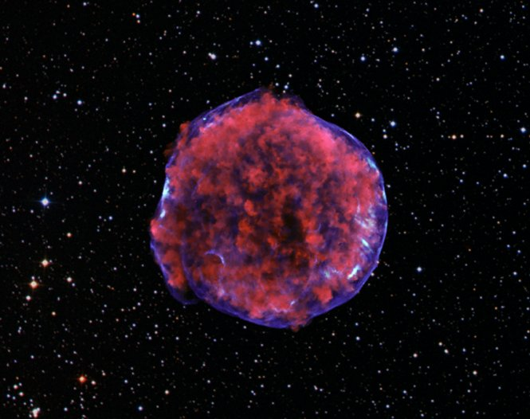
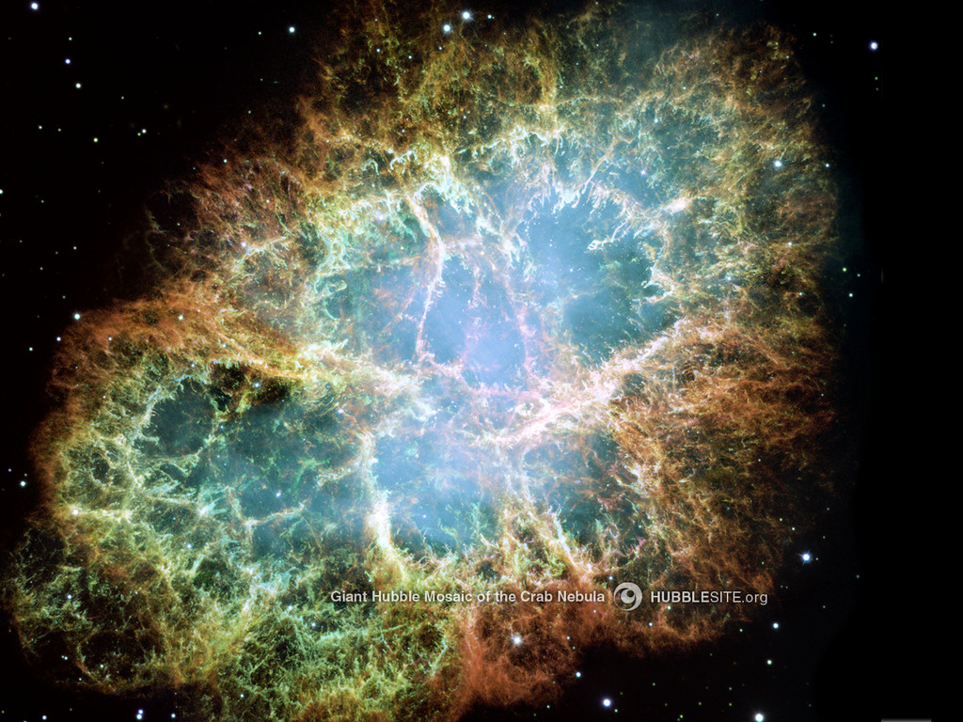
Heaviest Elements
Formed during supernova explosions

Slide 5
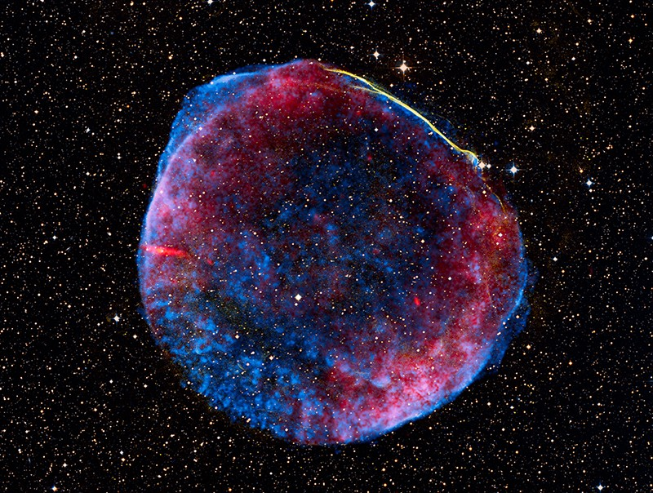
Heaviest elements
  Elements heavier than iron
  Nickel
  Copper
  Zinc
  Rubidium
  Lead
  Silver
  Iodine
  Cobalt
  Arsenic
  Bromine
  Krypton

Slide 6
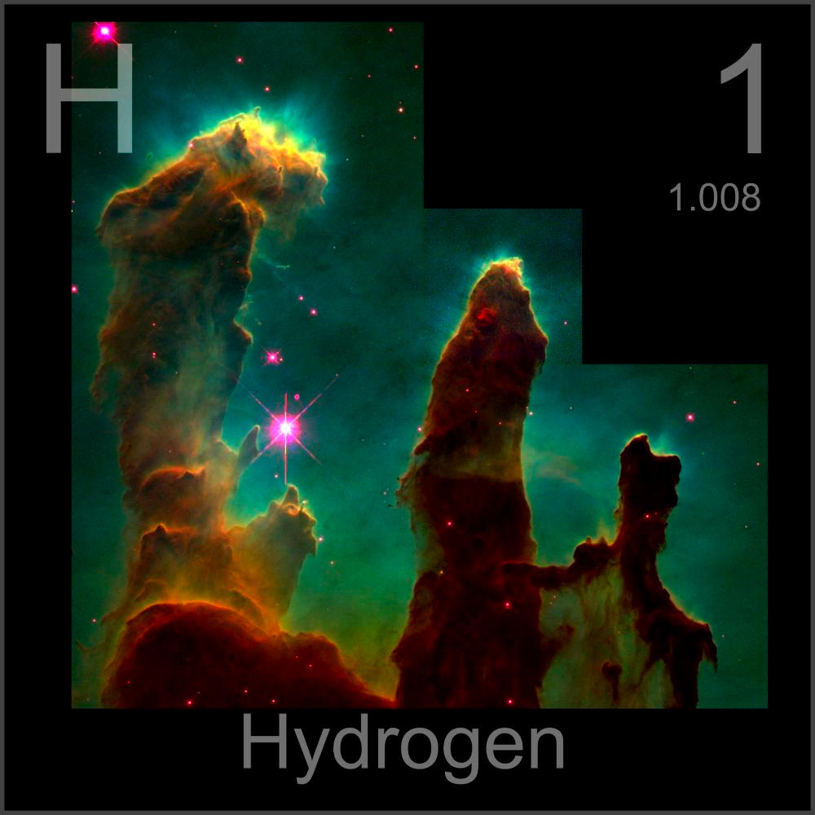
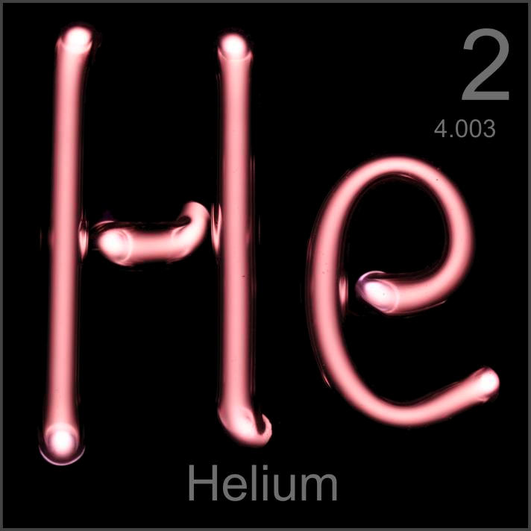
Abundant Elements
The two most abundant elements in the universe are Hydrogen and Helium

Slide 7
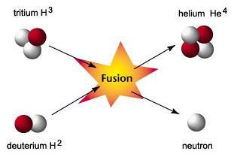
Fusion
The fusing of two elements to make a different element

Slide 8
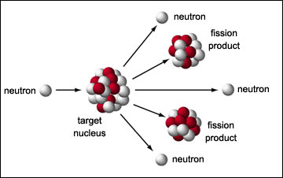
Fission
The separation of an element to make two smaller elements

Slide 9
Spectral Lines
Every element gives off a characteristic spectra that can be used to identify it
If the spectra has lines moved to the red side or blue side, than it means the light source is moving.
(Watch Spectral Lines from youtube)

