Slide 1
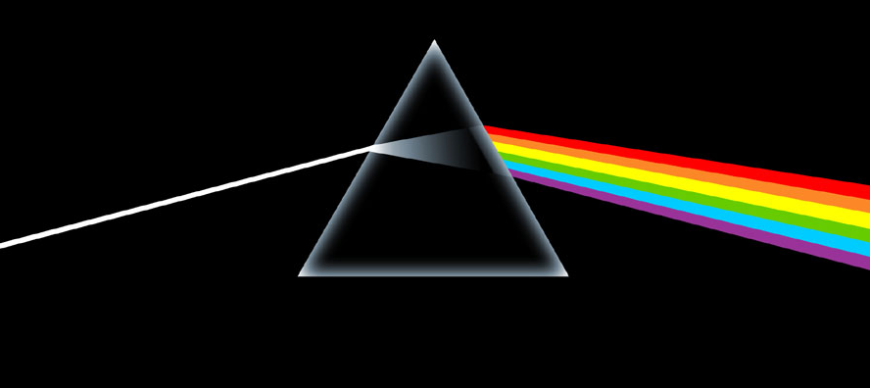
The Electromagnetic Spectrum

Slide 2
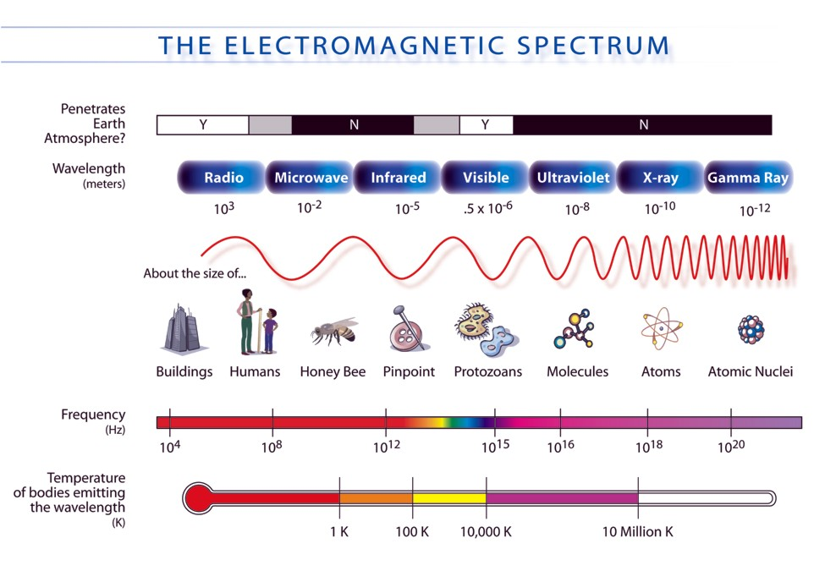

Slide 3
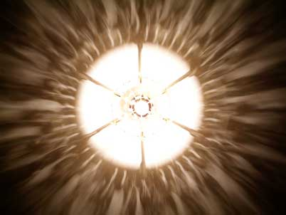
Behavior of Light
All light travels at the same speed
Behaves as a particle (photon)
Behaves as a wave: travels through space
All Waves
Carry Energy
Travel outward from
the source

Slide 4
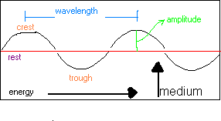
Parts of a Wave
Medium is the material it is traveling through
Sound can go through solid, liquids, or gases
Light can travel through any material because it has it’s own medium, a photon of light.

Slide 5
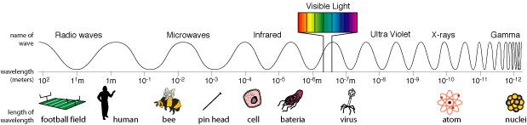
Wavelength and Frequency
Wavelength: The distance between 2 crests or 2 troughs of a wave
Frequency: The number of wavelengths that pass a certain point in one second

Slide 6
Wavelength(λ) and Frequency (ƒ)
As the wavelength increases (gets longer), the frequency decreases (gets shorter)
The higher the frequency, the more energy the light wave has

Slide 7
Wavelength (λ) and Frequency (f)

Slide 8
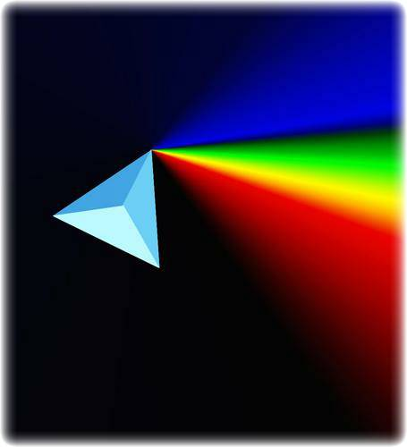
Wavelength (λ) and Frequency (f)
Longest wavelength?
  Radio Waves
Shortest wavelength?
  Gamma Rays
Lowest frequency?
  Radio Waves
Highest frequency?
  Gamma Rays
As the frequency of light increases, the wavelength decreases

Slide 9
Spectrograph
An instrument that separates incoming light into a spectrum based on wavelength and frequency
Tells scientists:
  What elements it is made of
  Its temperature
  Its density
  The direction it is moving
  Its magnetic field strength
  How it has changed over time
http://www.learner.org/teacherslab/science/light/color/spectra/

Slide 10
Emission Lines
Hydrogen
Helium
Carbon

Slide 11
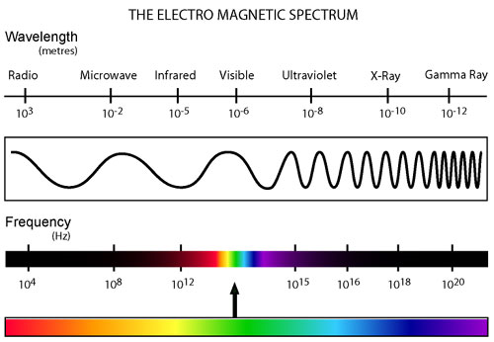

Slide 12
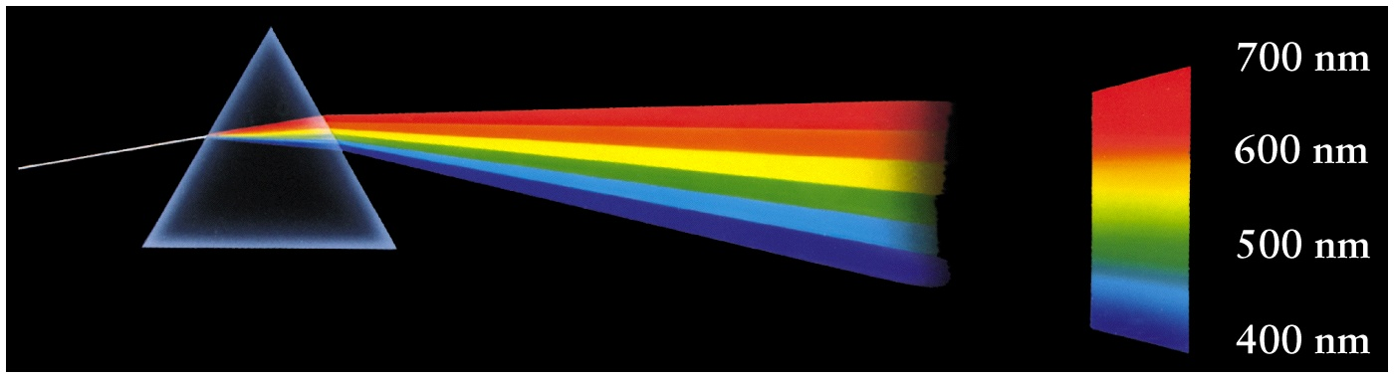
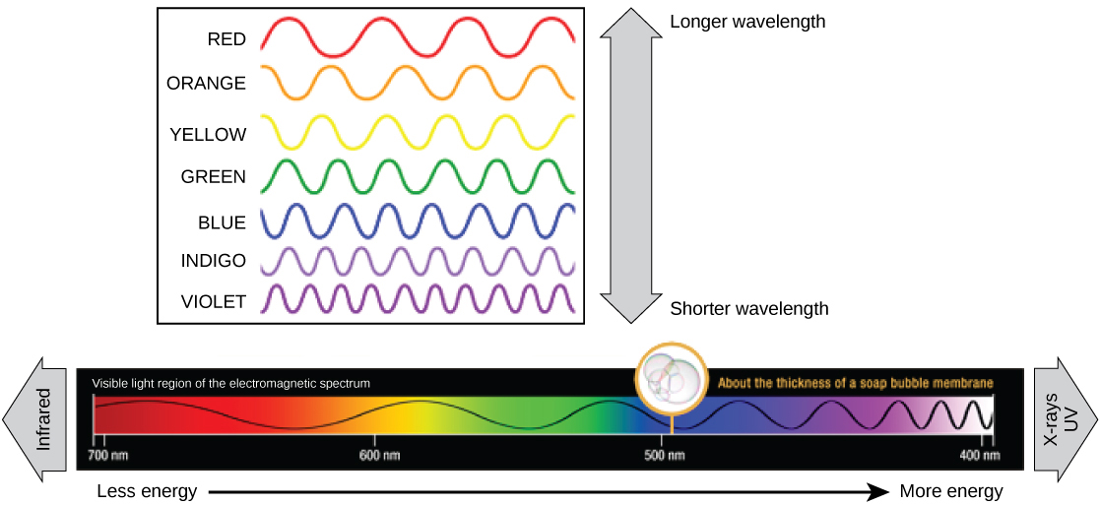
White light contains All the colors of the rainbox & can be separated using a Prism
Light’s Color Affects the Amount of Energy it Has
(Which color has the most & least energy?)

Slide 13
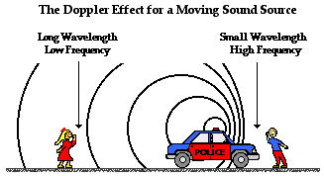
Doppler Effect
The change in the frequency of a wave that is emitted by an object in motion

Slide 14
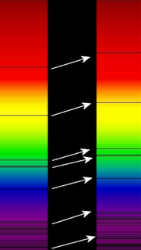
Red Shift
A shift in the light spectra of objects towards the red end
The object is moving away from the observer

Slide 15
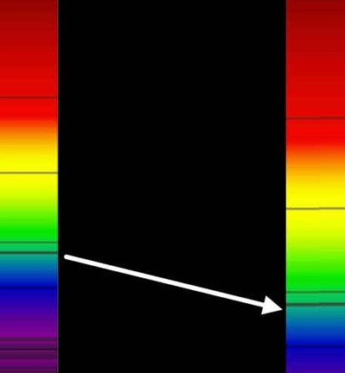
Blue Shift
A shift in the light spectra of objects towards the blue end
The object is moving closer to the observer

Slide 16
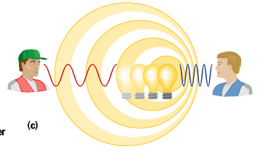

Slide 17
