Slide 1
Geologic Time Scale
A system of chronological measurements relating rock layers to times in geological history

Slide 2
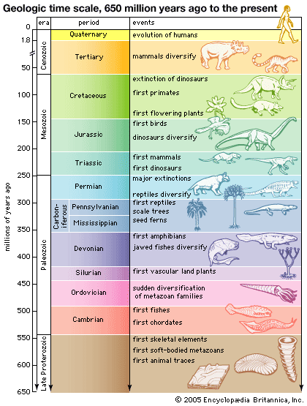

Slide 3
Eras of Geologic Time
Pre-Archaean
Archaean
Proterozoic
Phanerozoic: Complex life forms began on Earth and evolved
Paleozoic: ancient life
Mesozoic: Middle life
Cenozoic: recent life

Slide 4
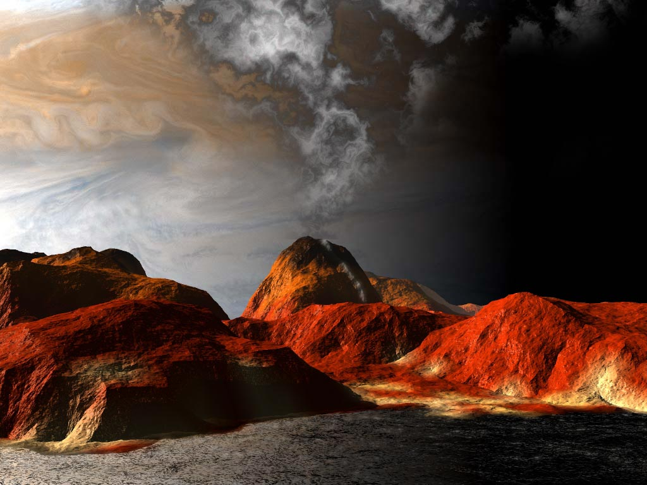
Pre-Archaean Time
4.5 billion years ago to 3.9 billion years ago
No life at this time

Slide 5
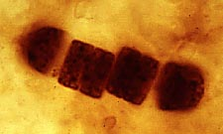
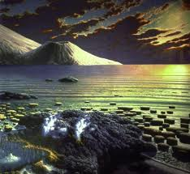
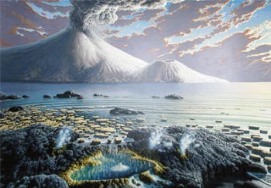
Archaean
3.9 bya to 2.5 bya
First single-celled life

Slide 6
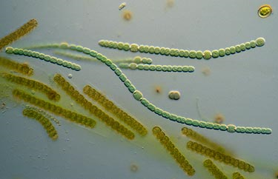
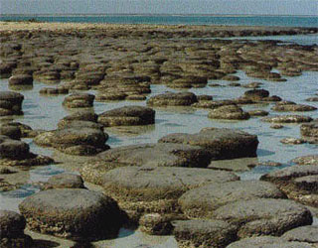
Proterozoic
2.5 bya to 544 mya
Bacteria, algae, worm-like

Slide 7
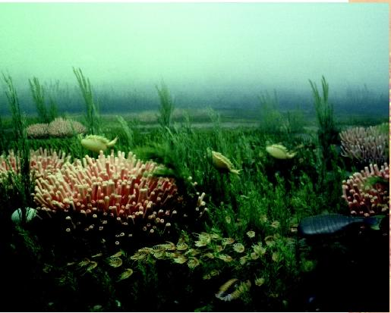
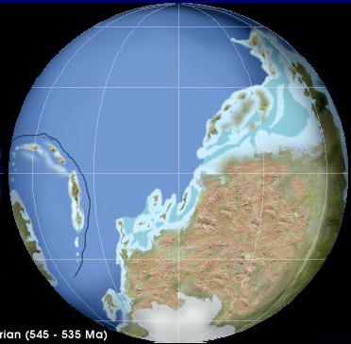
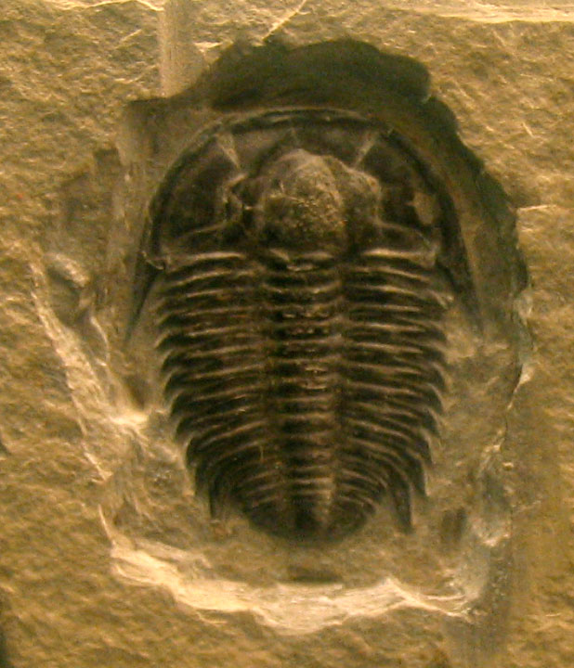
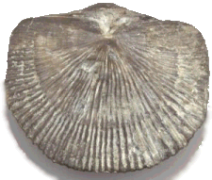
Cambrian
544 mya to 505 mya
Animals first appeared
Trilobites and brachiopods

Slide 8
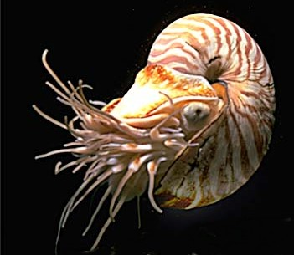
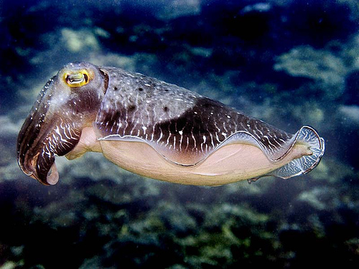
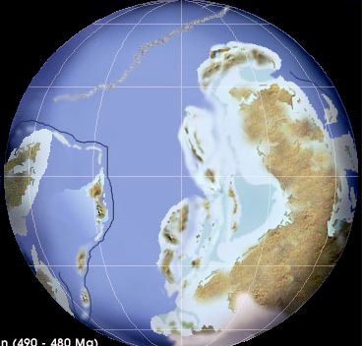
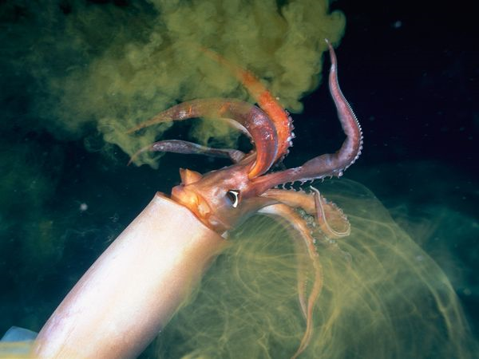
Ordovician
505 mya to 440 mya
Marine invertebrates
Early vertebrates

Slide 9
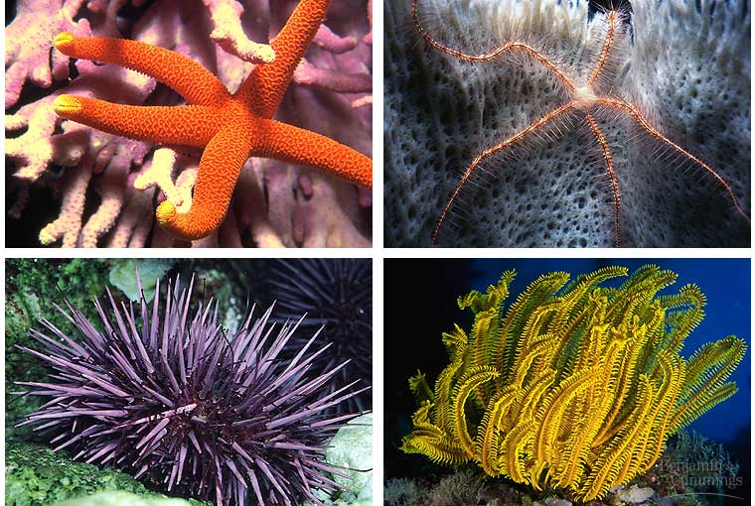
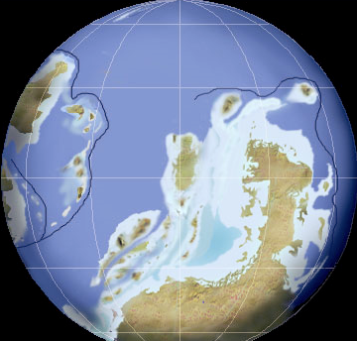
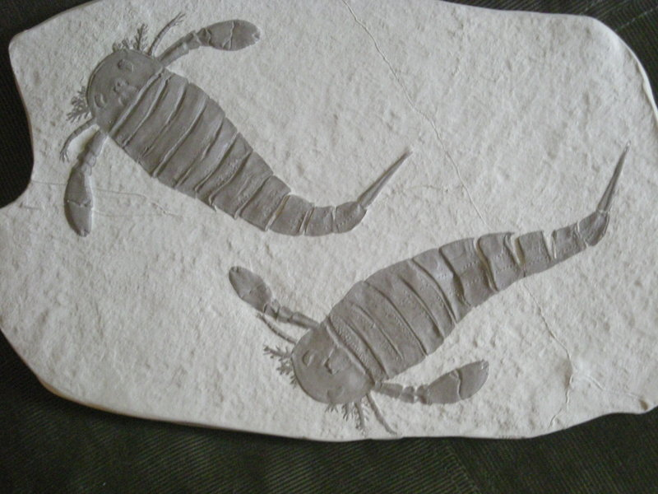
Silurian
440 mya to 410 mya
Coral reefs
Ancient plants and insects
Fish start to evolve

Slide 10
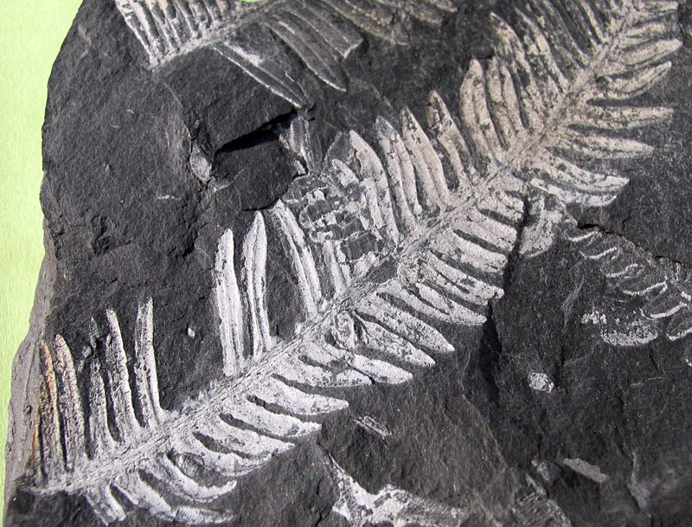
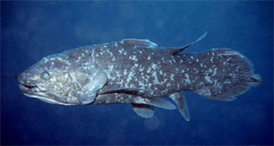
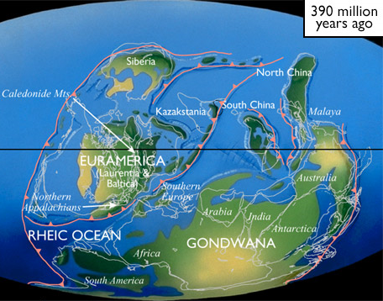
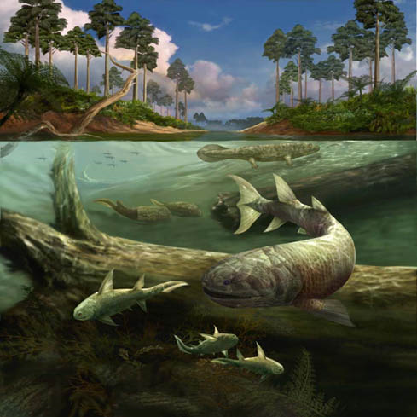
Devonian
410 mya to 360 mya
Ferns, seed plants appear
First Arthropods and tetropods

