Slide 1
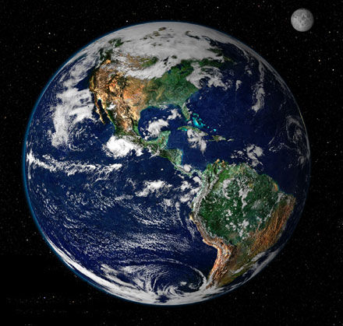
Earth Compared to Other Planets and Moons

Slide 2
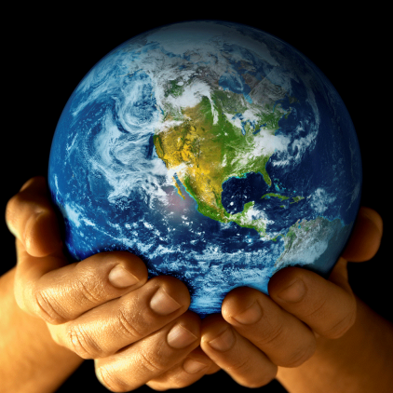
Earth
Atmosphere
  78% Nitrogen 21% Oxygen
  Ozone Layer protects from UV radiation
  Greenhouse gases
    Hold in heat and protect from meteorite impacts
Lithosphere
  Liquid core creates magnetic field
Temperature
  0 to 100 °F (20 to 50 °C)
Water
  Liquid water is abundant

Slide 3
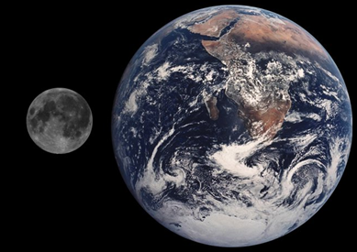
The Moon
Atmosphere
  Elements in solar winds (Hydrogen and Helium)
  Hammered by asteroids and meteorites
Lithosphere
  No magnetic field
  Past volcanoes?
Temperature
  Daytime: 260 °F (127 °C)
  Nighttime: -280 °F (-173 °C)
Water
  No evidence of water

Slide 4
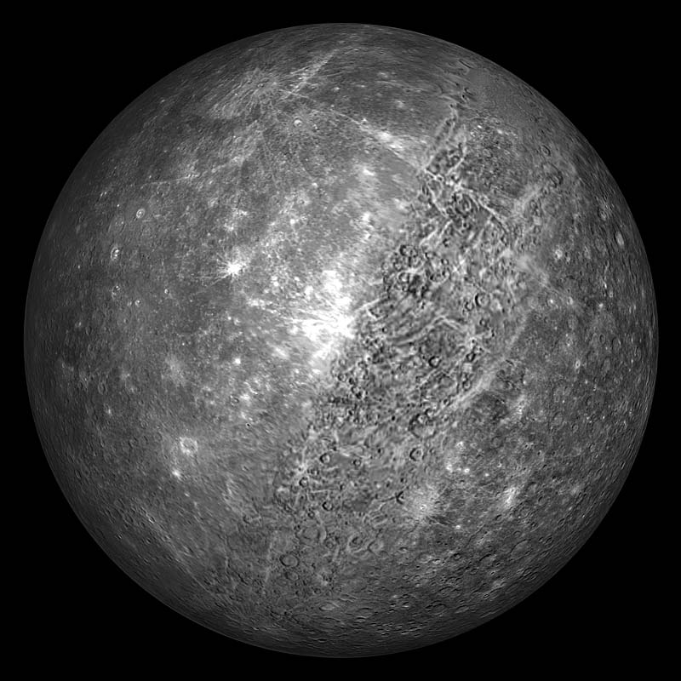
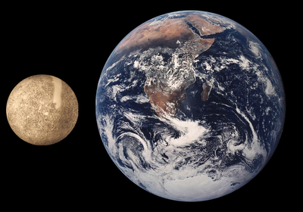
Mercury
Atmosphere
  Elements in solar winds (Hydrogen and Helium)
  Hammered by asteroids and meteorites
Lithosphere
  Little magnetic field (1% of Earth’s)
Temperature
  Daytime: 800 °F (427 °C)
  Nighttime: -290 °F -179 °C)
Water
  No evidence of water

Slide 5
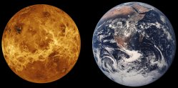
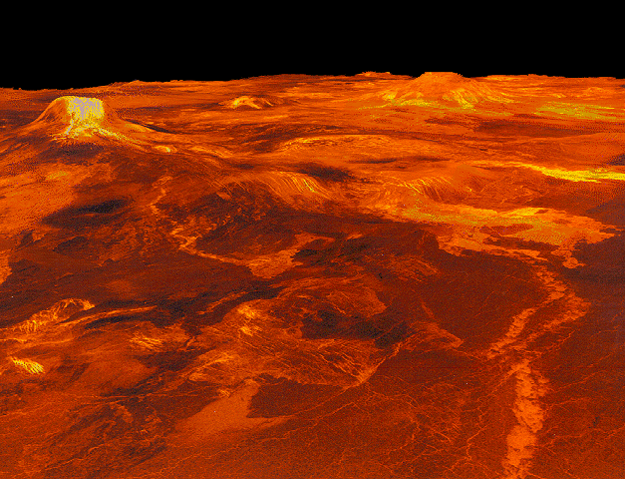
Venus
Atmosphere
  Thick atmosphere
  93x that of Earth
  96% Carbon Dioxide
Lithosphere
  Little magnetic field (1% of Earth’s)
  Volcanoes and mountains
Temperature
  880 °F (471 °C)
Water
  Traces of water vapor in the atmosphere

Slide 6
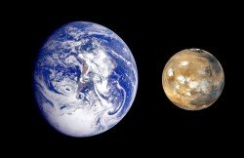
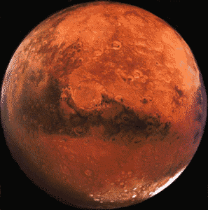
Mars
Atmosphere
  Thin
  95% Carbon Dioxide CO₂
  Cratered from meteorites hitting it
Lithosphere
  Evidence of past volcanoes and water
  Solid core: no magnetic field
Temperature
  Daytime: -25 °F ( -32 °C)
  Nighttime: -150 °F (-101 °C)
Water
  Water ice crystals in the soil

Slide 7
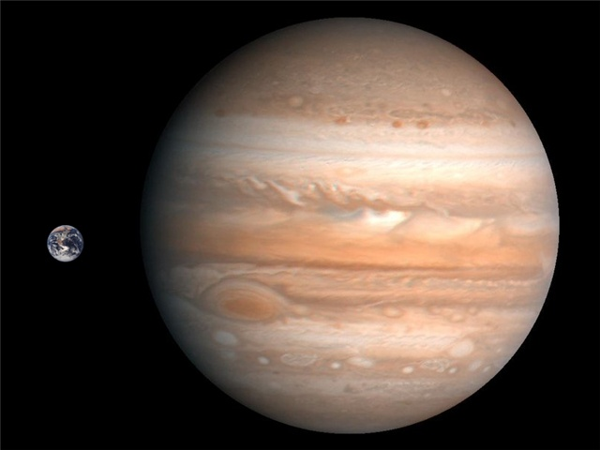
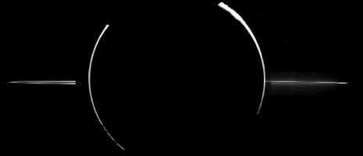
Jupiter
Atmosphere
  Thick! Hydrogen and Helium
  Clouds of ammonia and sulfur
Lithosphere
  Liquid metal in the core
  Strong magnetic field 14X larger than Earth’s
  Solid surface?
Temperature
  -230 to 70 °F -145 to 21 °C)
Water
  Water vapor in the atmosphere

Slide 8
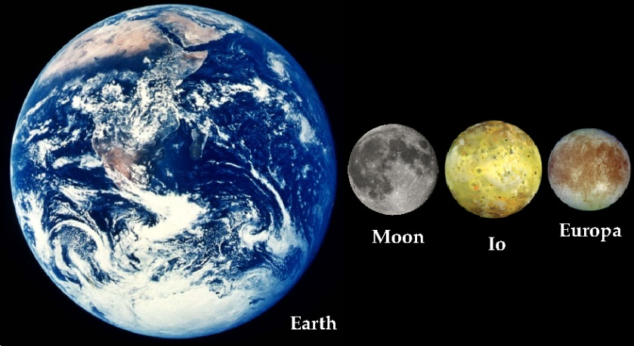
Io Europa
Atmosphere
  Sulfur dioxide SO₂
Lithosphere
  Covered in volcanoes
  Liquid core
  Tidal heating
Temperature
  -290 to 2240 °F
  -180 to 1227 °C
Water
  No liquid water
Atmosphere
  Mostly O₂ Gas
Lithosphere
  Frozen water 80-160 km thick (50-100 miles)
  Tidal heating from Jupiter
Temperature
  -275 °F (-171 °C)
Water
  ?? Maybe an ocean of water underneath the ice

Slide 9
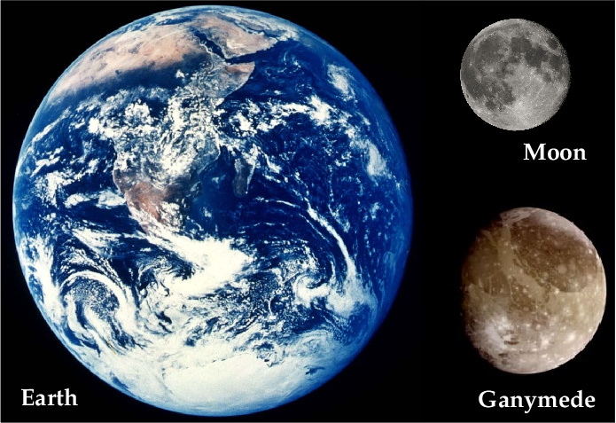
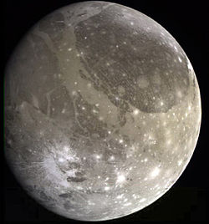
Ganymede
Atmosphere
  Thin oxygen O₂
  Craters
Lithosphere
  Liquid metal in the core: magnetic field
  Rocks and water ice
Temperature
  -290 to -170 °F -179 to -112 °C)
Water
  Frozen on the surface

Slide 10
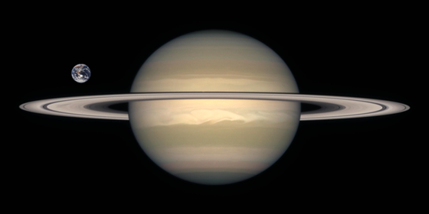
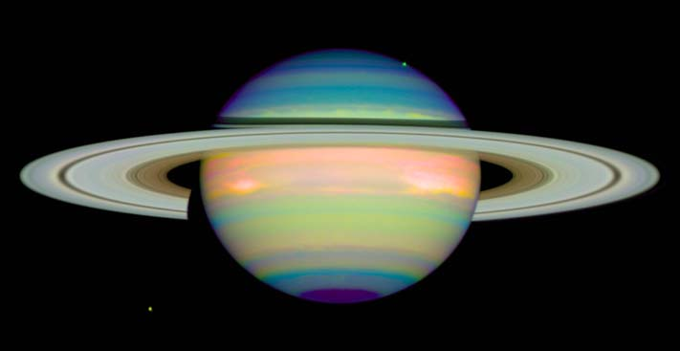
Saturn
Atmosphere
  Hydrogen and Helium
  Clouds of ammonia and sulfur
Lithosphere
  Magnetic field
  Rocks and metal core
Temperature
  -285 °F (-176 °C)
Water
  No evidence of liquid water

Slide 11
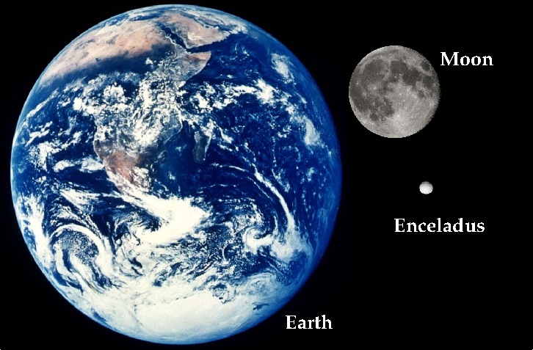
Enceladus
Atmosphere
  Mostly water vapor
  Reflects almost all of the sunlight that hits it
Lithosphere
  Tidal heating
  Liquid core
  Active water geysers
Temperature
  -330 °F (-201 °C)
Water
  Geysers: liquid water below surface?
  Water vapor in the atmosphere

Slide 12
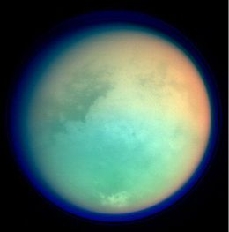
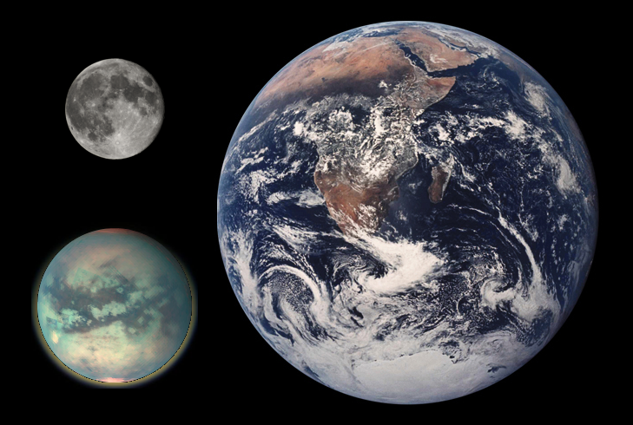
Titan
Atmosphere
  About as thick as Earth’s
  95% Nitrogen 3% Methane
Lithosphere
  Liquid and frozen methane
Temperature
  -290 °F (-178 °C)
Water
  No evidence of liquid water

Slide 13
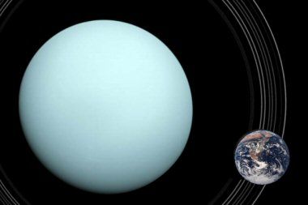
Uranus
Atmosphere
  Hydrogen, Helium and Methane
Lithosphere
  Mostly liquid and gases
  Small rocky core
Temperature
  -355 °F (-204 °C)
Water
  Liquid water with ammonia dissolved in it

Slide 14
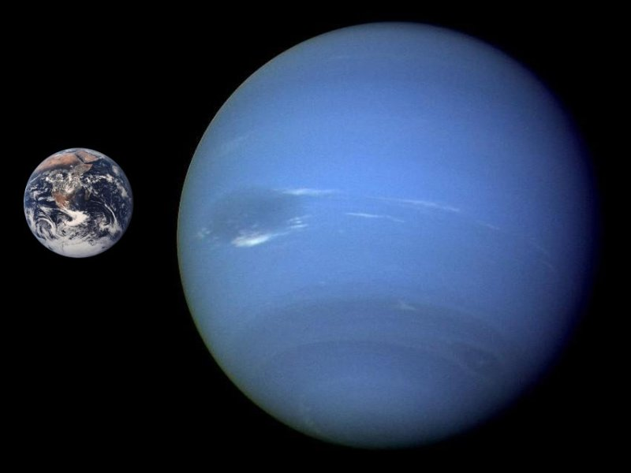
Neptune
Atmosphere
  Hydrogen, Helium and Methane
  Winds up to 750 mph
Lithosphere
  Rocks and methane ice
  Magnetic field 17X Earth’s
Temperature
  -390 °F
Water
  No evidence of liquid water

Slide 15
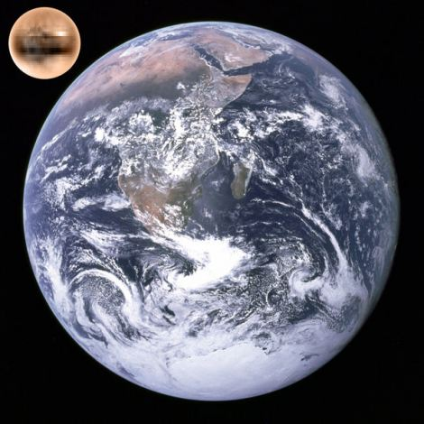
Pluto
Atmosphere
  Thin
  Methane and nitrogen
Lithosphere
  Rocky
  Nitrogen and methane ice
Temperature
  -375 °F (-226 °C)
Water
  No evidence of liquid water

Slide 16
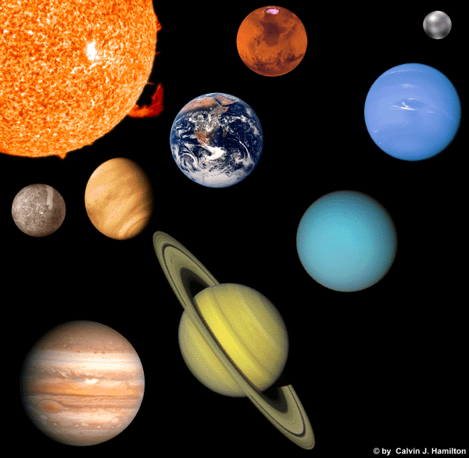
Which planet or moon would be most habitable?
In your groups, decide which planet or moon we talked about would be the easiest for humans or any organism to live on.
In your packet, write a paragraph (4-6) explaining why you picked that planet or moon and what life forms would need to survive there.

