Slide 1
Astronomy Technology

Slide 2
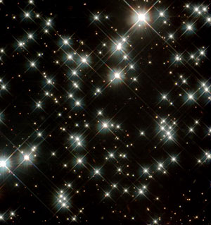
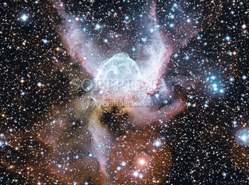
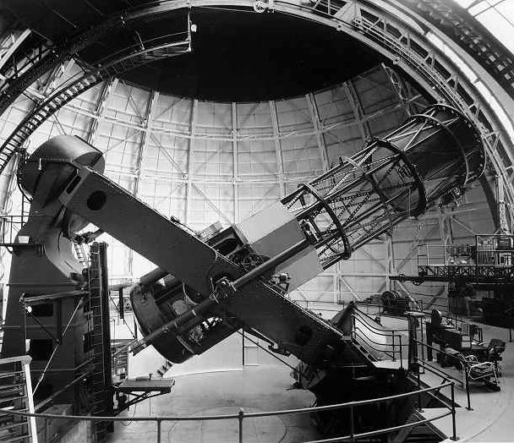
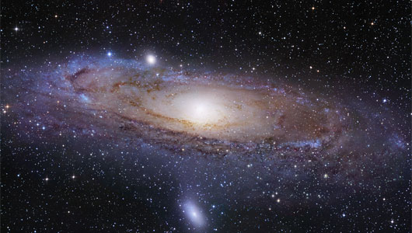
Studying the Sky
Observation
  Star gazing
  Keeping records
  Telescopes

Slide 3
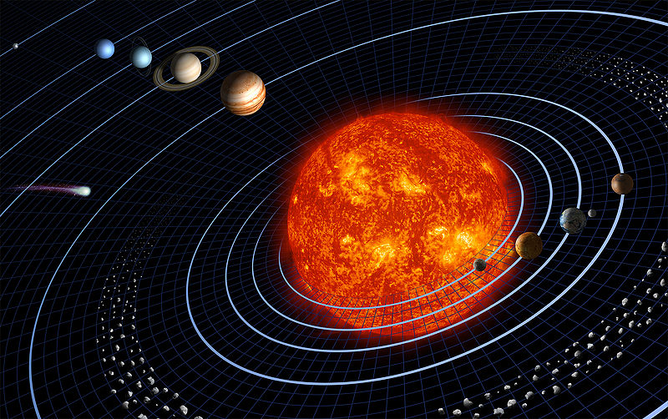
Laws of Physics
Universal Laws of Nature
  Newton
    Laws of Motion
    Law of Gravity
  Kepler
    Laws of Planetary
    Motion

Slide 4
Universal Gravitation
F_{gravity} is proportional m₁ * m₂ / d
Where F is the gravitational force between two planets
M1 is the mass of the first planet
M2 is the mass of the second planet
D is the distance between them.
http://www.physicsclassroom.com/class/circles/Lesson-3/Newton-s-Law-of-Universal-Gravitation

Slide 5
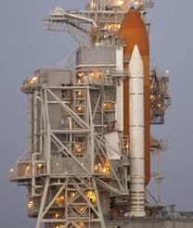
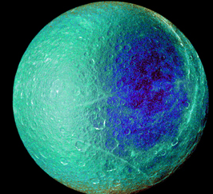
Technology
NASA
  Spectroscopes (tell element given off)_
  Space flights
  Hubble telescope
  Kepler telescope
  International Space Station
  Robotic Spacecraft Missions
  Probes

Slide 6
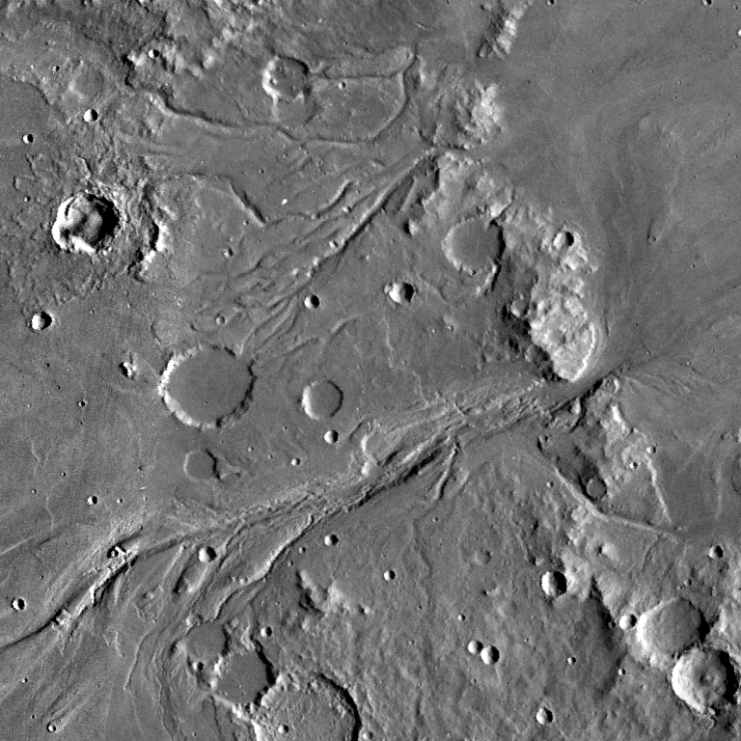
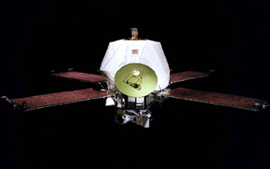
Mariner 9 1971

Slide 7
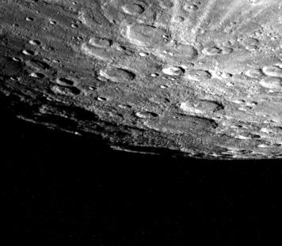
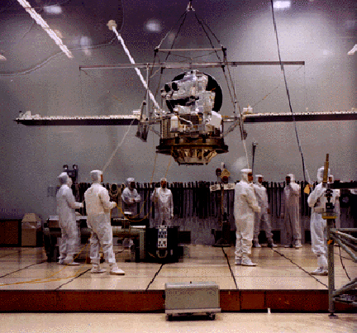
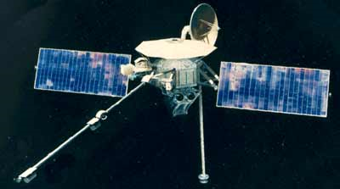
Mariner 10 1973

Slide 8
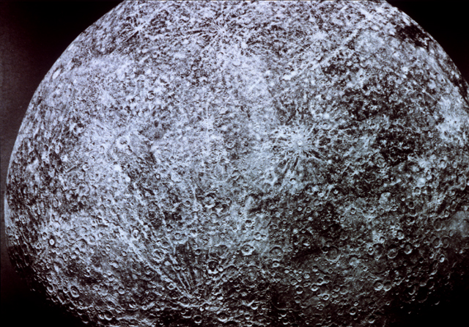
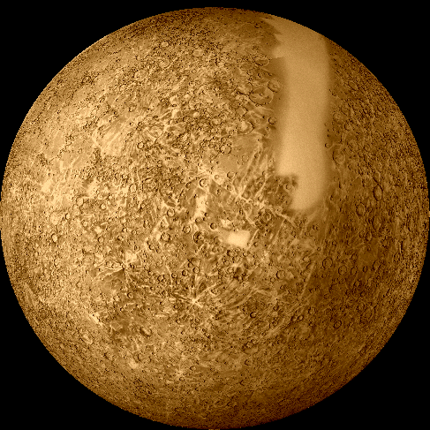

Slide 9
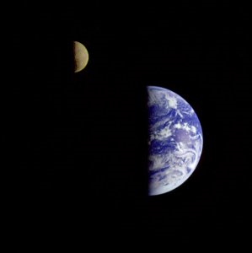
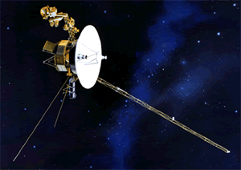
Voyager 1 & 2 1977
http://voyager.jpl.nasa.gov/index.html

Slide 10
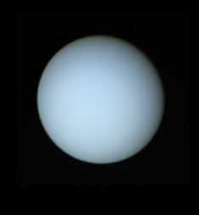
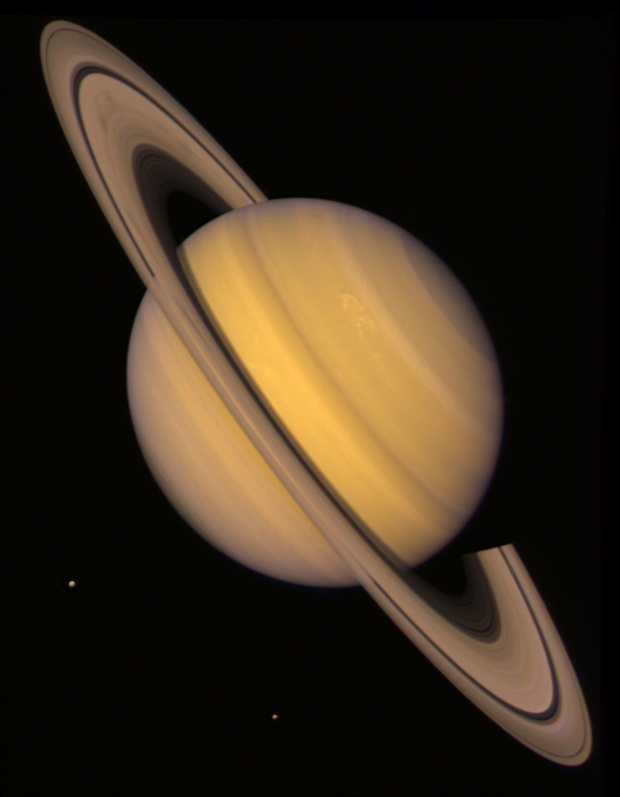
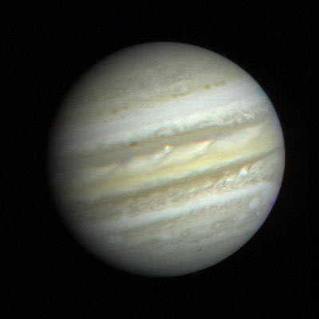
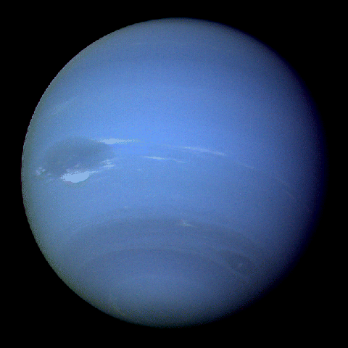

Slide 11
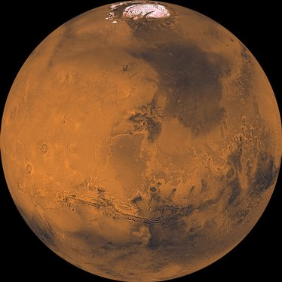
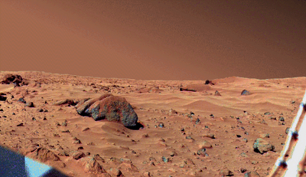
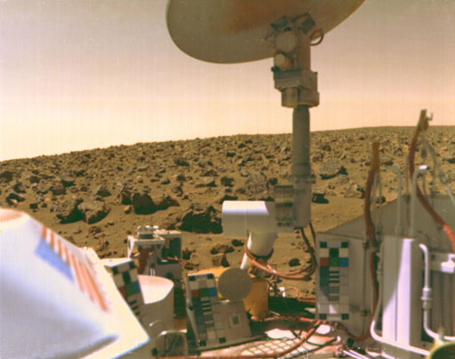
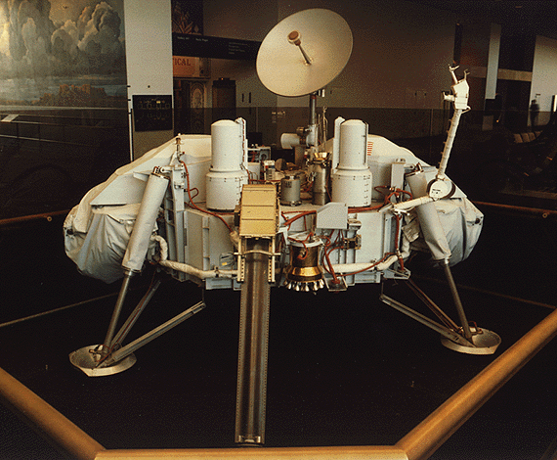
Viking 1975-1976

Slide 12
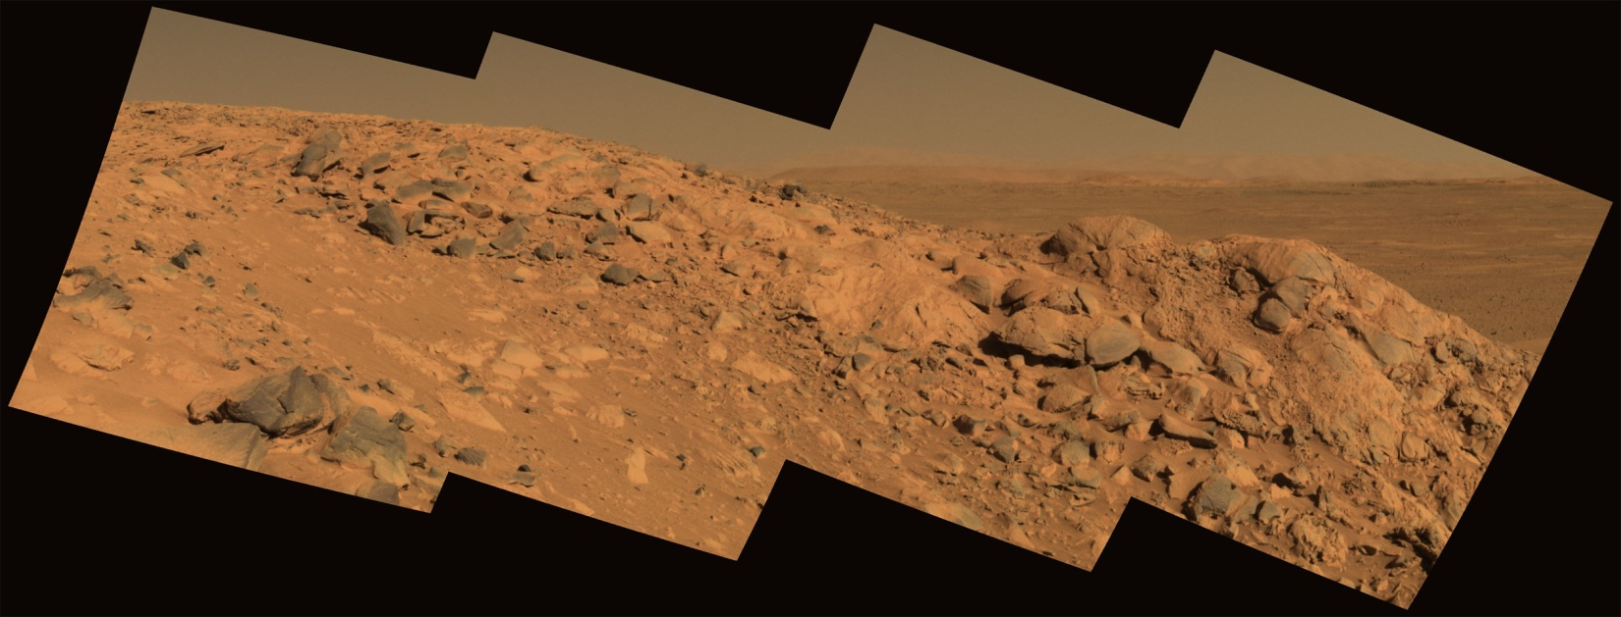
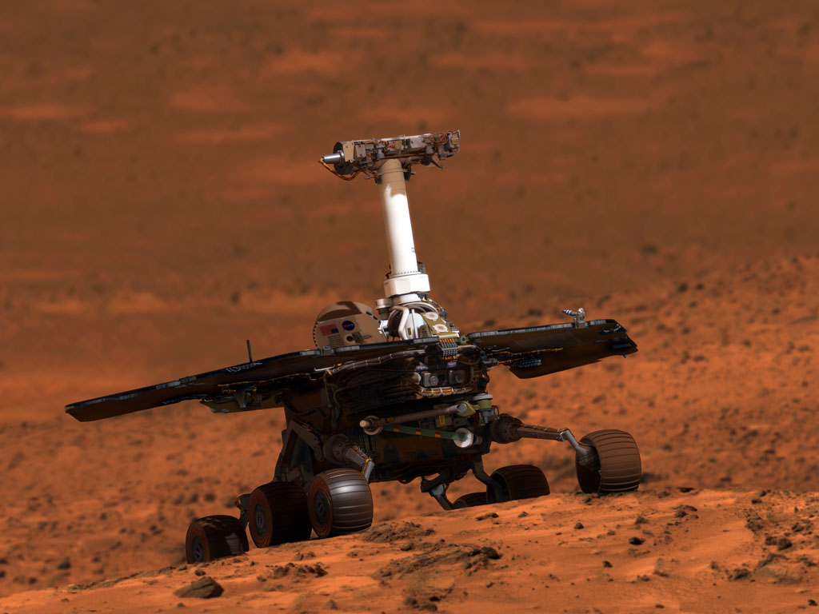
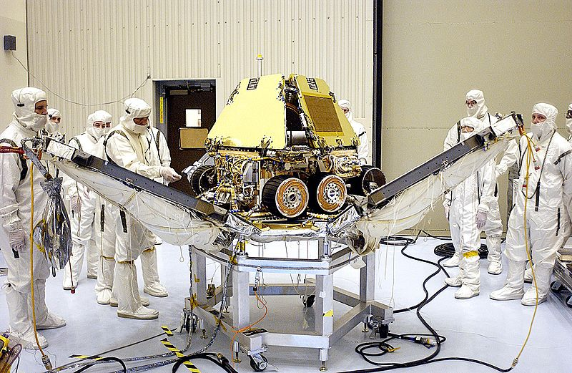
Spirit and Opportunity: 2003

Slide 13
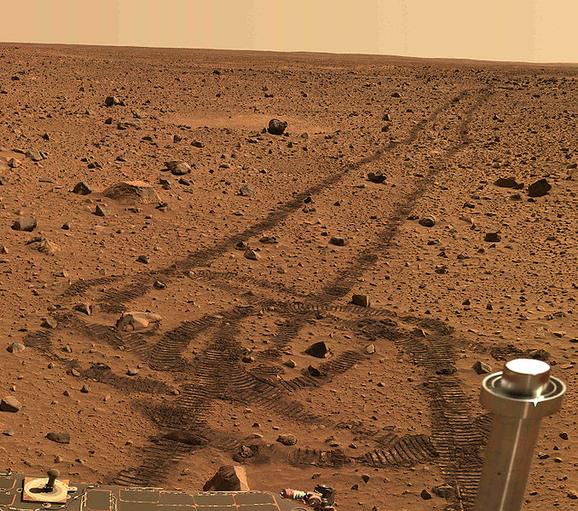

Slide 14
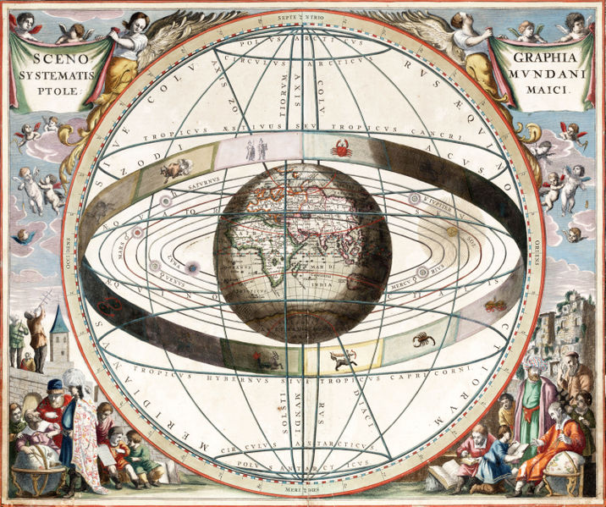
Geocentric Model
Geocentric Model:
  Belief that the Earth is the center of the solar system
(Early civilizations)

Slide 15
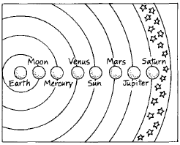

Slide 16
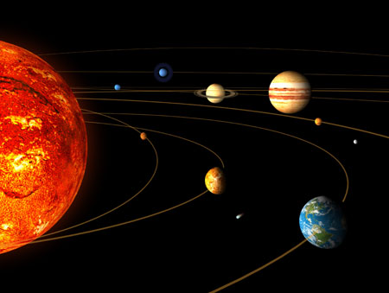
Heliocentric Model
  Belief that the sun is the center of solar system
  (Current belief)

Slide 17
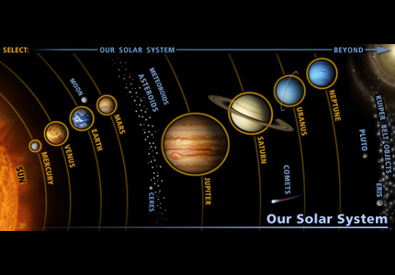

Slide 18
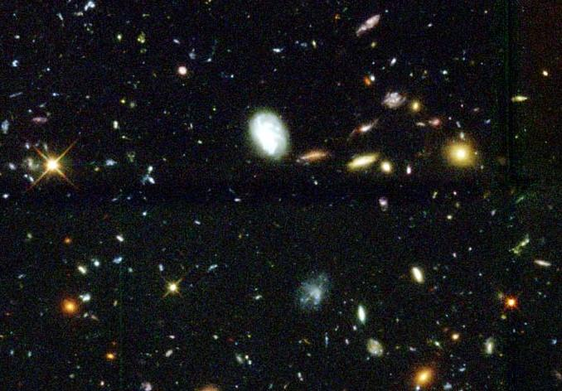
Island Universe Hypothesis: 1755
The Milky Way galaxy is just one of many galaxies in an enormous universe
  Most scientists agree

Slide 19
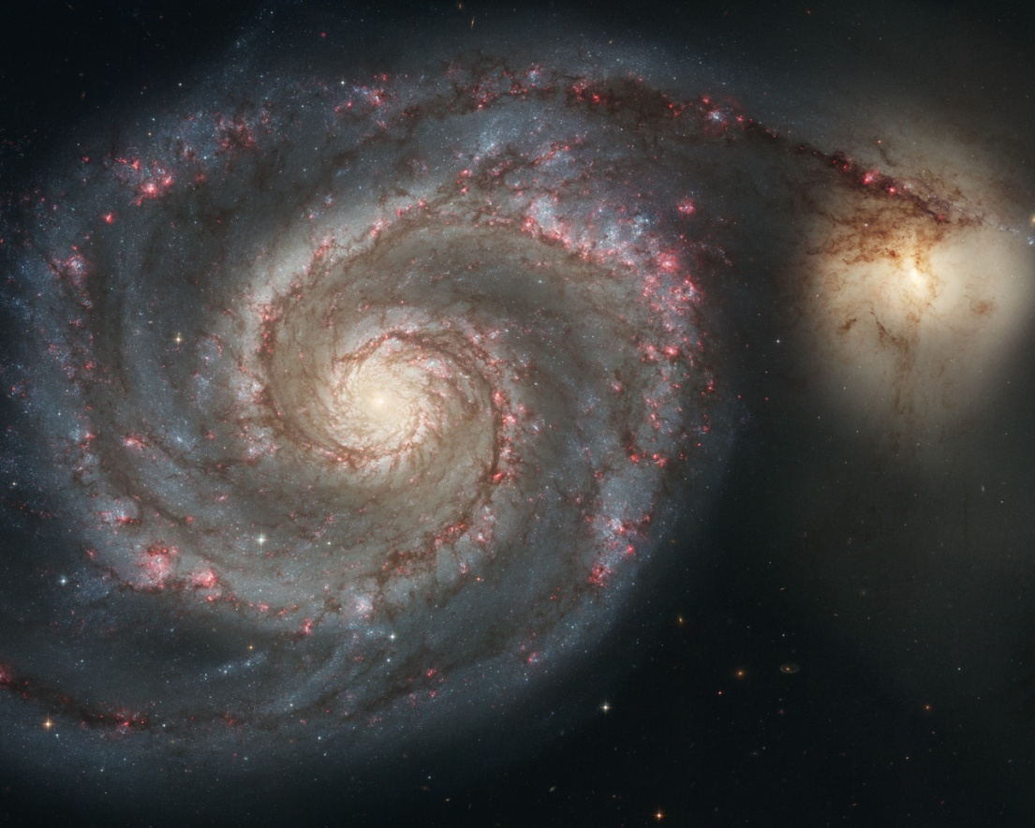
Nebulae Hypothesis 1796
The Milky Way IS the universe
  There are no other galaxies because the universe is not that large

Slide 20
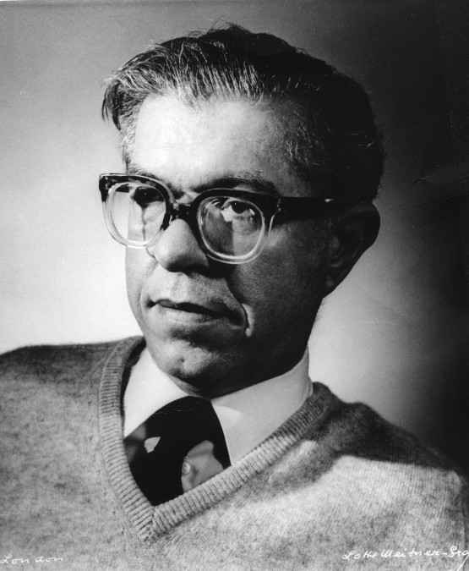
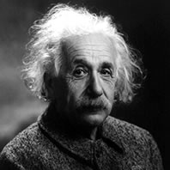
Steady State Theory 1917
The universe neither expanding nor contracting
Einstein: there is a counter-balancing force that keeps gravity from collapsing the universe in on itself

Slide 21
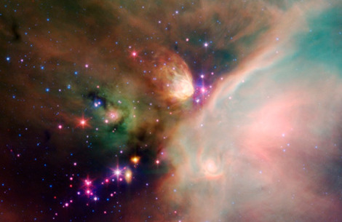
Expanding Universe Theory: 1925
The universe is continually moving outward from a single point of origin

Slide 22
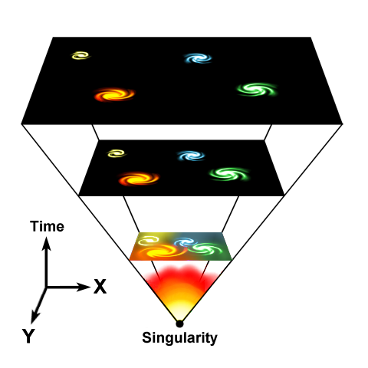
Big Bang Theory
13.8 billion years ago, the universe was very dense and hot; since then it has expanded and continues to expand becoming less dense and cooler

Slide 23
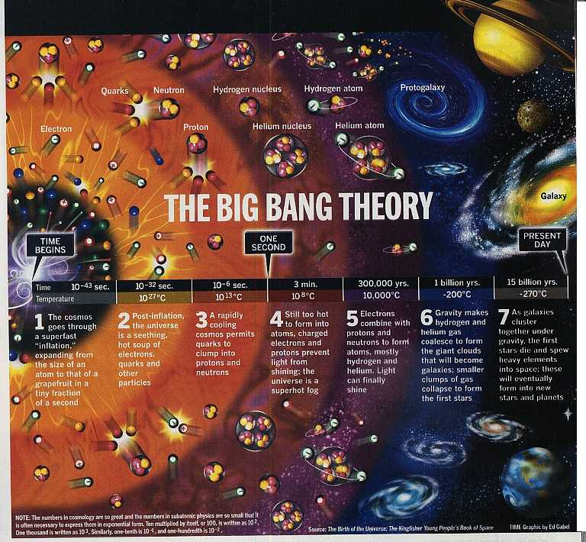

Slide 24
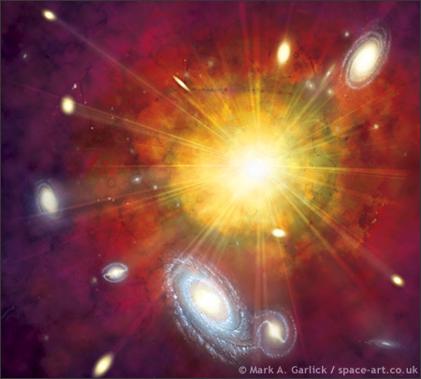
Big Bang Theory
For the big bang theory to be true…
1. The universal laws of physics must hold true throughout the entire universe
2. The small part of the universe which we can observe must be a good sample of what is happening everywhere in the universe

Slide 25
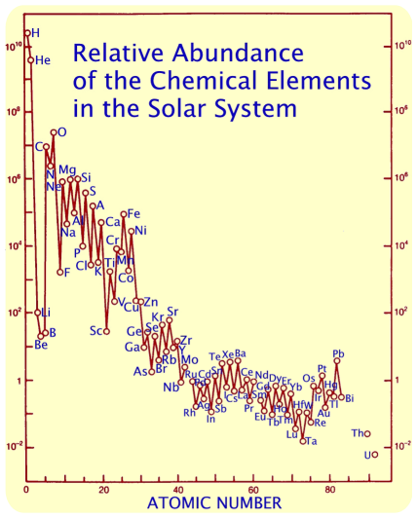
1. Abundance of light elements
The ratio of hydrogen to helium throughout the universe is constant
Scientists can estimate how long it has taken to make heavier elements

Slide 26
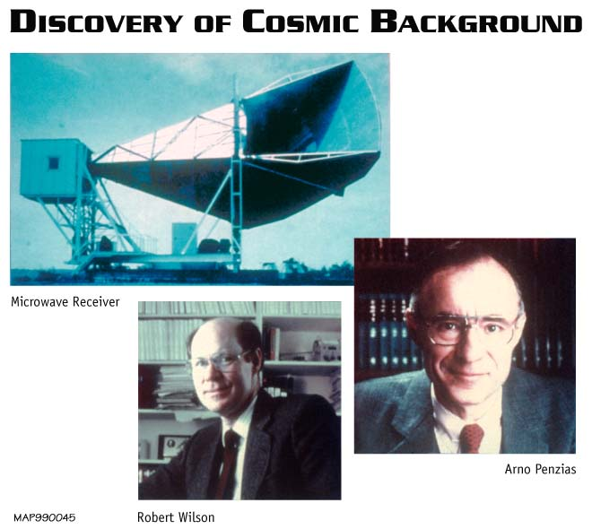
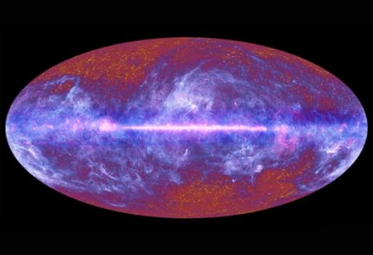
2. Background Microwave Radiation
1964: Penzia and Wilson
There is background radiation left over from the Big Bang

Slide 27
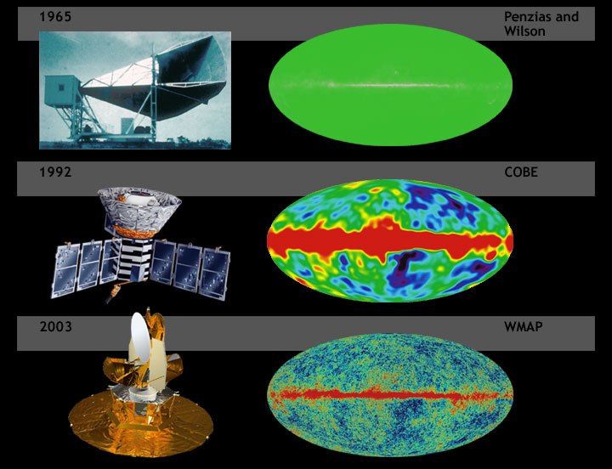

Slide 28
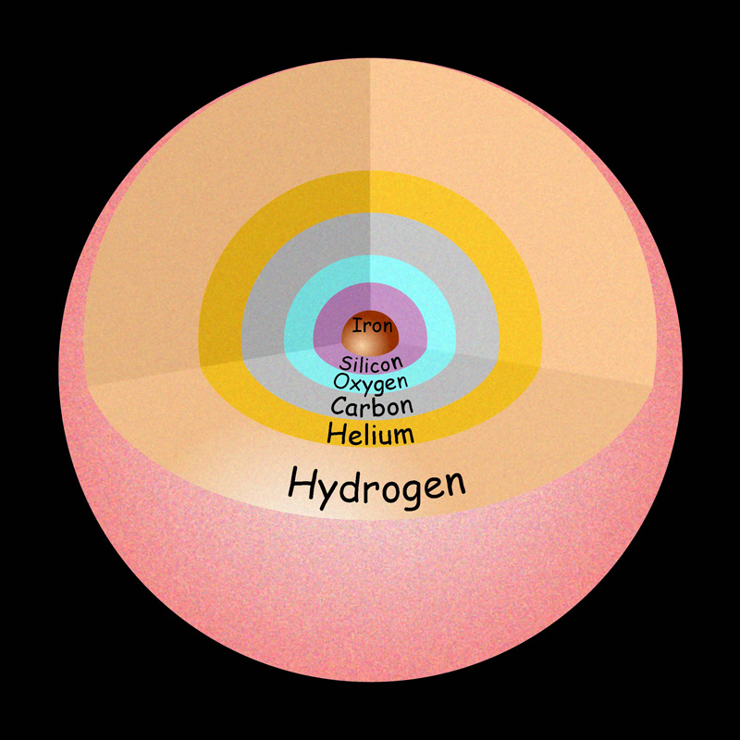
3. The Evolution of Stars
Scientist observe stars in all different stages so they can calculate how old the stars are
Oldest stars are white dwarfs: 10 billion years old

Slide 29
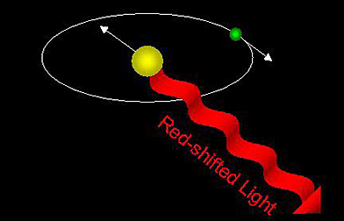
4. Hubble’s Red Shift of Light
If a distant object is moving away, its light will shift towards the red end of the light spectrum

Slide 30
The Big Rip Theory
The universe is expanding faster and faster and someday it will be going so fast it will rip itself apart

Slide 31
The Big Crunch Theory
Someday the universe will reach a maximum size and it will turn around and start collapsing
  Might produce another “Big Bang” expansion

