Slide 1
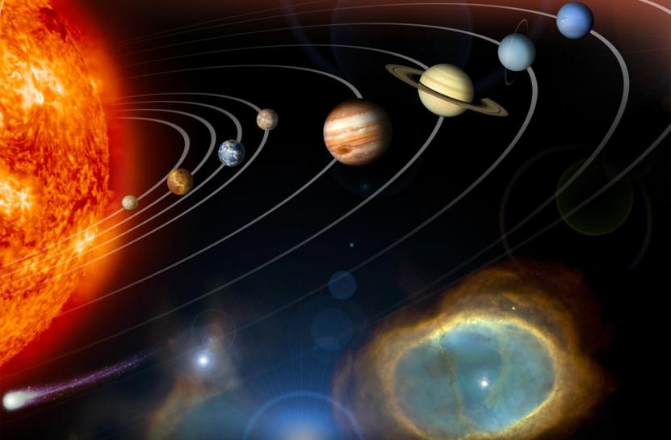
The Planets

Slide 2
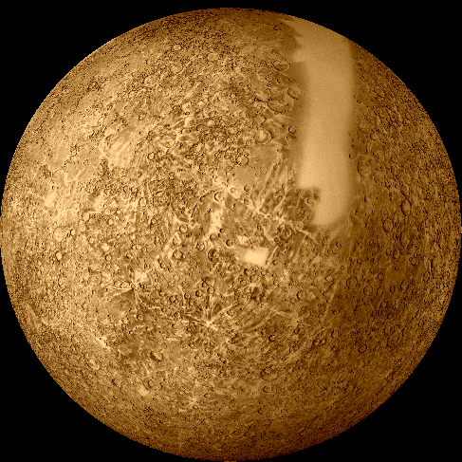
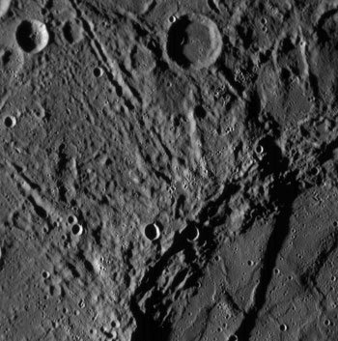
Mercury
The Messenger God
Closest planet to the Sun
0.39 AU
Main gases: Na, O, He
-300 °F at night
800 °F during the day
No moons
1 day = 59 Earth Days
1 year = 88 Earth days
Surface is cratered
Smallest planet
Widest range of temperatures

Slide 3
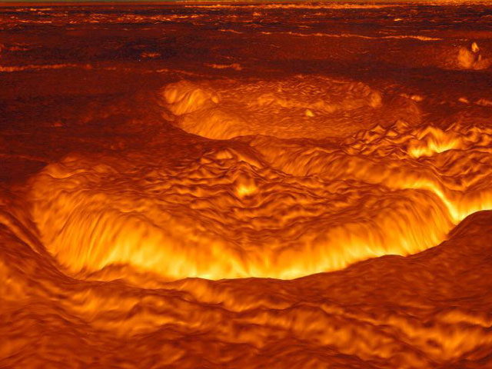
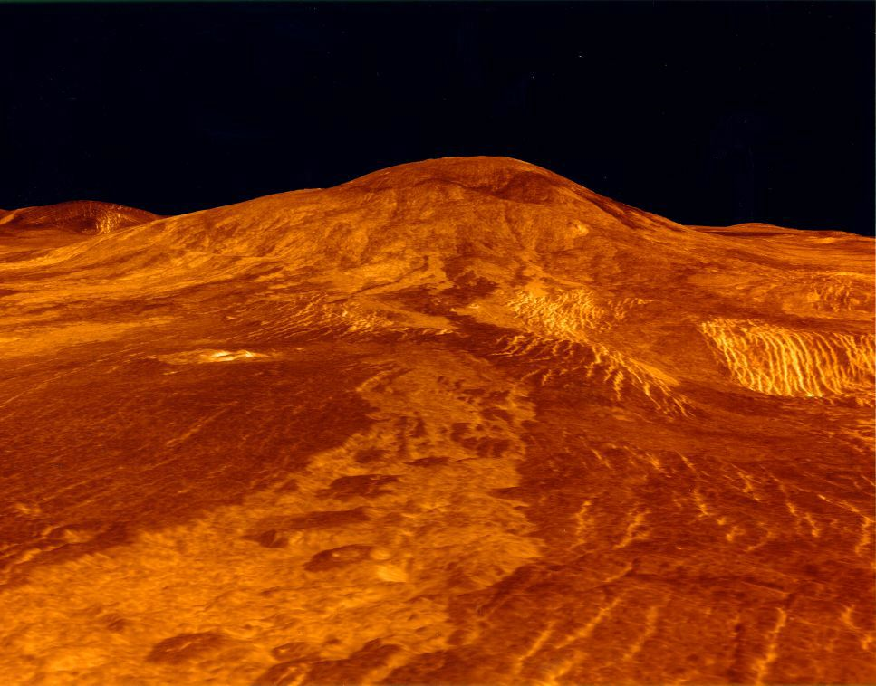
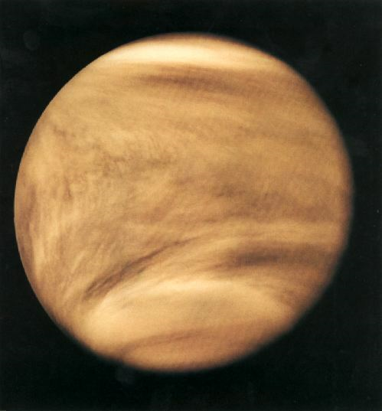
Venus
Goddess of love and beauty
2nd planet from the Sun
0.72 AU
Mostly CO₂, N₂, SO₂
855 °F
No moons
1 day = 243 Earth days
1 year = 225 Earth days
Runaway greenhouse effect
Retrograde motion
Volcanic activity
Hottest planet

Slide 4
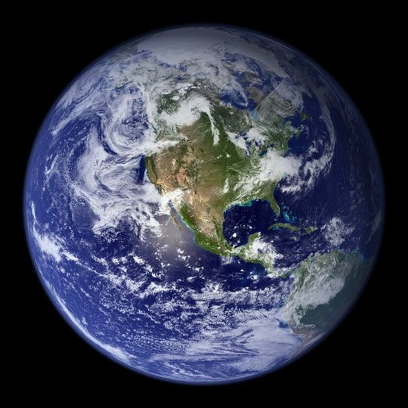
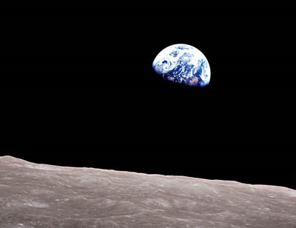
Earth
Terra
3rd planet from the Sun
1 AU
N₂, O₂, Ar, CO₂, H₂O
45 ⁰F
1 Moon
1 day = 24 hours
1 year = 365.3 days
Only planet with life
Tectonic plate movement creates internal heat and magnetic field
Vast amounts of liquid water

Slide 5
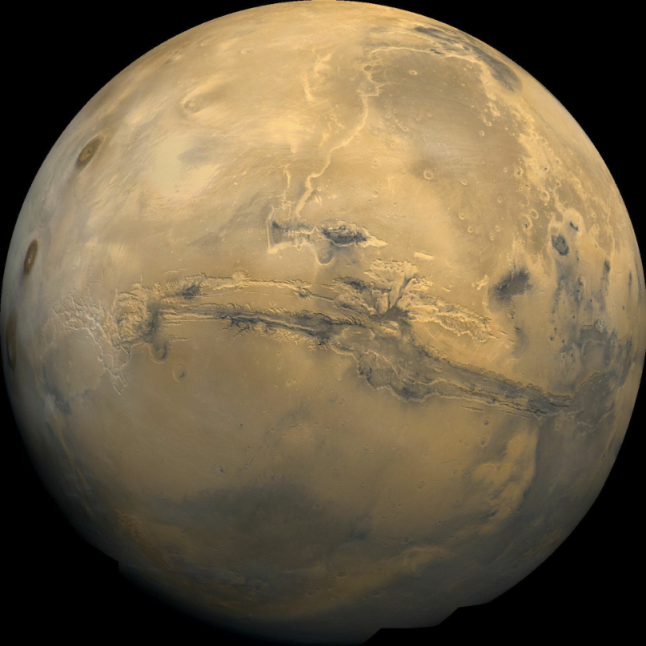
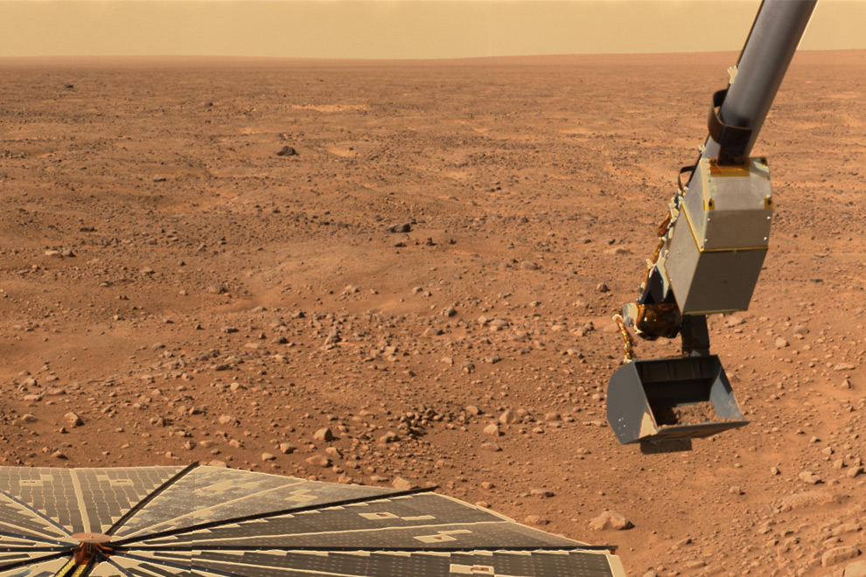
Mars
God of War and Bloodshed
4th planet from the Sun
1.52 AU
Thin atmosphere CO₂, N₂, Ar
-82 ⁰F
2 Moons
1 day = 24.6 hours
1 year = 687 days
Most Earth-like environment
Polar ice cap
Evidence of past oceans and volcanoes
Most robotic space mission sent there

Slide 6
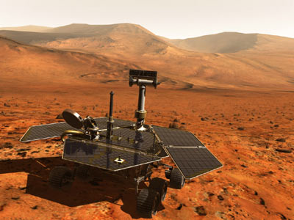
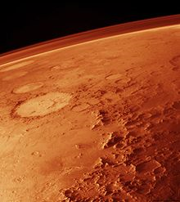
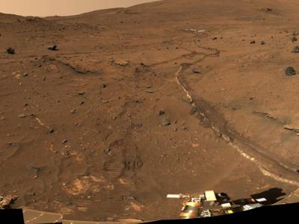
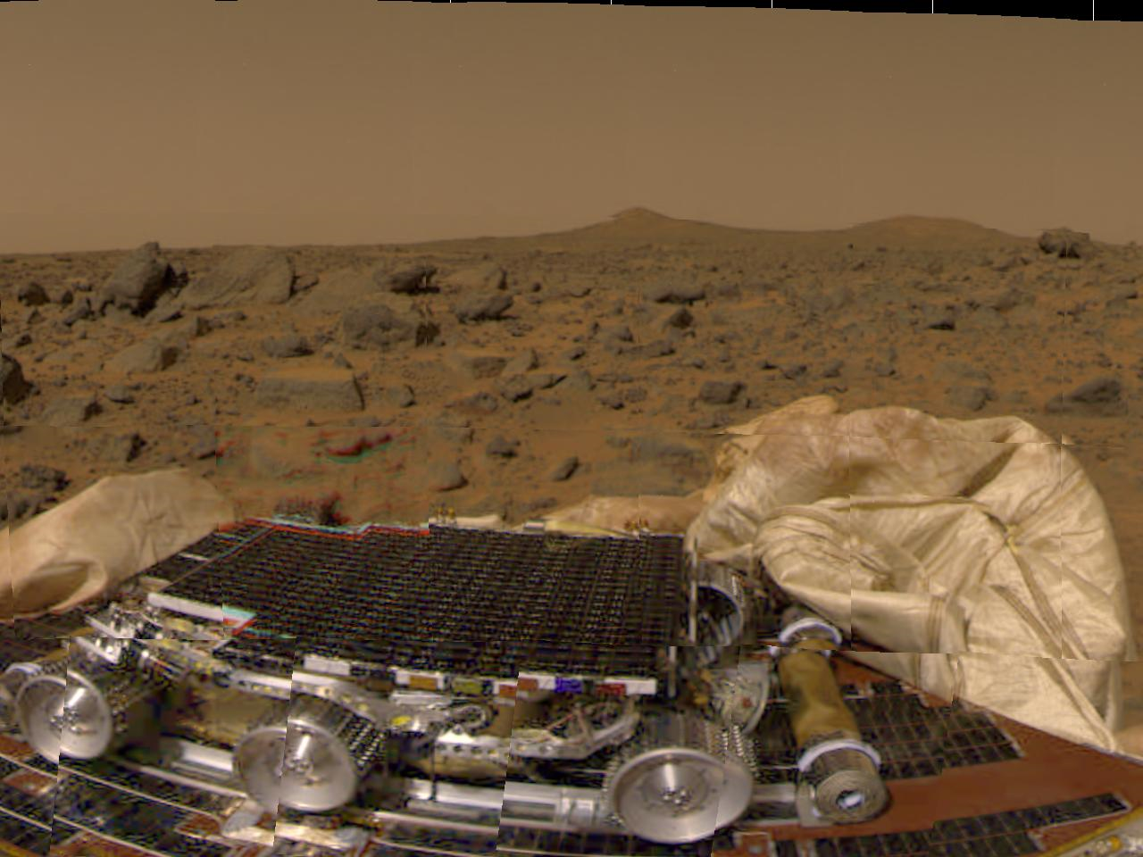

Slide 7
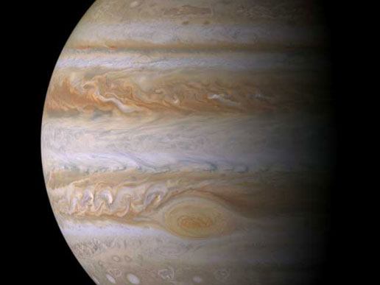
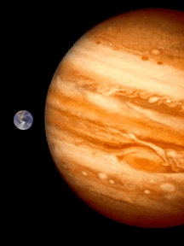
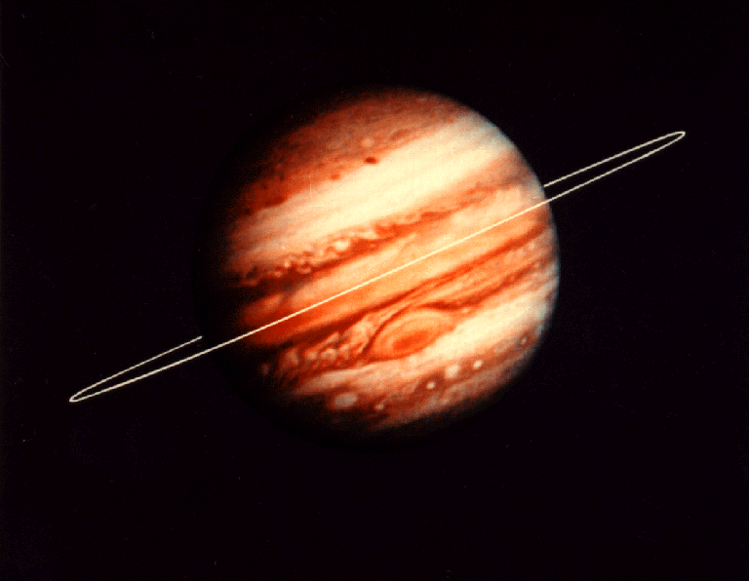
Jupiter
God of the gods (Zeus)
5th planet from the Sun
5.2 AU
H, He
-235 °F
66 moons
1 day = 9.9 hours
1 year = 11.86 years
Gas giant
Largest planet
1 ring
Giant Red Spot Storm

Slide 8
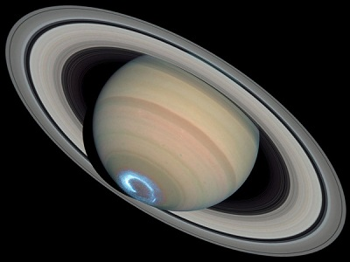
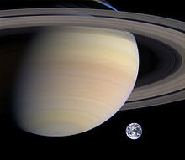
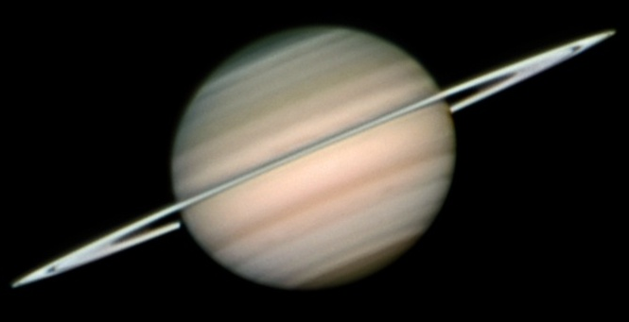
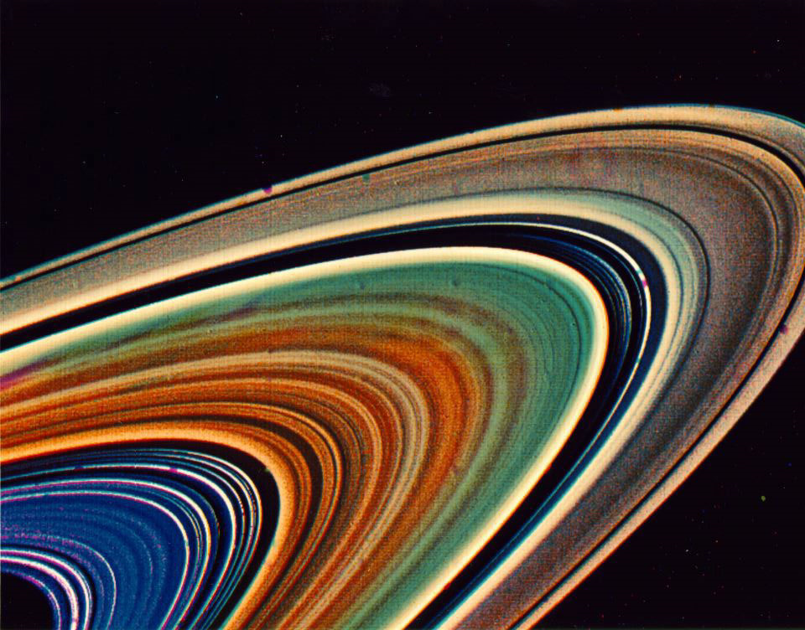
Saturn
Jupiter’s Grandfather
6th planet from the Sun
9.5 AU
Mostly H, He
-289 °F
63 moons
1 day = 10.7 hours
1 year = 29.5 years
Gas giant
Large ring system
Less dense than water
Has auroras at the poles

Slide 9
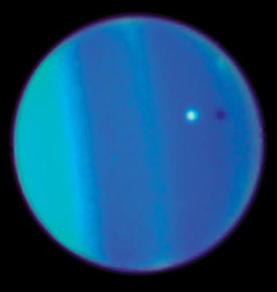
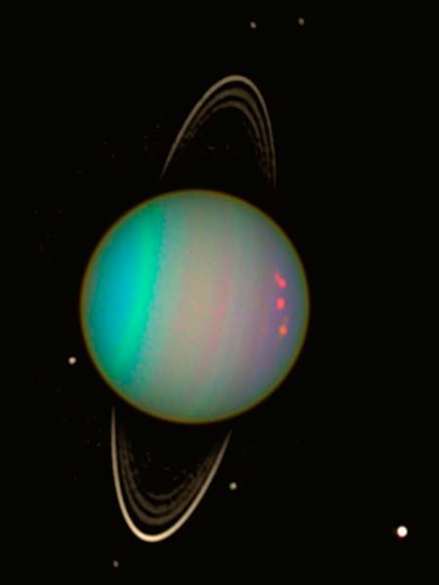
Uranus
God of the Sky
7th planet from the Sun
19.2 AU
Hydrogen, Helium, Methane
-352 °F
27 Moons
1 day = 17.2 hours
1 year = 84 years
Ice Giant
Tilted 98°
Has a ring system

Slide 10
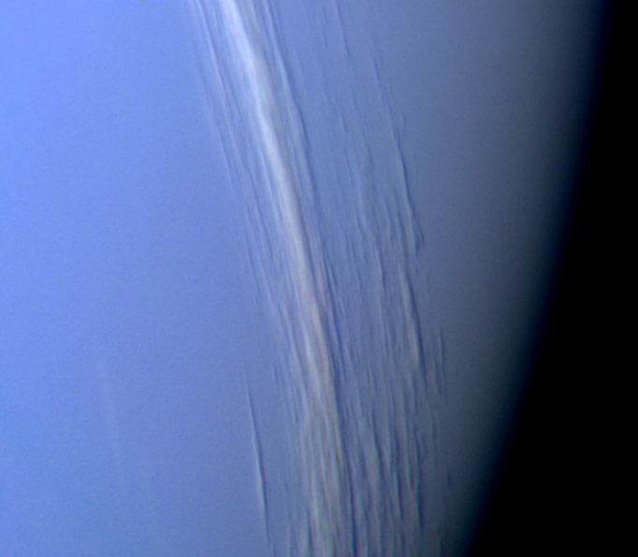
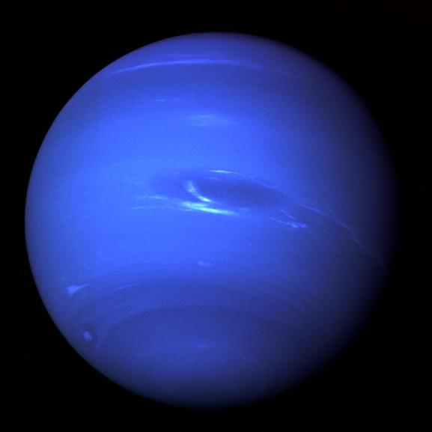
Neptune
God of the Sea
8th planet from the Sun
30.1 AU
Hydrogen, Helium and Methane
-355 °F
13 Moons
1 day = 16.1 hours
1 year = 164 years
Great dark spot: storm
2 rings
Ice giant

Slide 11
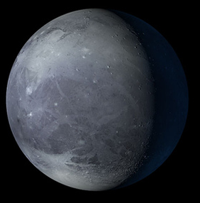
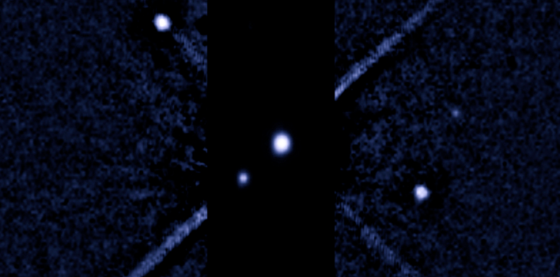
Pluto
God of the Underworld
9th planet from the Sun
39.5 AU
Nitrogen and methane
-388 °F
3 moons
1 day = 6.5 days
1 year = 248.5 years
Smaller than our Moon
Rocks and Nitrogen ice
One of its moons is almost as large as Pluto

Slide 12
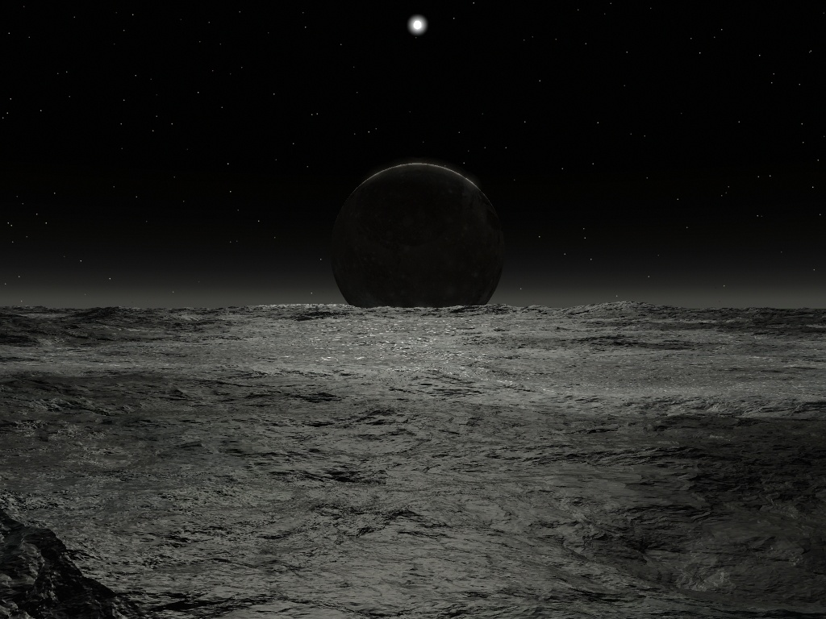
What the Sun would look like from Pluto

Slide 13
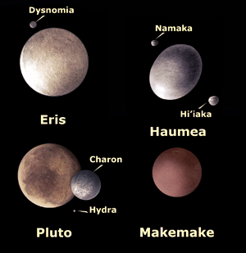
Dwarf Planets
A planet that does not dominate the region of space it is in
  Orbits the sun.
  Has enough mass to assume a nearly round shape.
  Has not cleared the neighborhood around its orbit.
  Is not a moon.

Slide 14
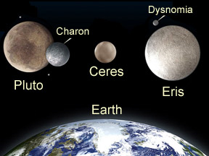
Dwarf Planets
Eris: Goddess of Discord
  1 moon
  Found in the Kuiper Belt
  557 years = 1 year
Ceres: Goddess of Harvest
  No moons
  Located in the asteroid belt
  Discovered in 1801

Slide 15
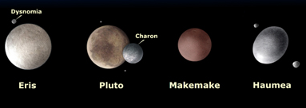
Dwarf Planets
Makemake: God of Fertility
  No moons
  Located in the kuiper belt
  310 years = 1 year
Haumea: Goddess of Fertility
  2 moons
  Located in the kuiper belt
  285 years = 1 year

