Slide 1
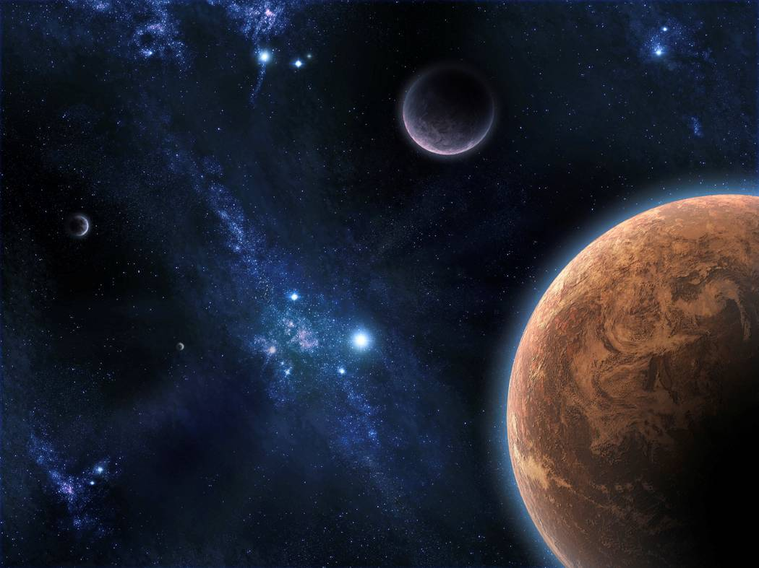
Astronomy
The study of celestial objects that originate outside of the Earth’s atmosphere and is depended upon technology available.
Astronomy is the oldest of the sciences

Slide 2
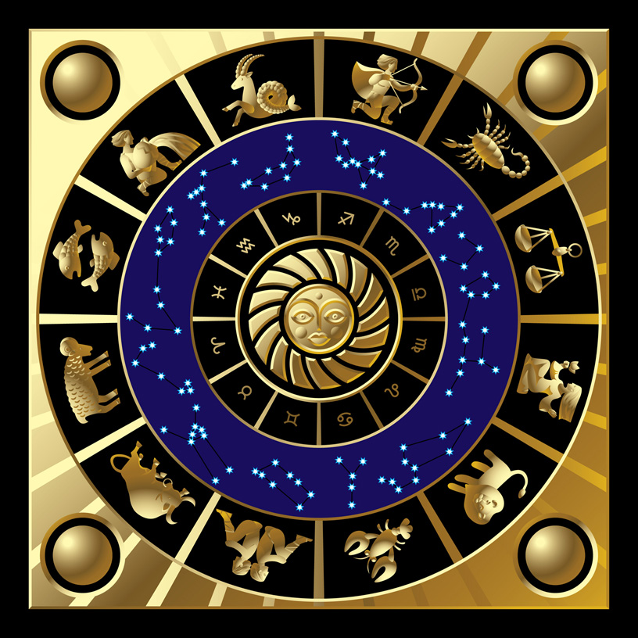
Astrology
The belief that the position of the Sun and the Stars affect your life

Slide 3
Ancient Man
Studied the skies for:
Navigation
Telling time
Planting and harvesting crops
Making Calendars
Worshiping their gods

Slide 4
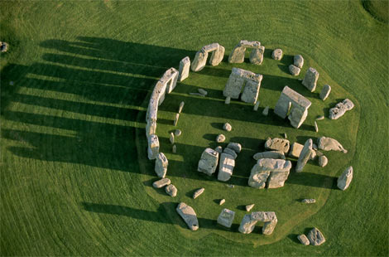
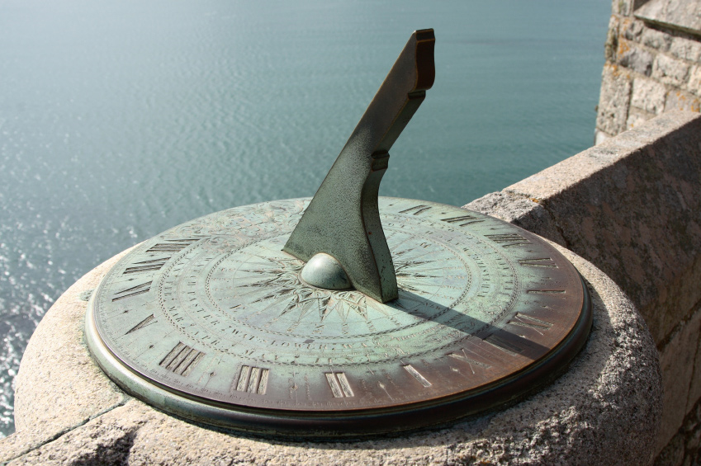
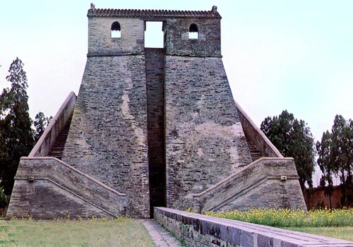
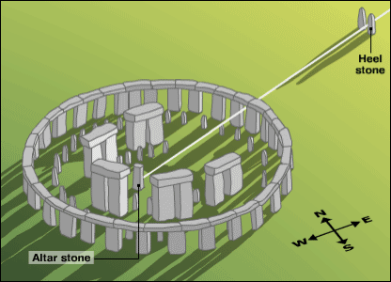

Slide 5
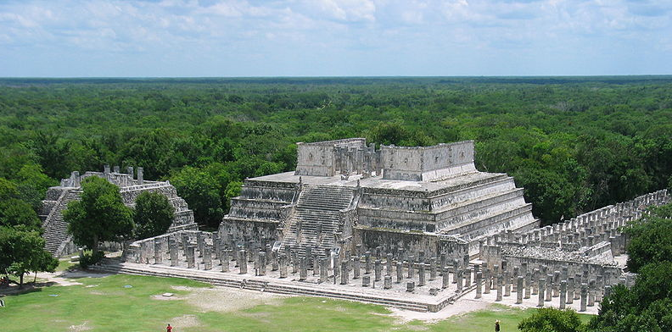
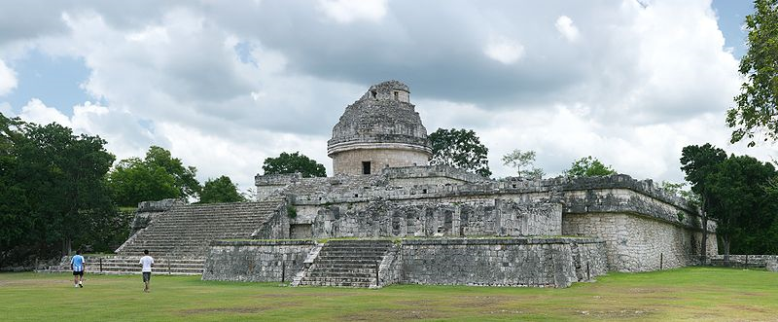

Slide 6
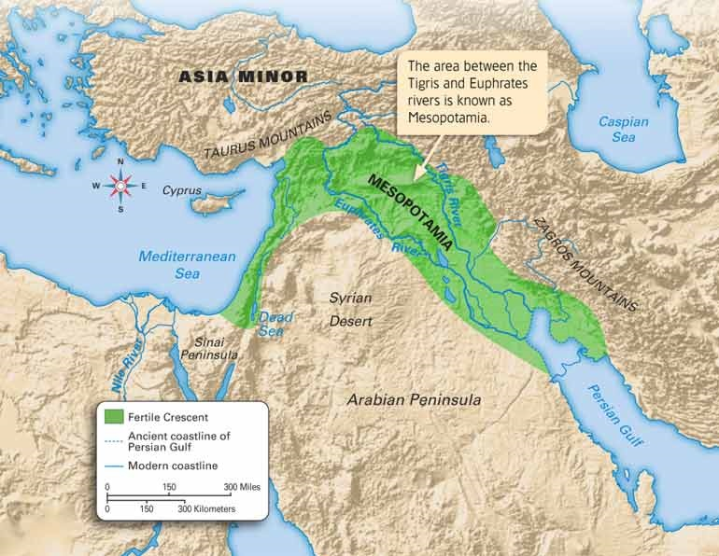

Slide 7
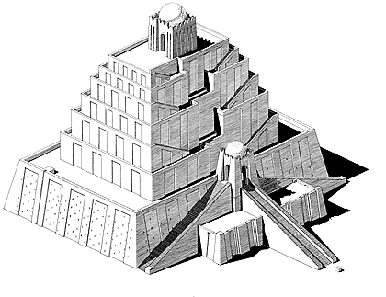
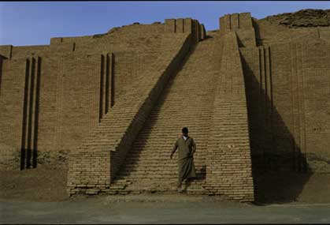
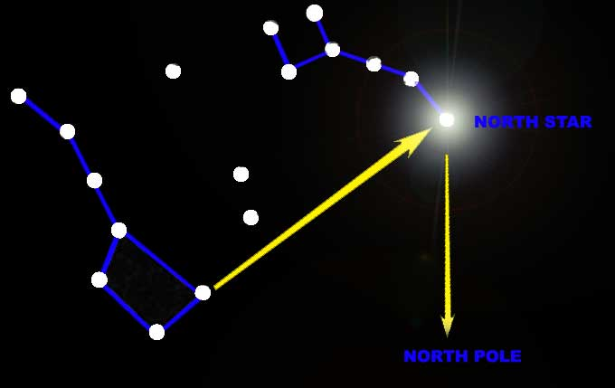
Mesopotamians
Built observatories called ziggurats
Named brighter stars and planets

Slide 8
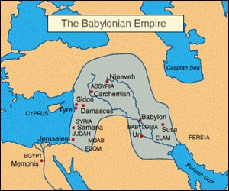
Babylonians

Slide 9
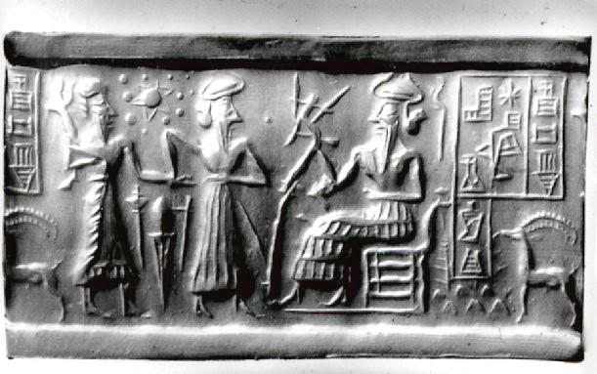
Babylonians
Tracked the movement of planets
Kept records of star and planet movement

Slide 10
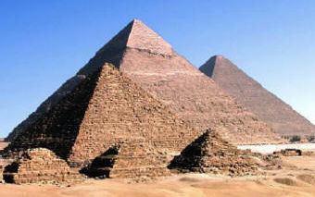
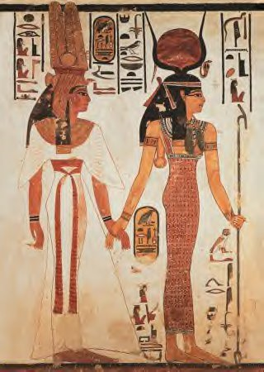
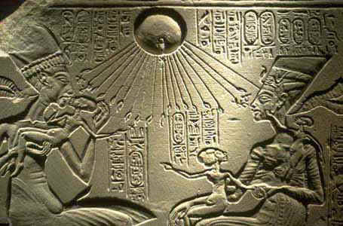
Egyptians
Aligned their pyramids with the Sun and stars

Slide 11
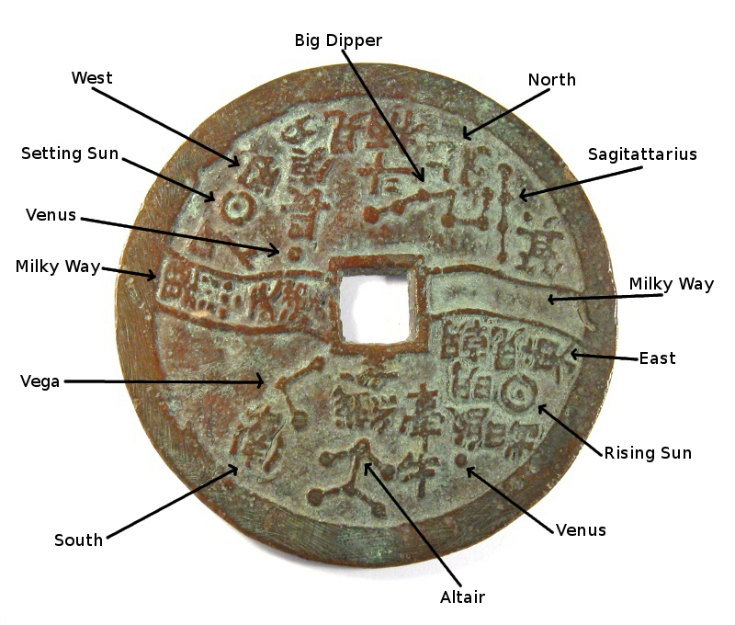
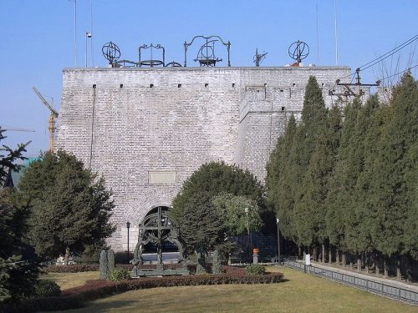
Chinese
Kept records of eclipses, comets, meteor showers and supernova explosions

Slide 12
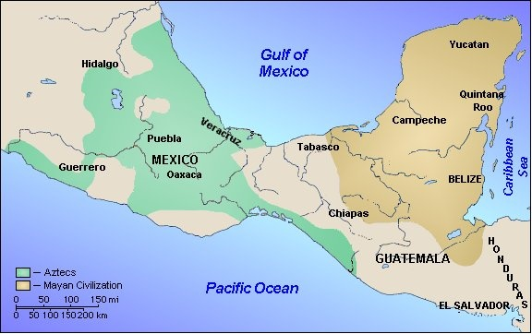

Slide 13
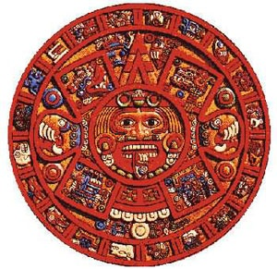
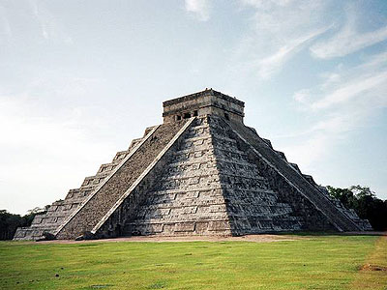
Mesoamericans
Mayans and Aztecs
Made calendars that included the Moon, the Sun, the stars and Venus

Slide 14
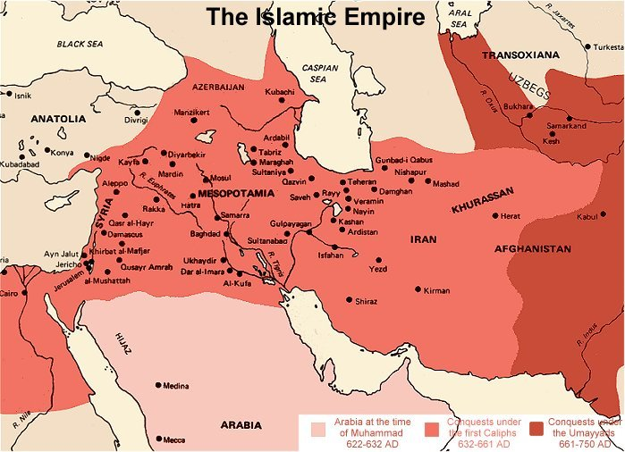

Slide 15
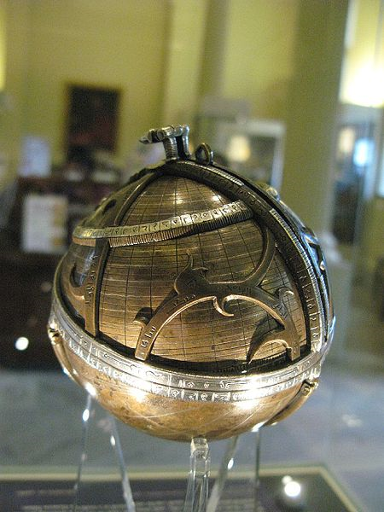
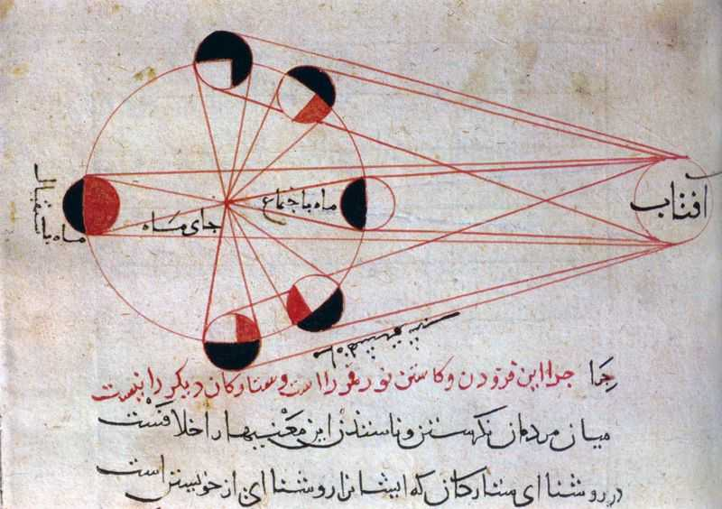
Islamic Astronomy
First astronomical instrument: Astrolabe

Slide 16
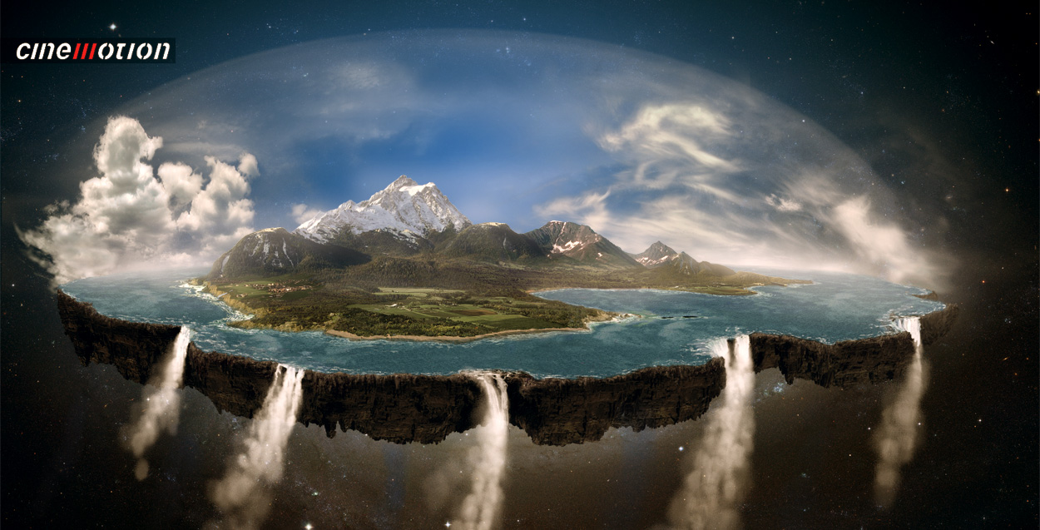
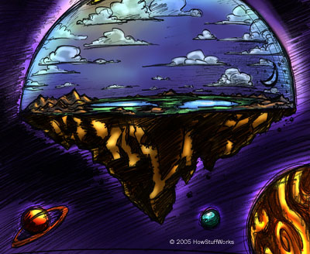
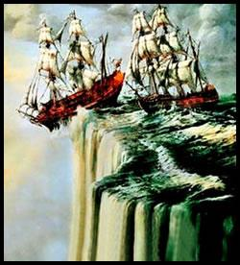

Slide 17
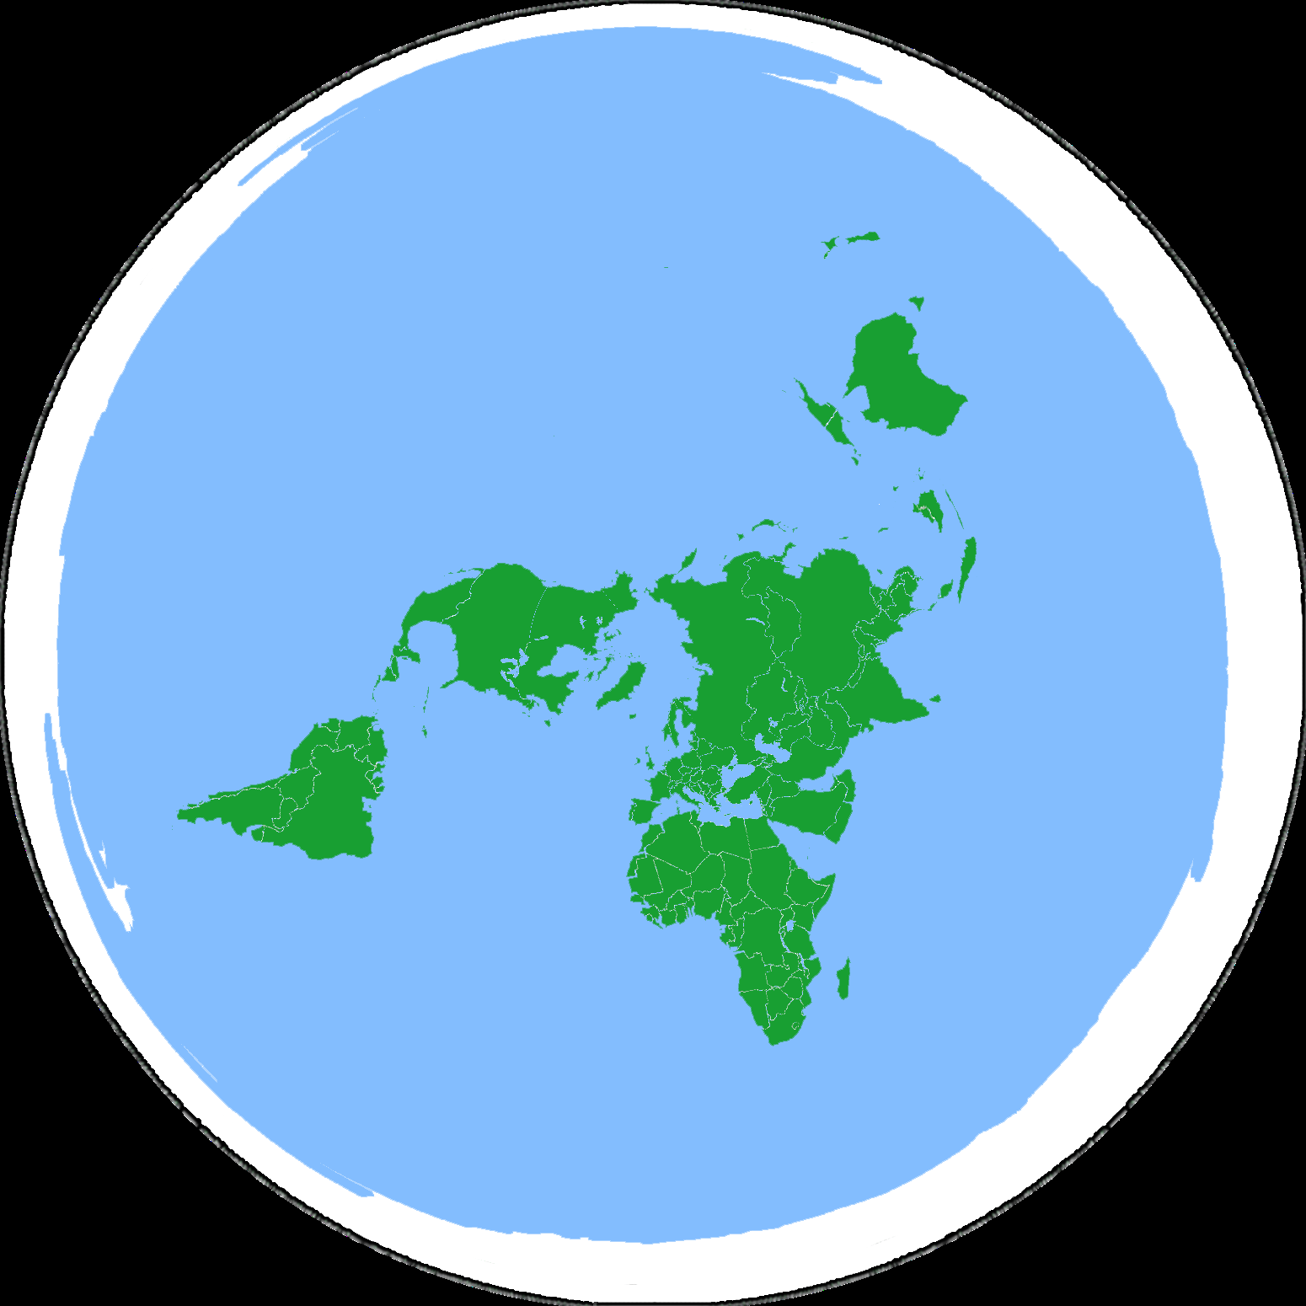
http://theflatearthsociety.org/cms/

Slide 18
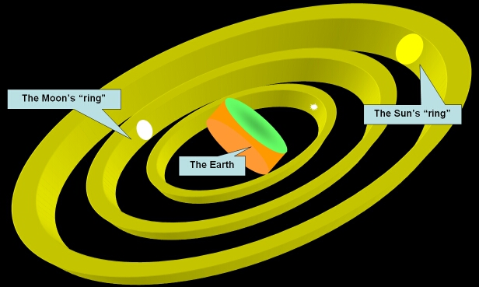
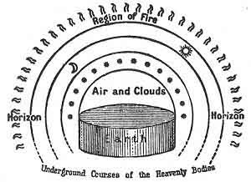
Anaximander
Earth is a cylinder floating in space and the Sun, Moon, stars and planets are wheels filled with fire

Slide 19
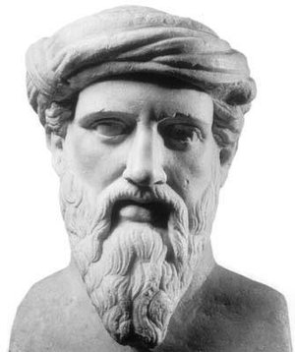
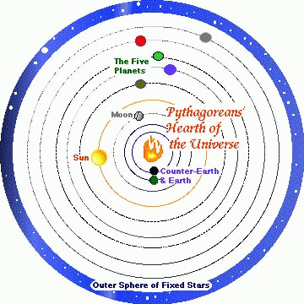
Pythagoras
Earth is a sphere: NOT FLAT
Earth is the center of the solar system

Slide 20
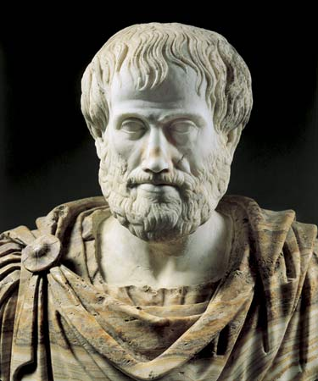
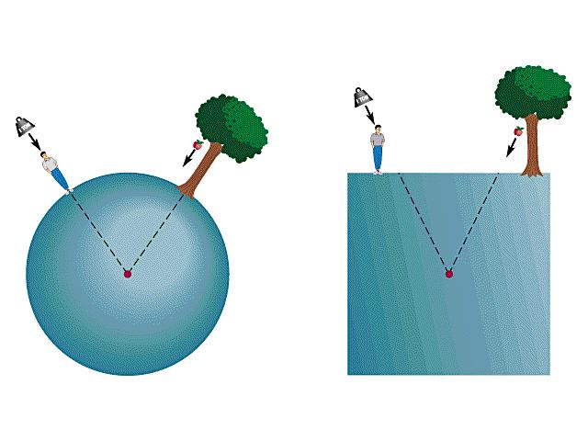
Aristotle
Tried to prove that the Earth is a sphere
Earth is the center and is too big to move

Slide 21
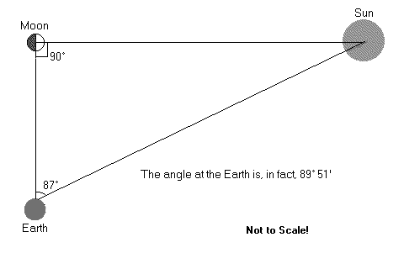
Aristarchus
Calculated the size of the Sun and the Moon
The Sun is the center of the solar system; NOT EARTH

Slide 22
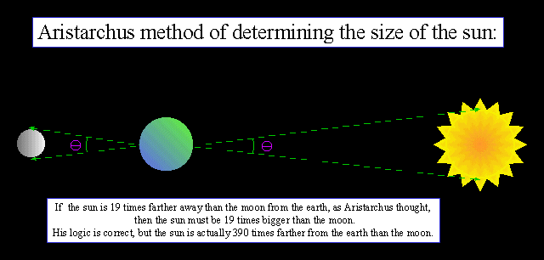

Slide 23
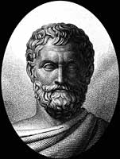
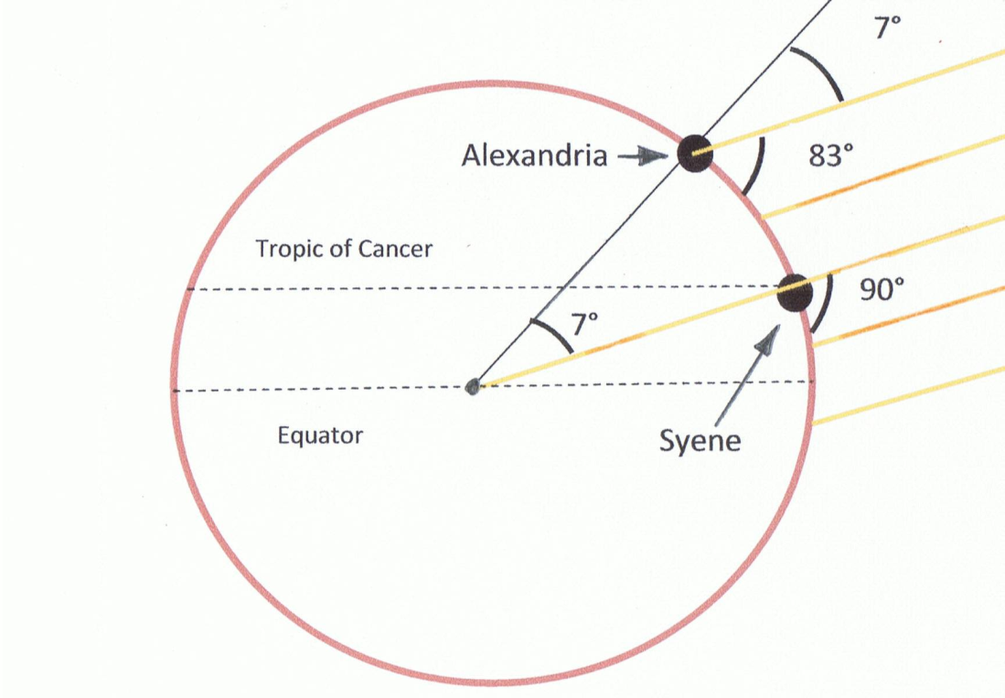
Eratosthenes
Used geometry to calculate the circumference of the Earth

Slide 24
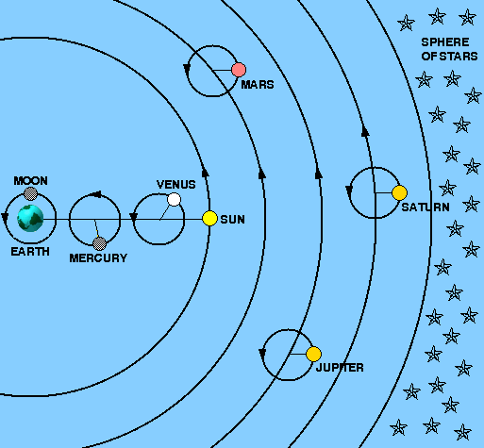
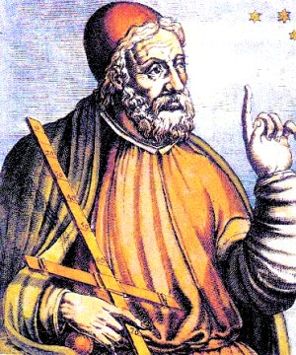
Ptolemy
Made maps: north, south, east and west
Also Latitude and longitude

Slide 25
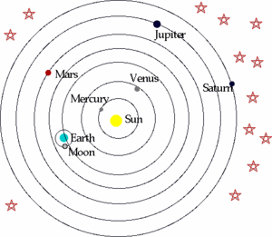
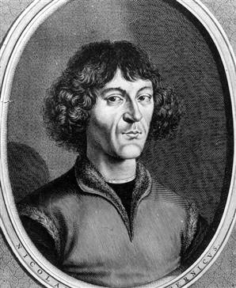
Nicklaus Copernicus
Made the first Sun-centered model of the solar system

Slide 26
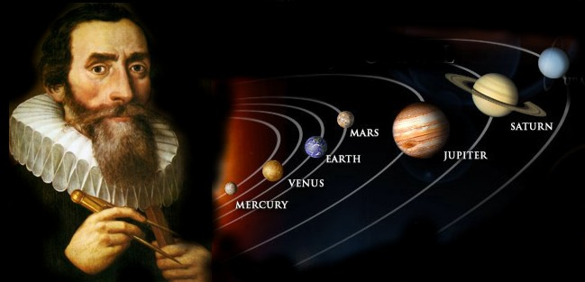
Kepler
The laws of planetary motion
Planet’s orbits are elliptical, not circular

Slide 27
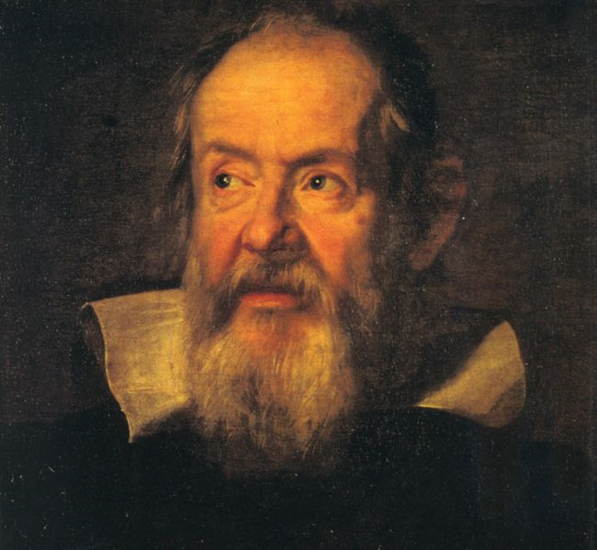
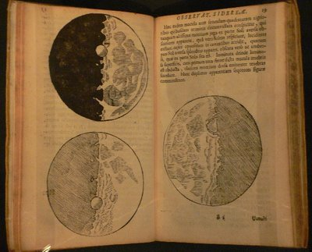
Galileo
Invented the first telescope
Discovered moons around Jupiter and the Saturn's rings
Mapped the moon

Slide 28
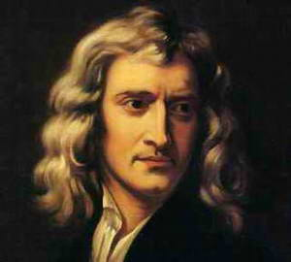
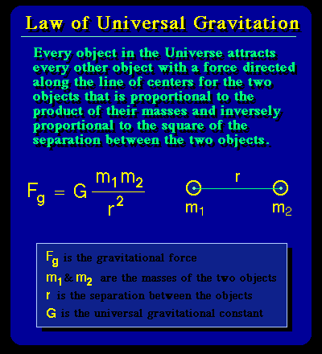
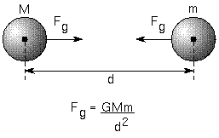
Sir Isaac Newton
Law of universal gravity and laws of motion explained how planets orbit

Slide 29
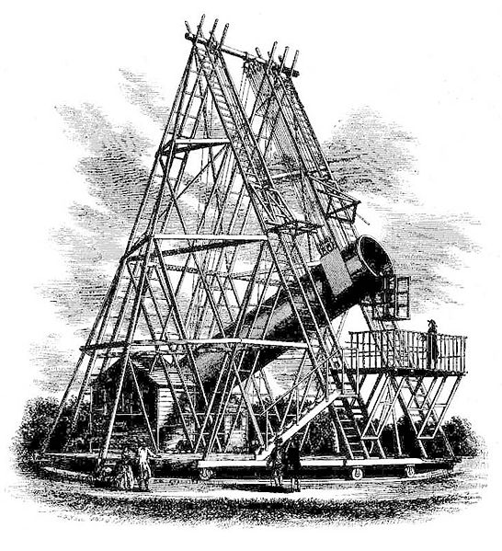

Herschel
Discovered Uranus
Spent his life improving telescopes

Slide 30


Albert Einstein
Theory of relativity
E = mc²
Space and time curve in the presence of matter

Slide 31



Edwin Hubble
Discovered evidence to help prove that the universe is expanding
Red shift data

Slide 32


Lemaitre
Catholic priest and physics professor
Proposed the Big Bang Theory

