Slide 1
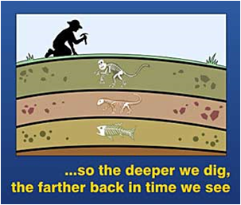
Geology

Slide 2
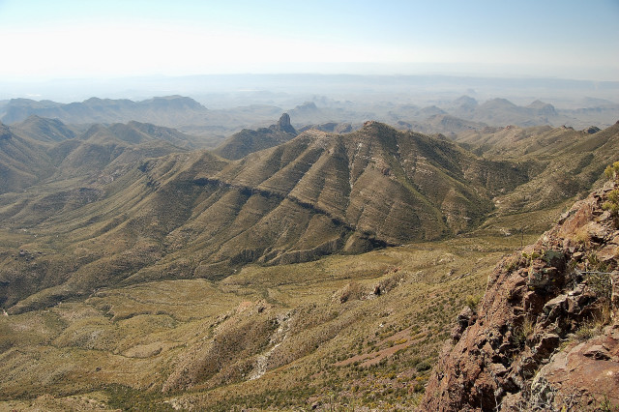
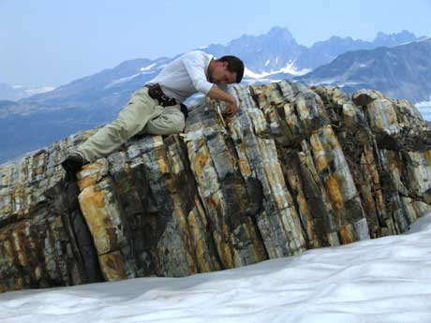
Geology
The study of the solid Earth and the processes that shape it
  Plate tectonics
  Past climates
  Natural disasters
  Fossil Record
  Evolution
  Rock layers

Slide 3
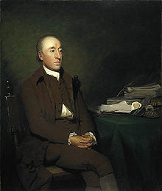
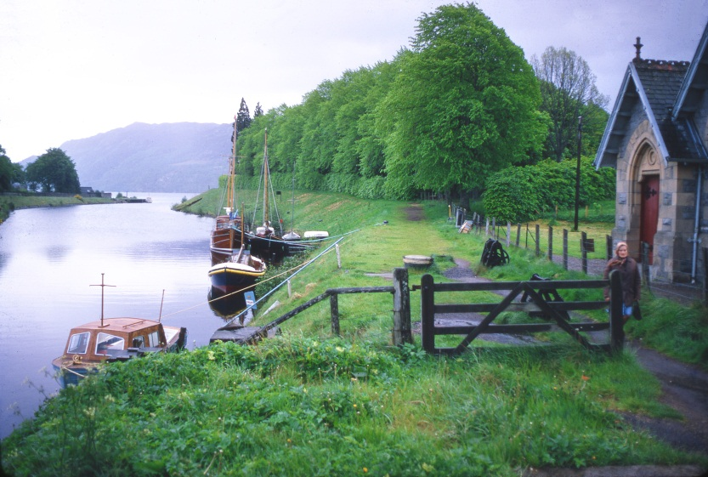
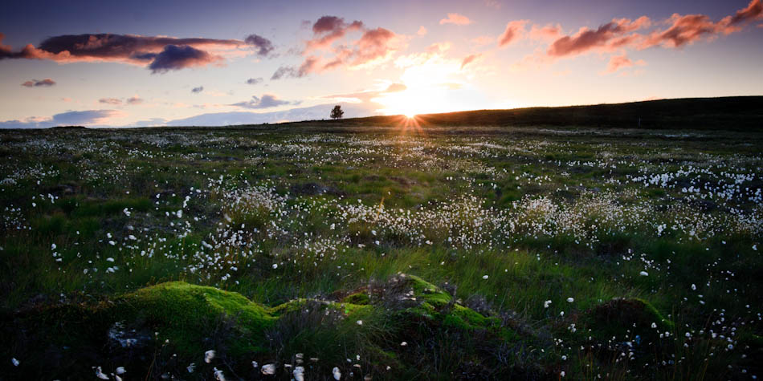
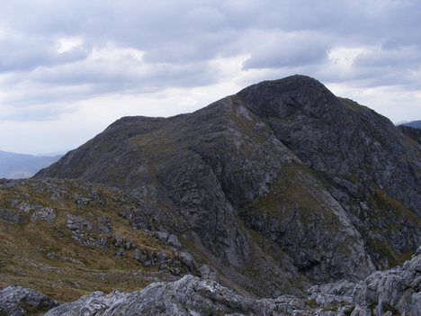
James Hutton
1780:Father of Geology
Scottish physician, naturalist, farmer

Slide 4
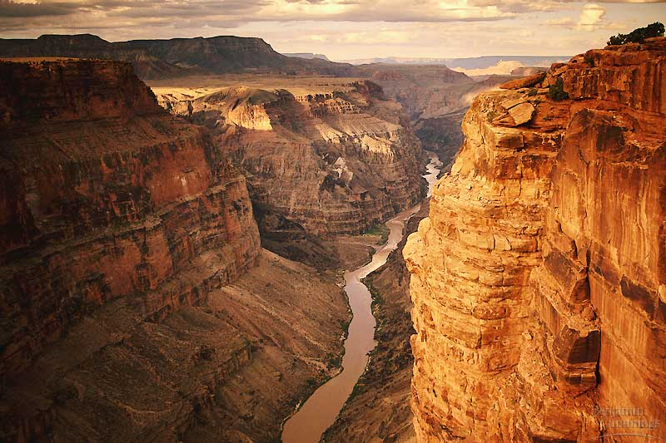
Uniformitarianism
The same processes that shape Earth today are the same processes that have shaped Earth since it was formed
  Indicates a very old Earth
*Widely accepted*

Slide 5
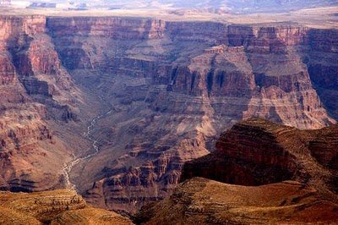
Catastrophism
Earth was shaped by a series of sudden, violent events
  Indicates a young Earth

Slide 6
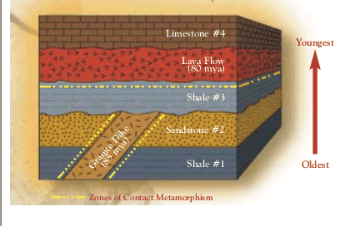
Law of Superposition
Rock layers are younger on top and older on bottom

Slide 7
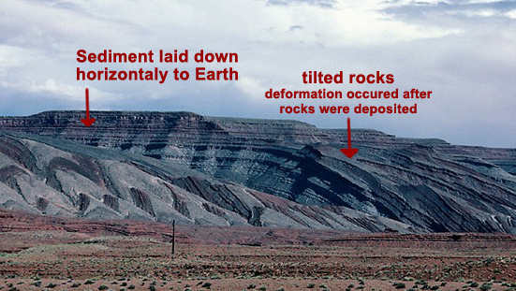
Original Horizontality
Originally rock layers are deposited horizontally and other processes uplift and reposition layers

Slide 8
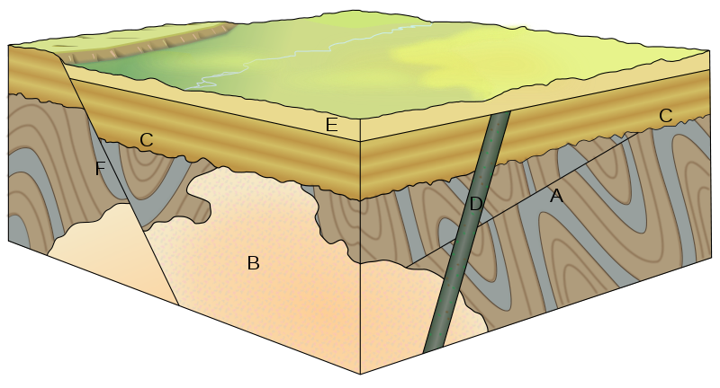
Cross-cutting
The fault or intrusion is always younger than the rock layers it cuts through

Slide 9
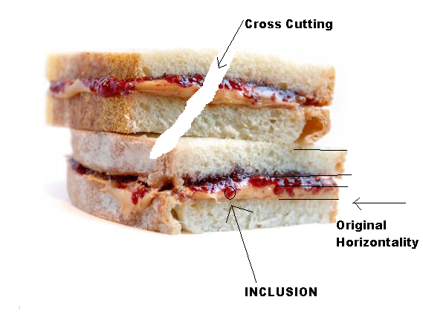
Analogy

Slide 10
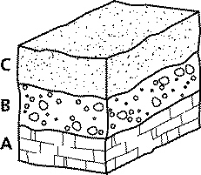
Determining the Relative Age of Rock Layers

Slide 11
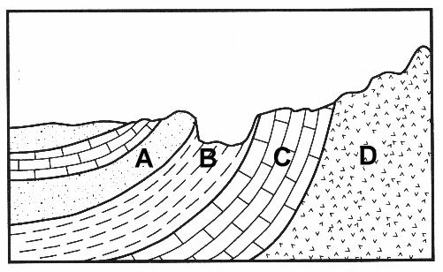
Rock Layers

Slide 12
Rock Layers
B
F
H
C
A
E
G
D

Slide 13
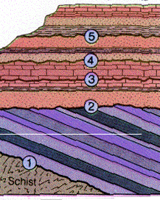
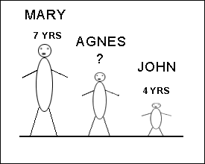
Relative Age
Tells you which rock layer is older and younger but does not tell you the actual age of the rock in years

Slide 14
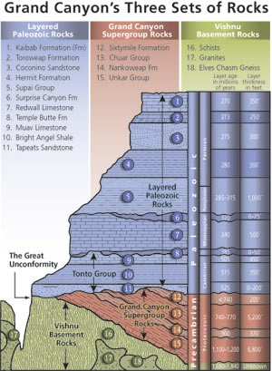
Absolute Age
The numeric age of rock formations in years

Slide 15

Radiometric Dating
Uses the decay of radioactive elements to measure the absolute age of rocks and fossils

Slide 16

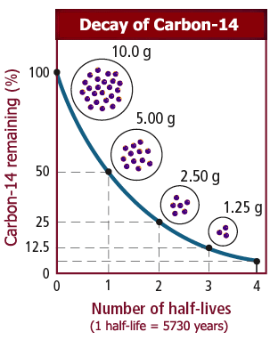
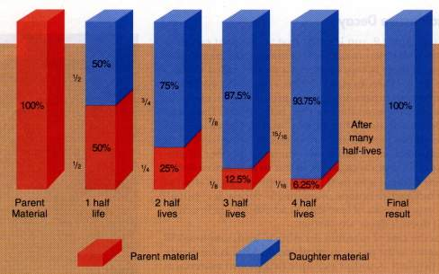
Half-life
The time it takes for an isotope to decay by half
  Different for every element

Slide 17
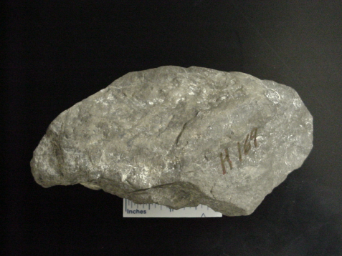
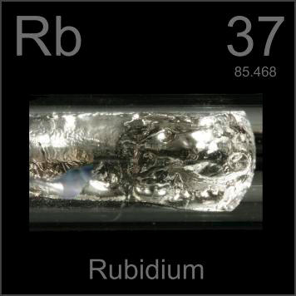
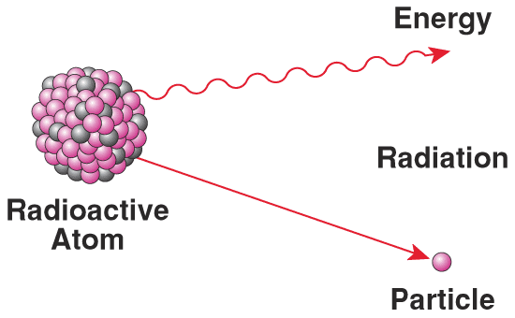
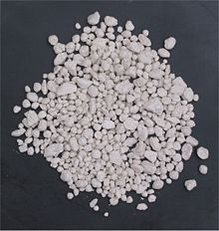
Radioactive Isotopes
The accuracy of radioactive dating depends on the type of isotope used
  Uranium 238: half-life of 4.5 billion years
  Potassium 40: half-life of 1.25 billion years
  Rubidium 87: half-life of 49 billion years
  Carbon 14: half-life of 5730 years

